Slide 1


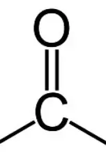
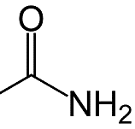
Module 4: Intro - Nomenclature
3. International Union of Pure and Applied Chemistry (IUPAC) rules
Identification of the longest “parent” hydrocarbon chain. Identification of the parent functional group, if any, with the highest order of precedence. Identification of the side-chains branching off the parent one. Identification of the remaining functional groups, if any, and naming them by their ionic prefixes (such as hydroxy for -OH, oxy for =O, oxyalkane for O-R, etc.).Different side-chains and functional groups will be grouped together in alphabetical order. (The prefixes di-, tri-, etc. are not taken into consideration for grouping alphabetically. Identification of double/triple bonds. Numbering of the chain. So that the functional group with the highest precedence has the lowest possible number. Numbering of the various substituents and bonds with their functional group. If there is more than one of the same type of substituent/double bond, a prefix is added showing how many there are (di – 2 tri – 3 tetra – 4 then as for the number of carbons below with 'a' added).
Adding of punctuation: Commas are put between numbers (#) Hyphens are put between a number(#) and a letter Successive words are merged into one word The finalized name should look like this: #,#-di<side chain>-#-<secondary functional group>-#-<side-chain>-#,#,#-tri<secondary functional group><parent chain prefix>
Order of precedence of groups: Cations> Carboxylic acids>Esters>Amide>Nitrile>Aldehyde>Ketone>Alcohol>Amines
1. Keywords
Functional group: | An atom or group of atoms, such as a carboxyl group, that replaces hydrogen in an organic compound and that defines the structure of a family of compounds and determines the properties of the family.
General formula: | a chemical formula applicable to a series of compounds (as ROH for alcohols, CnH2n + 2 for alkanes where n is an integer)
Homologous series | A series of related chemical compounds that have the same functional group(s) but differ in formula by a fixed group of atoms.
Isomer | two or more compounds with the same formula but a different arrangement of atoms in the molecule and different properties
2. Functional groups.
Homologous series | Prefix or suffix | Functional group
Alkanes | -ane | C—C
Alkenes | -ene | C=C
Alcohols | hydroxy-/-ol | -OH
Carboxylic acid | -oic acid
Haloalkane | Chloro- Bromo- Iodo- | -Cl -Br -I
Aldehydes | -ale
Ketones | -one
Amines | Amino-/-ine | -NH
Nitril | Cyano-/-nitrile | -CN
Amides | -amide
3. Chain nomenclature
Number of C atoms | 1C | 2C | 3C | 4C | 5C | 6C | 7C | 8C | 9C | 10C
prefix | Meth- | Eth- | Prop- | But- | Pent- | Hex- | Hept- | Oct- | Non- | Dec-
4. Cahn-Ingold-Prelog (CIP) rules
These rules help with naming geometric isomers E/Z: Compare the atomic number of the atoms directly attached to the double bond; the group having the atom of higher atomic number receives higher priority. If there is a tie, we must consider the atoms at distance 2 from the double bond—as a list is made for each group of the atoms bonded to the one directly attached to the double bond. Each list is arranged in order of decreasing atomic number. Then the lists are compared atom by atom; at the earliest difference, the group containing the atom of higher atomic number receives higher priority. If there is still a tie step 2 is repeated for the atoms at distance 3 from the double bond. If two groups differ only in isotopes, then the larger atomic mass is used to set the priority. This process is repeated recursively, each time with atoms one bond farther from the double bond, until the tie is broken.
E: the higher priority groups are on opposite sides of the double bond. Z : the higher priority groups are on the same side of the double bond.

Slide 2
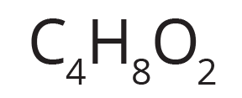
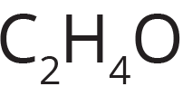
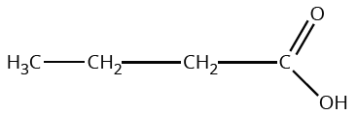
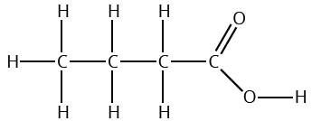
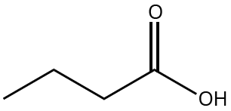

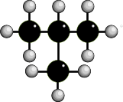
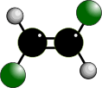

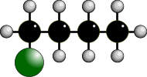

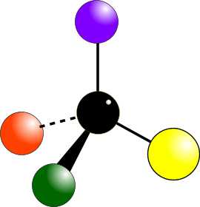
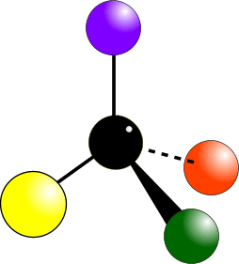


Module 4:Intro- Spatial representation
2. Types of chemical formulas
Chemical Formula | Definition | Example
Molecular Formula (written) | shows the actual number of atoms of each element in a molecule.
Empirical Formula (written) | shows the simplest whole number ratio of atoms of in a compound.
Structural Formula (drawn) | shows the minimal detail that shows the arrangement of atoms in a molecule.
Displayed Formula (drawn) | shows the relative positioning of atoms and the bonds between them, all bonds shown
Skeletal Formula (drawn) | shows only the bonds of the carbon skeleton and any functional groups. C atoms not shown, nor H atoms bonded to C atoms.
1. Type of chemical reactions
Reaction Type | Explanation
Addition: | reaction where two or more molecules combine to form a single product with 100% atom economy. C2H4 + Br2 → C2H4Br2
Combustion: | is a high-temperature exothermic redox chemical reaction between a fuel and an oxidant, usually atmospheric oxygen, that produces oxidized, often gaseous products, in a mixture termed as smoke. CH4 + 2O2 → 2H2O + CO2
Condensation: | reaction in which two or more molecules combine to form a larger molecule, with the simultaneous loss of a small molecule such as water or methanol. CH3NH2 + CH3COOH → CH3NHCOCH3 + H2O
Decomposition: | is the process or effect of simplifying a single chemical entity into two or more fragments. 2H2O2 → 2H2O + O2
Dehydration: | is a reaction that involves the loss of water from the reacting molecule or ion. CH5Cl + NaOH → C2H4 + NaCl + H2O
Displacement | when an element or ion moves out of one compound and into another. It is a type of substitution reaction. Mg + 2H2O → Mg(OH)2 + H2
Elimination: | produces an unsaturated product by loss of atoms or groups from adjacent carbon atoms. CH5Cl + NaOH → C2H4 + NaCl + H2O
Hydrolysis: | reaction in which a molecule of water is added to a substance= a compound splits apart in a reaction involving water. Sometimes this addition causes both substance and water molecule to split into two parts. H2SO4 + H2O → H3O+ + HSO4-
Neutralisation | reaction in which an acid and a base react quantitatively with each other. NaOH + HCl → NaCl + H2O
Redox: | redox is a type of chemical reaction in which the oxidation states of atoms are changed. Fe2O3 + 3CO → 2Fe + 3CO2
Substitution | reaction during which one functional group in a chemical compound is replaced by another functional group. CH4 + Cl2 → CH3Cl + HCl
STRUCTURAL ISOMERISM
STEREOISOMERISM
Same molecular formula but different structural formulae
Same molecular formula but atoms occupy different positions in space.
CHAIN ISOMERISM
GEOMETRICAL ISOMERISM
Occurs due to the restricted rotation of C=C double bonds (E/Z or trans/cis)
E-trans
Z-cis
POSITION ISOMERISM
OPTICAL ISOMERISM
Occurs when molecules have a chiral centre. Get two non-superimposable mirror images.
Two options R/L
FUNCTIONAL GROUP ISOMERISM

Slide 3
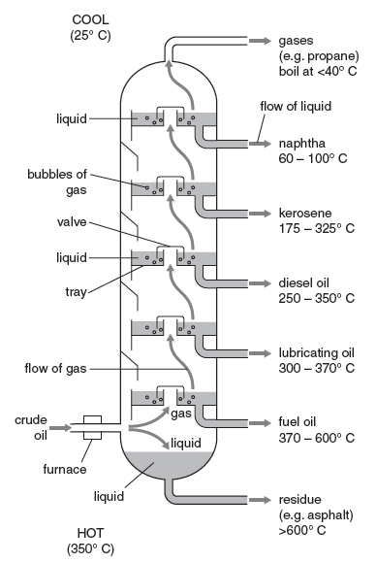
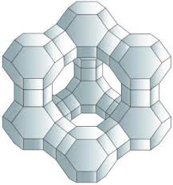
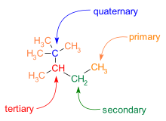
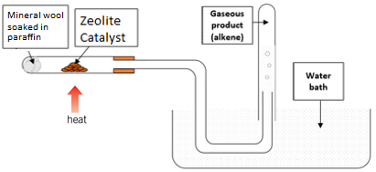
Module 4: Alkanes
1. Properties
General formula: CnH2n+2 Properties of the alkanes, summarised to the left, are linked to the length of their chains. Between these simple molecules there are weak intermolecular forces of attraction which increase with the chain length. Alkanes are fairly unreactive but good combustibles.
Size chain | Short | Long
Boiling point | Low | High
Flammability | High - Ignites easily | Low -Hard to ignite
Viscosity | High - Flows easily | Low - Doesn’t flow well
2. Fractional distillation
In fractional distillation: crude oil heated to about 370℃ and fed into the bottom of a fractionating column, hottest at bottom, coolest at top. the vapours pass up the tower via a series of rays containing caps until they reach a tray that is cold enough to allow their condensation depending on boiling point. at each level the fraction is piped of. lighter smaller chains rise, cool and condense at the top heavier longer chain fractions are collected at the bottom Large chain fractions are cracked producing smaller more useful fuels.
Properties of alkanes
3. Cracking
Cracking – breaks long chain hydrocarbons into shorter chain hydrocarbons Thermal cracking Conditions high temperature (700-1200°K) and high pressure 7000Pa. C-C bonds break forming 2 radicals that form a variety of shorter chains molecules. High proportions of alkanes are produced. Catalytic cracking Conditions 720°K, pressure just above atmospheric and Zeolite catalyst. Makes branched alkanes, cycloalkanes and aromatic compounds.
Zeolite - structure
4. Combustion
Complete combustion (plenty of oxygen) of alkanes produces carbon dioxide and water only, releasing large amounts of energy. Incomplete combustion (limited supply of oxygen) of alkanes produces carbon monoxide and water ,with even less oxygen carbon (soot) is produced. This often happens with long hydrocarbons that need a lot of oxygen. Less energy is released.
Fractionating column
Laboratory catalytic cracking equipment

Slide 4
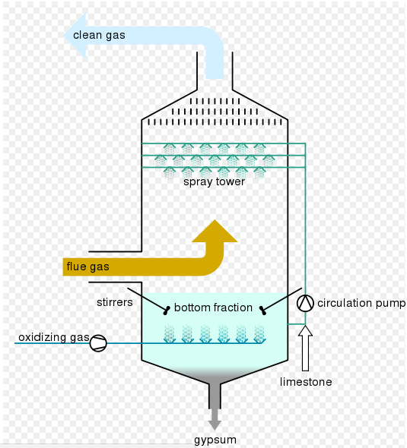
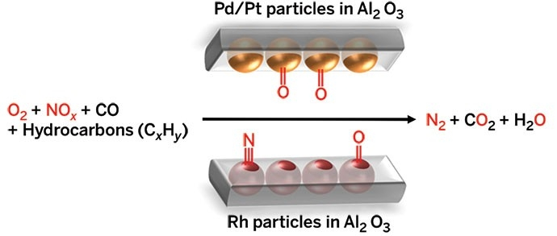
Module 4: Pollution
1. Pollution
Combustion of all hydrocarbons may produce polluting products when burnt such as: Carbon monoxide (CO): a poison Nitrogen oxides (NOx): formed in the engine thanks to the high temperatures. These gasses can react with water to form nitric acid arising acid rain and photochemical smog. N₂(g) + O₂(g) 🡪 2NO(g) Sulphur dioxide (SO₂): produced by sulphur impurities in fuel. This gas can react with water to form sulphuric acid arising acid rain. S(s) + O₂(g) 🡪 SO₂(g) SO₂ (s) + 0.5O₂(g) + H₂O(l) 🡪 H₂SO₄(l) Carbon particles, called particulates, which can cause cancer and asthma. Unburnt hydrocarbons may enter the atmosphere that contribute to photochemical smog and are green house gasses. Carbon dioxide (CO₂):a green house gas. Water vapour (H₂O): a green house gas.
2. Desulfurisation
The gas given out by power stations are called flue gases so the process of removing sulphur dioxide is called flue gas desulfurisation. In one method a slurry of calcium oxide (lime) and water is sprayed into the flue gas to form gypsum (calcium sulphate) that can be used to make plaster and plasterboards: CaO (s) + SO₂ (s) + 0.5O₂(g) + 2H₂O(l) 🡪 CaSO₄•2H₂O(s) In an alternative process calcium carbonate (limestone) is used instead of calcium oxide: CaCO₃ (s) + SO₂ (s) + 0.5O₂(g) 🡪 CaSO₄ + CO₂ (g)
Flue gas desulfurisation
3. Catalytic converter
The catalytic converters is a honeycomb made of ceramic coated with platinum and rhodium metals that work as catalysts. The structure allows for a high surface area to catalyse: CO (g) + NO (g)) 🡪 CO₂ (g) + 2CO₂(g) And this reaction with unburned hydrocarbons (this reaction can be adapted to any hydrocarbon): C₈H₁₈ + 25NO 🡪 12.5N₂ + 9H₂O + 8CO₂
Catalytic converter
4. CFCs
Chlorofluorocarbons (CFCs) can be damaging for the Ozone layer due to a free radical mechanism reaction where chlorine acts as a catalyst to the breakdown of ozone into oxygen. (more details about free radicals in section 4) CCl₂F₂ → ●CClF₂ + Cl● Cl● + O₃ → ClO● + O₂ ClO● + O₃ → Cl● + 2O₂

Slide 5
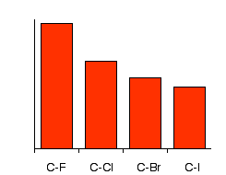
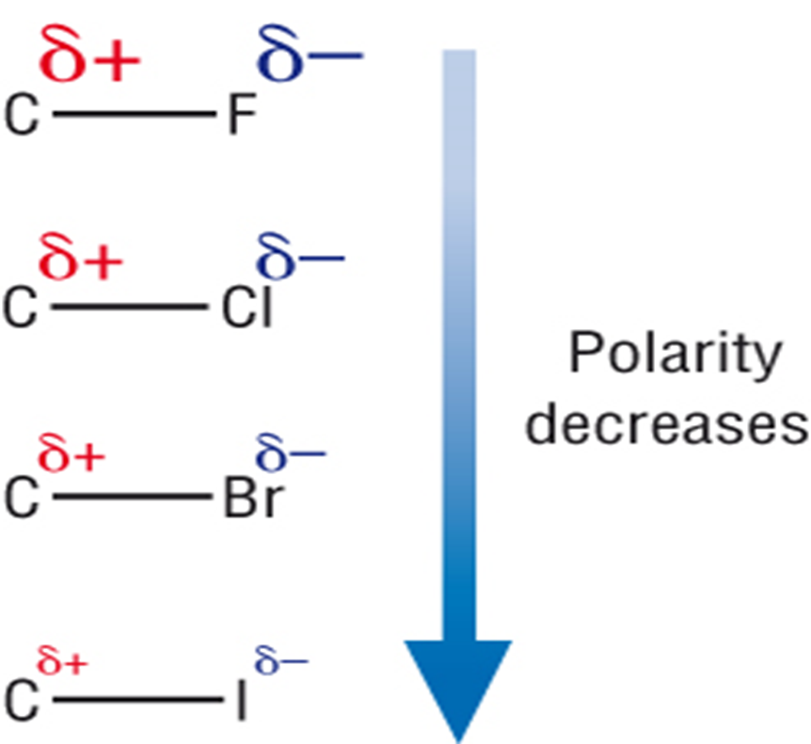
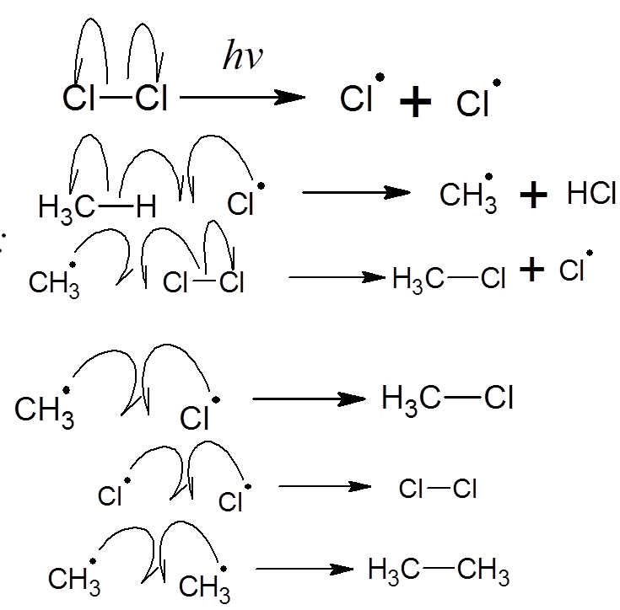
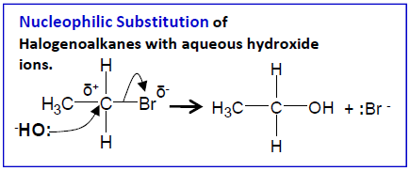
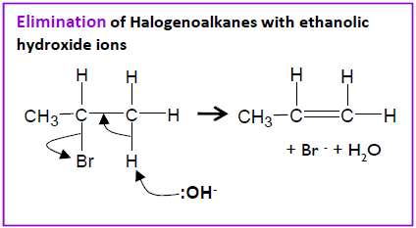
Module 4: Halogenoalkanes
2. Properties
General formula C_{n}H_{2n+1}X where X is the halogen
Halogenolakanes can be classified into: Primary have one R group attached to the carbon linked to the halogen. Secondary have two R groups attached to the carbon linked to the halogen. Tertiary have three R groups attached to the carbon linked to the halogen.
Physical properties of halogenoalkanes mainly depend on the polarity of the C-X bond. Solubility: the polarity of the bond is not enough to make halogenoalkanes soluble in water, the main intermolecular forces are Van der Walls and dipole-dipole attractions. Boiling point: - increases with increased chain length. - increases going down the halogen group.
Chemical properties depend on the C-X bond strength and polarity. Reactivity increases going down the halogen group even though C-I is the least polar bond, this is due to atom size.
1. Keywords
Anhydrous | In the absence of water
Initiation: | Radical forming step.
Nucleophile: | Electron pair donor.
Propagation: | Spreading of the radicals.
Radical: | Free radicals are reactive species with an unpaired electron and are drawn using a dot.
Termination: | All radicals are removed.
3 Formation
Halogenoalkanes are formed via different mechanisms.
Free radical substitution reaction starting from an alkane and an halogen, this reaction occurs only in the presence of UV light.
CH₄ (g) + Cl₂ (g) 🡪CH₃Cl(g) + HCl (g) this reaction occurs in 3 steps: Initiation: breaking of the covalent bond of the halogen. Highly reactive free radicals are formed. Propagation: the free radical takes the hydrogen on the alkane to form an acid and a new alkyl radical is formed. The new radical reacts with another halogen producing an halogenoalkane and another halogen radical. Termination: in this step free radicals react with each other. All radicals are removed. Other products are formed.
From alkenes with hydrogen halides at room temperature or from alkenes reacting with halogens. C₃H₆ + HBr 🡪 C₃H₇Br C₃H₆ + Brl₂ 🡪 C₃H₆Brl₂
Bond enthalpy KJ/mol
4 Chemical reactions
Halogenoalkanes undergo Nucleophilic substitution in the presence of a nucleophile with the halogens as the leaving group. Or elimination reaction in hot anhydrous, usually ethanolic, conditions.

Slide 6
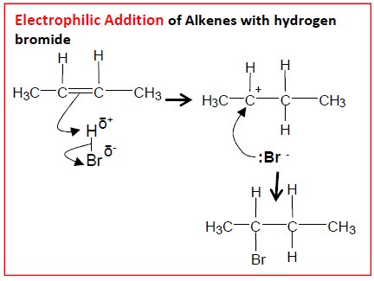
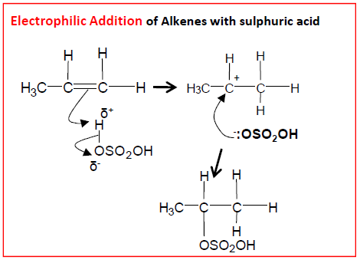
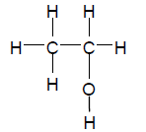

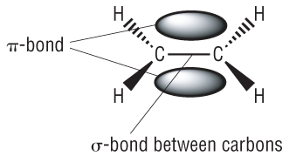
Module 4: Alkenes
2. Properties
General formula C_{n}H_{2n}
Alkene’s functional group is the C=C double bonds which consists of a sigma bond and a pi bond. The pi bond lies above and below the sigma bond. There is no rotation around a double bond – resulting in geometric isomers (cis/trans E/Z) The double bond sits on a plane and the angles between each bond is roughly 120°
Physical properties are very similar to those of the alkanes.
Chemical properties are influenced by the double bond that had an enthalpy of 612kJ/mol (a C-C bond has a bond enthalpy of 347kJ/mol) and it is an electron rich area which can easily attract electrophiles
1. Keywords
Carbocation | ion with a positively charged carbon atom.
Electrophile | Electron pair accepting groups
3. Reactions
Combustion – alkenes will burn in oxygen like alkanes.
Electrophilic additions reactions undergo via carbocation. Main products are determined by the stability of the carbocation. Hydrogenation - ethene reacts with hydrogen in the presence of a finely divided nickel catalyst at a temperature of about 150℃. Ethane is produced CH₂=CH₂ + H₂ 🡪 CH₃CH₃ Uses of hydrogenation – Process used to manufacture margarine from unsaturated vegetable oils in palm and sunflower seeds. Vegetable oils = liquids, have double carbon bonds that are mostly cis-double bonds. These get converted to C-C bonds, turns liquid oils into spreadable fatty solids like margarine. Alkenes and steam – react in presence of phosphoric acid catalyst to produce alcohols. Generally reversible reaction. 570K, 65 atm pressure, C₂H₄ + H₂O 🡪 CH₃CH₂OH Alkenes and halogens – Cl₂ and Br₂ react rapidly at room temperature with alkenes to form dihalogenoalkanes via electrophilic addition reaction. Reaction with iodine is slower. – the reaction with bromine water is the qualitative test for alkenes. Shake alkene with bromine water, orange solution goes colourless. Alkenes with hydrogen halides –react readily at room temperature with alkenes, form halogenoalkanes. Unsymmetrical alkenes will react to produce a major and minor product. Alkenes with hydrogen halides – reacts at room temperature and it is exothermic the sulfuric acid acts as a catalyst and the product is an alcohol.
H₂O
Increasing stability due to positive inductive effect

Slide 7
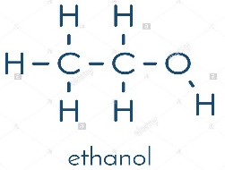
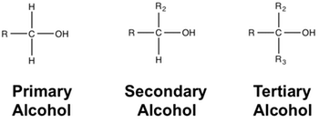
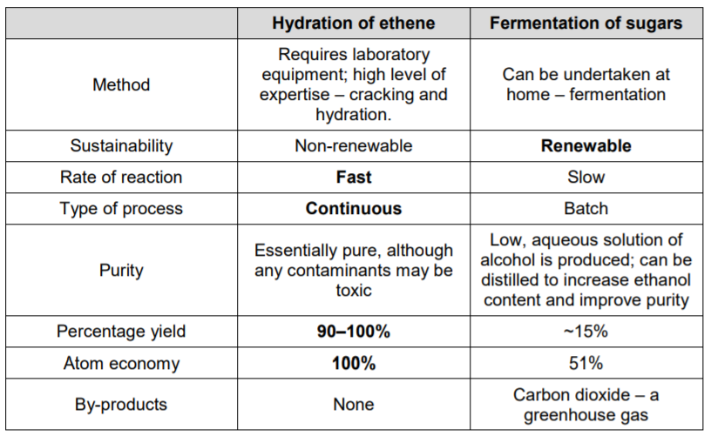
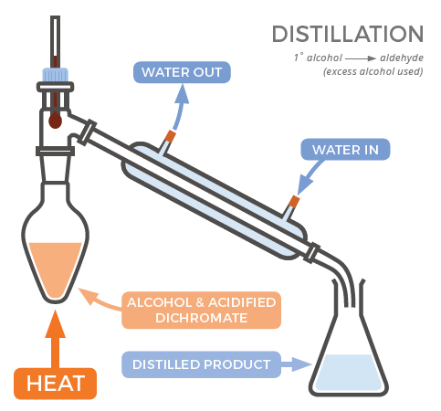
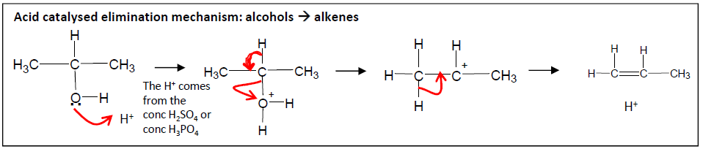
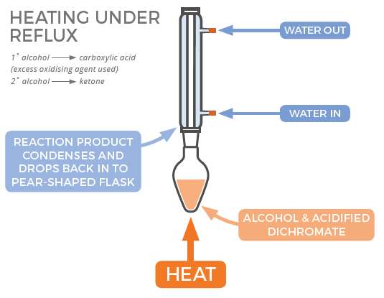
Module 4: Alcohols
1. Physical properties
General formula C_{n}H_{2n+1}OH
Alcohols are classified into primary, secondary and tertiary based on the substitution of the carbon linked to the -OH group, like the halogenoalkanes. The –OH group allows alcohols to form hydrogen bonds. Short alcohols are soluble in water
+
+
104.5⁰
2. Production of ethanol
Ethanol is the most important alcohol in industrial chemistry since it is used as intermediate in reactions and as solvent.
Ethanol can be made industrially in two ways: Hydration of ethane in the presence of phosphoric acid as catalyst (high yield, little sustainability) C₂H₄ + H₂O 🡪 C₂H₅OH Fermentation of sugars (batch production, renewable) C₆H₁₂O₆ (aq) 🡪 2C₂H₅OH (aq) + CO₂(g)
3. Reactivity
Alcohols can undergo the following reactions:
-Combustion, all alcohols are flammable and can undergo complete or incomplete combustion, like alkanes.
-Elimination: it is a dehydration reaction with conc sulphuric or phosphoric acid or by passing its vapours over heated aluminium oxide. An alkene is formed.
-Oxidation: alcohols can be oxidised ins stages, usually potassium dichromate (VI) is used since its reduction into chromium (III) ions translates into a change of colour from orange to green. Partial oxidation to aldehydes (if primary alcohol) or ketones (if secondary) is done with a distillation apparatus. C₂H₅OH (l) + [O] 🡪 C₂H₄O (g) + H₂O(l) Complete oxidation of a primary alcohol (or aldehyde) to carboxylic acid is performed in the presence of potassium dichromate (VI) under reflux. C₂H₅OH (l) + 2[O] 🡪 CH₃COOH (g) + H₂O(l) Oxidation is also used as a test for alcohols or to distinguish primary alcohols from the others
Substitution: alcohols undergo substitution reactions to form haloalkanes with halide ions in the presence of an acid (NaBr/H₂SO₄). The order of reactivity of alcohols is 3° > 2° > 1°. The order of reactivity of the hydrogen halides is NaI > NaBr > NaCl (NaF is generally unreactive).

Slide 8
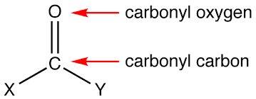
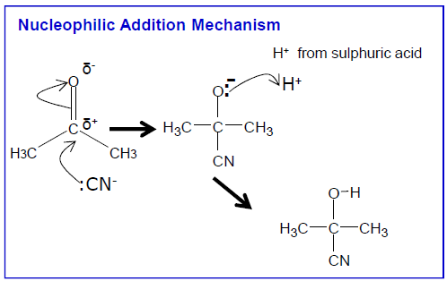
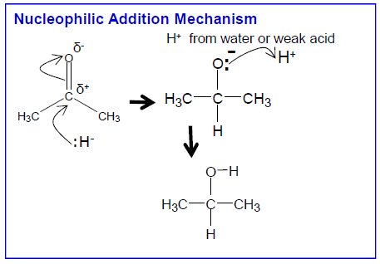
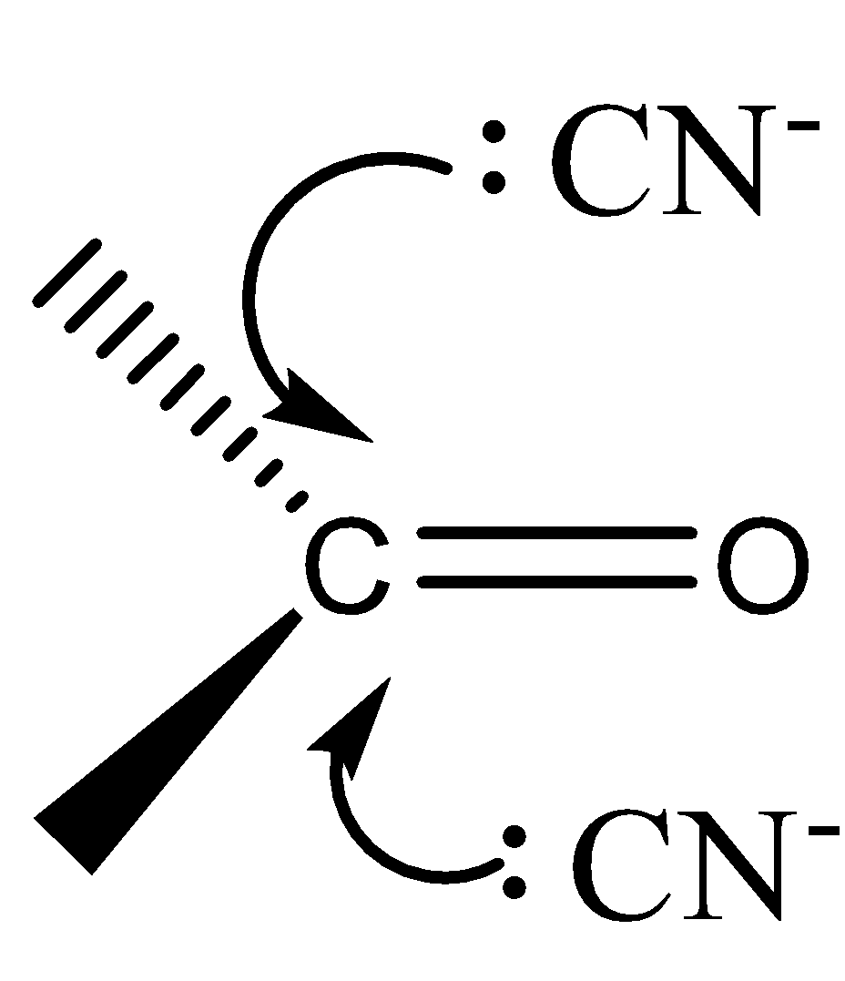
Unit 7: The carbonyl group
2. Nomenclature
The carbonyl group is present in aldehydes (RCHO) and ketones (RCOR’). They are both represented by the general formula C_{n}H_{2n}O.
Aldehydes (-al suffix) can only be at the end of a molecule so there is no need to provide numbering their functional group. No ketone (-one suffix) can have less than 3 carbons. So you don’t need to number the carboxyl group in propanone or butanone
1. Keywords
Dipole-dipole forces : | attractive forces between the positive end of one polar molecule and the negative end of another polar molecule
Electronegativity: | is a measure of an atom's ability to attract shared electrons to itself
Racemic mixture (racemate) | Mixture that has equal amounts of left- and right-handed enantiomers of a chiral molecule.
3. Physical properties
The big difference in electronegativity between carbon and oxygen, makes the C=O bond strongly polar. There are permanent dipole-dipole forces between the molecules.
Shorter chains carbonyl compounds are readily soluble in water since they form hydrogen bonds with water. As the aryl/alkyl chain lengthens solubility decreases.
Methanal is a gas at room temperature. Short carbonyl compounds are liquids.
-
δ
+
δ
4. Reactivity
Most reactions involve the C=O bond because it is strongly polar.
Nucleophilic addition reaction: The reaction with NaCN and dilute HCl is very important since it increases the length of the carbon chain by one carbon. This reaction will produce a racemic mixture (racemate) of hydroxynitriles. If performed on ethanol and followed by and hydrolysis with HCl it will produce a racemate of lactic acid.
Oxidation: Aldehydes can be oxidised to carboxylic acids.
Reduction (another nucleophilic addition reaction) : Many reducing agent will reduce carbonyl groups to alcohols. Once reducing agent is sodium tetrahydridoborate(III) (NaBH₄) which provides a source of hydrogen to act as a nucleophile creating the H- (hydride ion).
(Reduction)

Slide 9
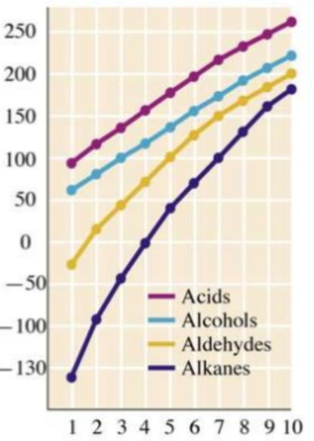
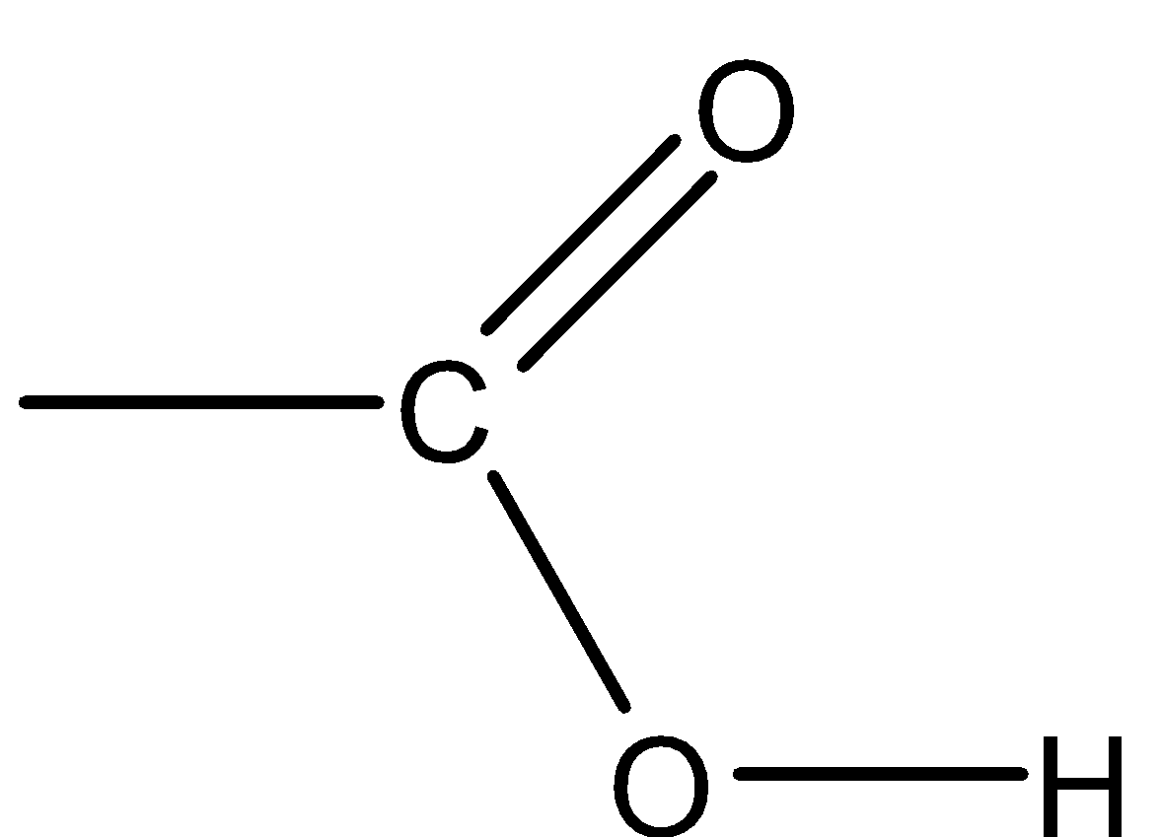
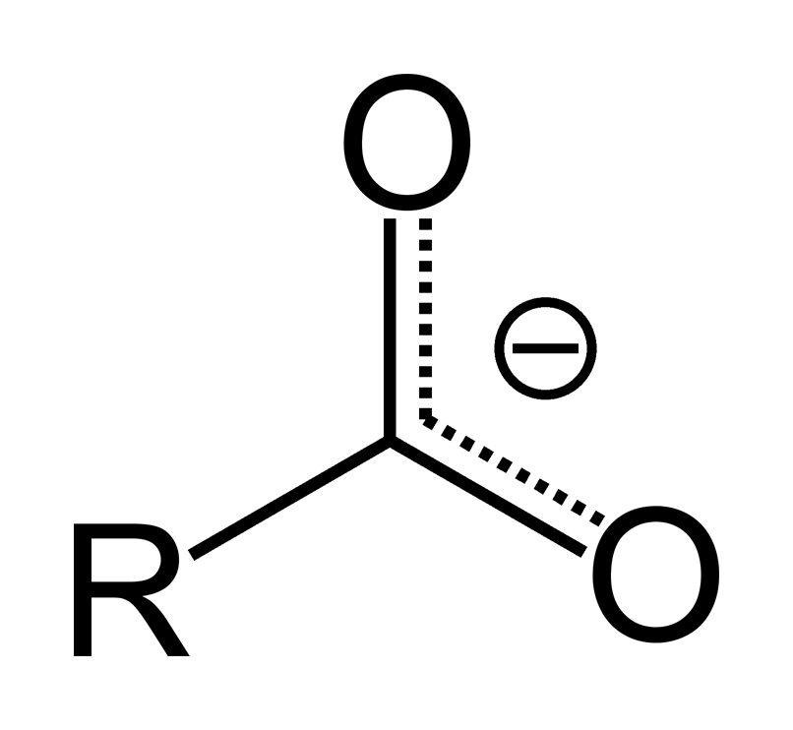
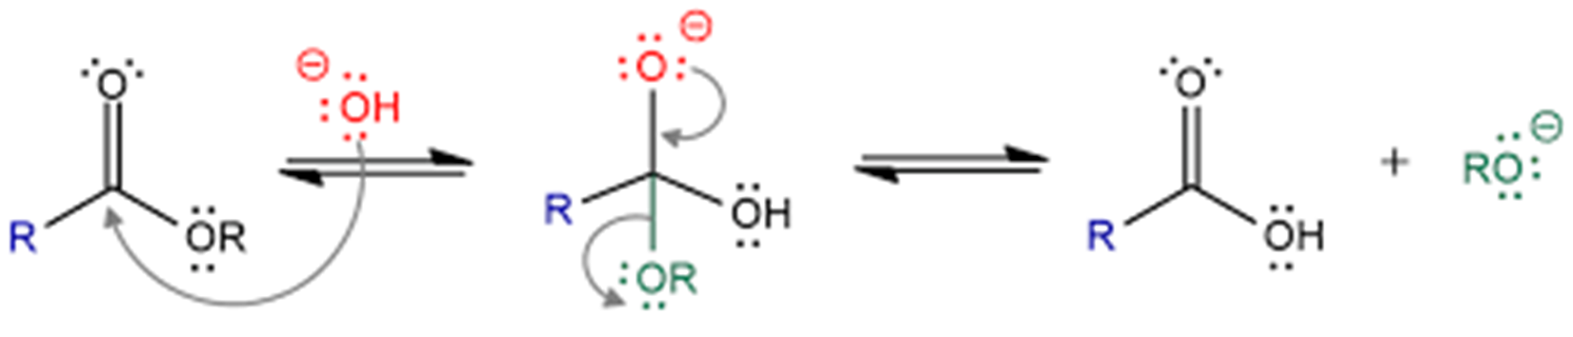
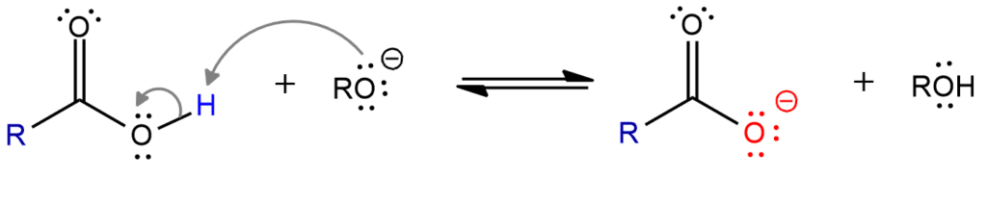
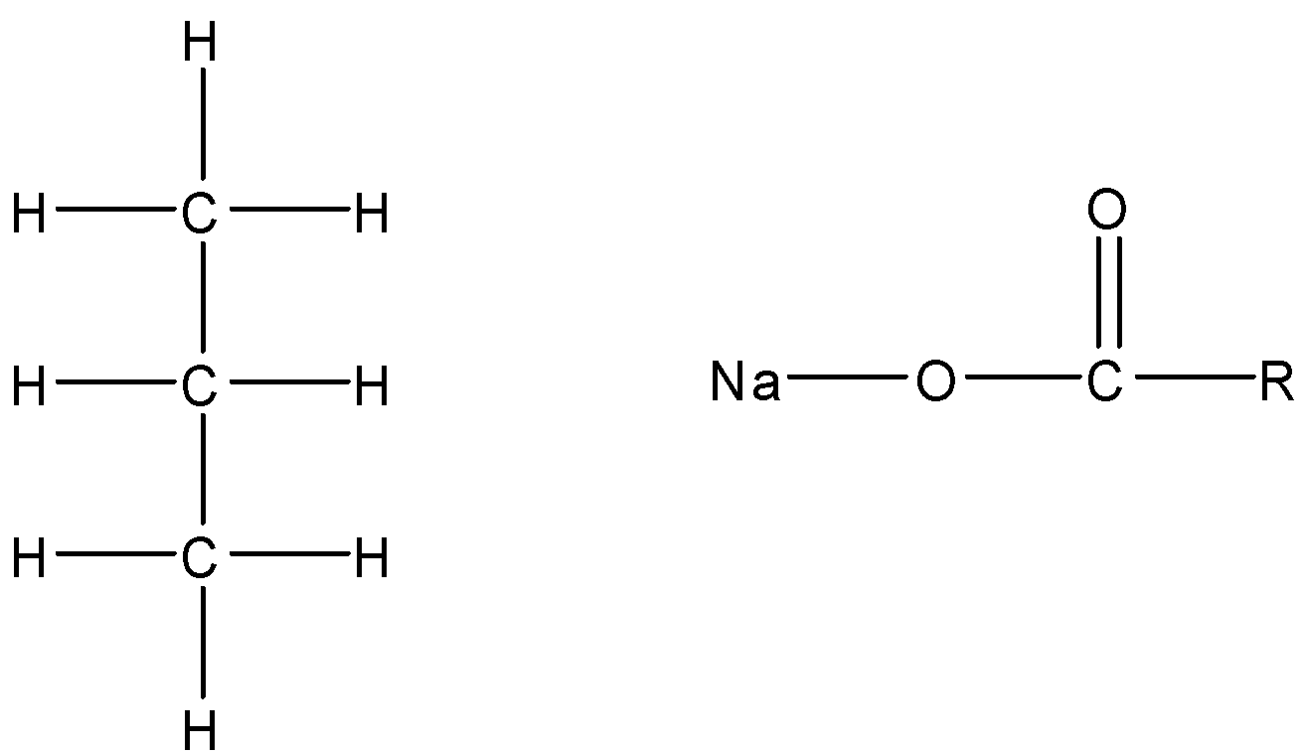
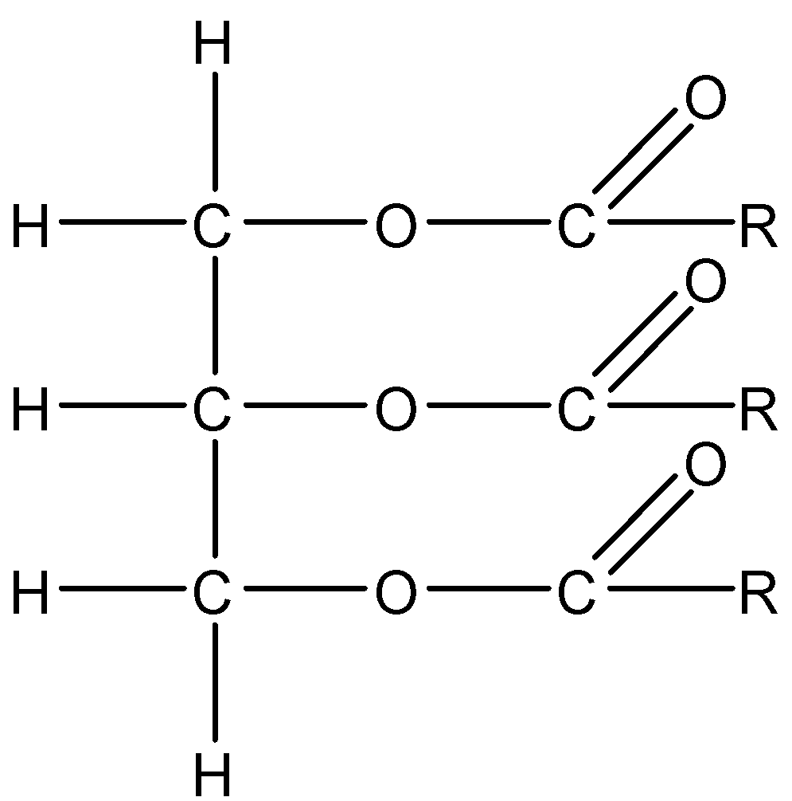
Unit 8: The carboxyl group
2. Carboxylic acids
Carboxylic acids (RCOOH) have two functional groups: Carboxyl group Hydroxy group
Nomenclature: Suffix: -oic acid The functional group always ends the chain and is included in carbon chain of the root name if the acid is not attached to a benzene ring. Numbering starts from the carboxyl –COOH carbon.
Physical properties: Acids are able to form hydrogen bonds also in their solid states that’s why they have higher boiling points than the respective alkanes.
Reactivity: Due to electronegativity the –OH group in acids is more acidic than alcohols, carboxylic acids are weak acids, so they form an equilibrium when they dissociate. They undergo the same chemical reactions as any inorganic acid acting as proton donors, the carboxylate ion is stabilised by charge delocalisation.
1. Keywords
Delocalisation: | when electrons in a molecule, ion or solid metal that are not associated with a single atom or a covalent bond.
Nu:
-
+
δ
+
δ
+
-
δ
δ
Boiling point °C
Charge delocalisation
3. Esters
Nomenclature: Esters (RCOOR’) are derived from the reaction between carboxylic acids and alcohols in the presence of a strong acid acting as a catalyst. The name of the esters are based on that of the parent acid but the name always begins with the alkyl or aryl group that has replaced the hydrogen of the acid; i.e. methanol + ethanoic acid 🡪 methyl ethanoate
Physical properties: Short esters are volatile and have pleasant fruity smells and are used in perfumes or as flavourings. They are also use as solvent and plasticisers. Fats and oils are esters with longer carbon chains.
Reactivity: Formation see above. Hydrolysis to acid and alcohol: Acidic: can occur at room temperature with a strong acid as a catalyst, the reaction does not go to completion. Base: in the presence of a base the salt of the acid is produced and the reaction goes to completion
Triglycerides (animal fats and vegetable oils): Triglycerides are esters of the alcohol propane-1,2,3-triol (glycerol) and the so called “fatty acids” which are long chained (12-18) carboxylic acids. Fats are solid unsaturated and solid, vegetable oil are saturated and liquids. Fats and oils can be hydrolysed by boiling in NaOH – making glycerol and a mixture of sodium salts. The salts are called soap and are used as cleaning agents.
Number of carbons
Base hydrolysis
Glycerol base hydrolysis (saponification)
+ 3NaOH
+3

Slide 10
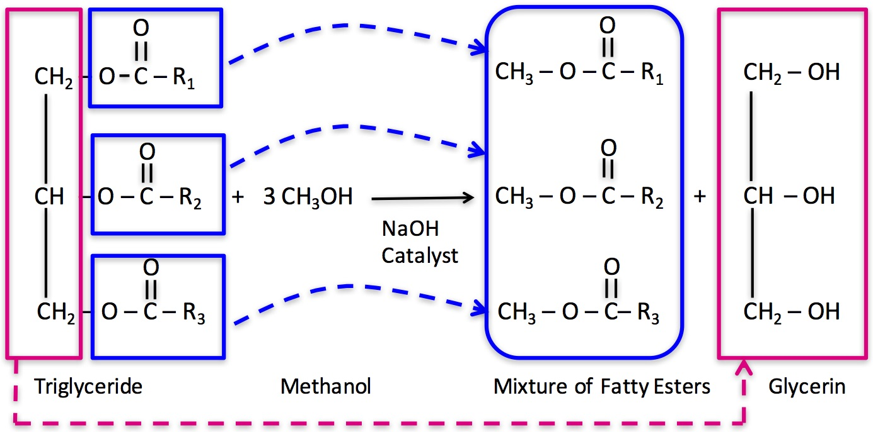
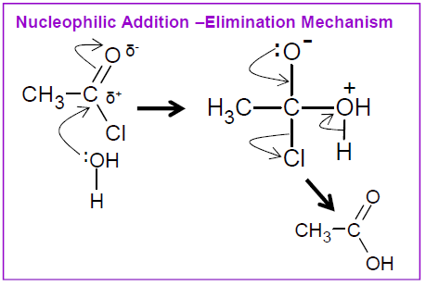
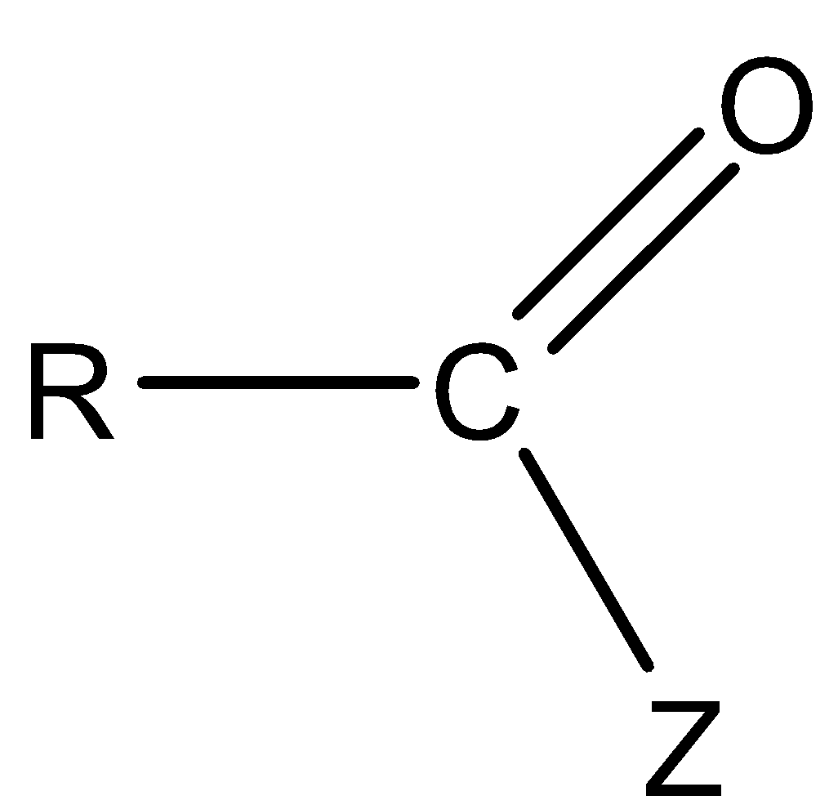
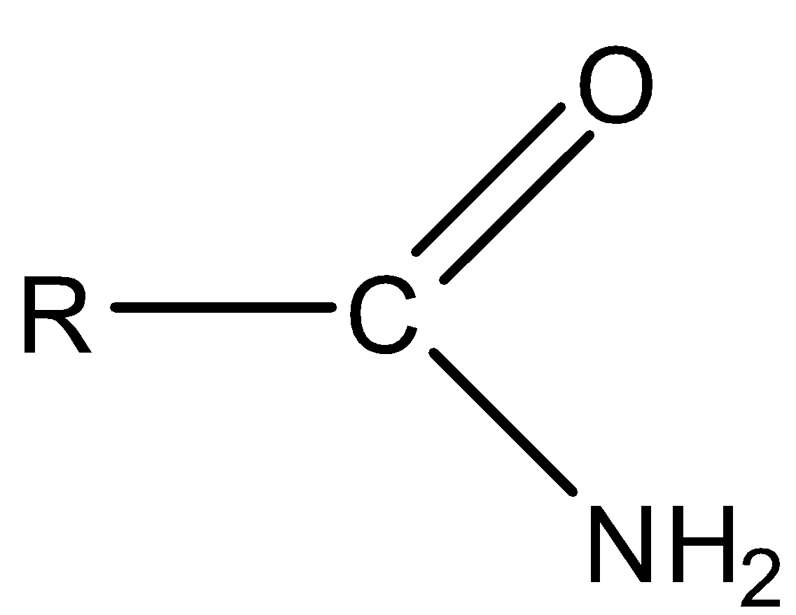
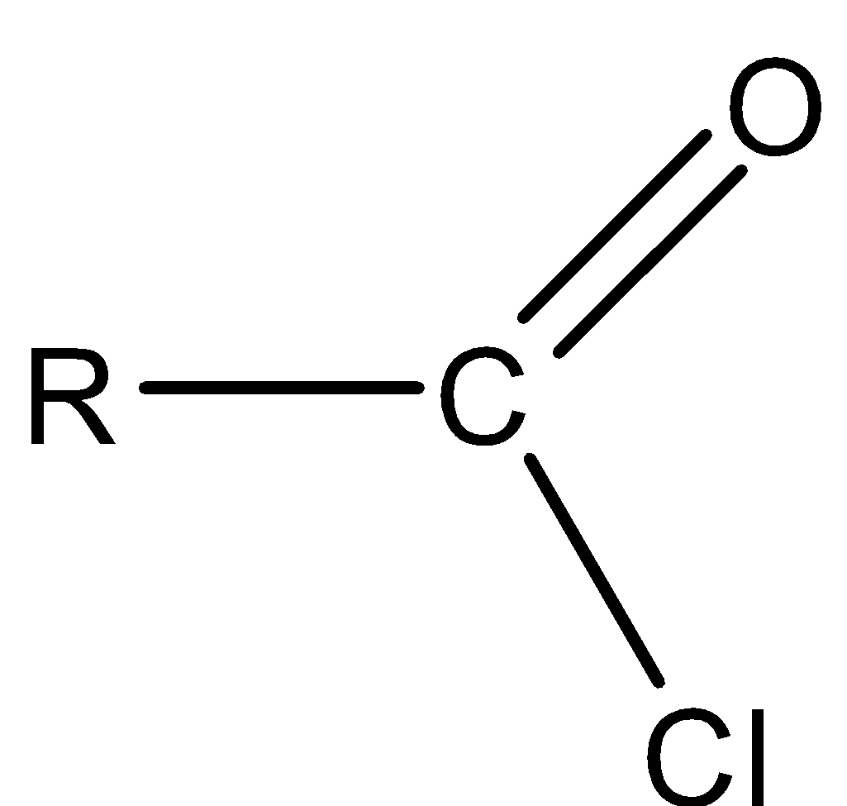
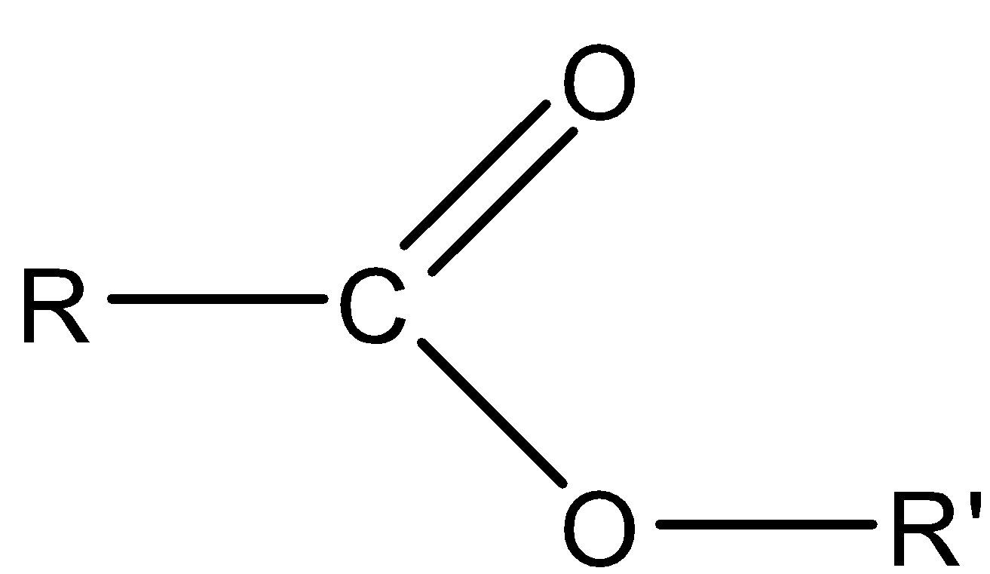



Unit 8b: The carboxyl group
Biodiesel
Biodiesel is a renewable fuel obtained from oils, mainly rape seed oil. Triglycerides are reacted with methanol in the presence of a strong alkali as a catalyst to form methyl esters and glycerol.
Uses of Glycerol Glycerol is able to form many hydrogen bonds and it is very soluble in water so it has extensive applications: Used in creams and ointments to prevent their drying Solvent in the food industry, medicines and toothpastes Plasticiser.
1. Keywords
Delocalisation: | when electrons in a molecule, ion or solid metal that are not associated with a single atom or a covalent bond.
2. Acylation (Addition- elimination reaction)
Acylation is the addition of the acyl group (-COR) into another molecule. Acid derivatives all have the acyl group as part of their structure. The acid derivative is polarized and its carbonyl group can be attacked by a nucleophile, the nucleophile gets acylated.
-Z | Name of acid derivative | General formula |  | Example
-OR | ester | RCOOR’ |  | Ethyl ethanoate CH₃COOC₂H₅
-Cl | acyl chloride | RCOCl |  | Ethanoyl chloride, CH₃COCl
-OCOR’ | acid anhydride | RCOOCOR’ |  | Ethanoic anhydride, CH₃COOCOCH₃
Addition- elimination reaction depends from: The polarization of the acid derivative depends on the electron-releasing or attracting power of Z. How good Z is leaving group How good the nucleophile is.
Ethanoic anhydride is used as an acylating agent over ethanoyl chloride because: It is cheaper It is less corrosive It is safer as the by-product is ethanoic acid rather than hydrogen chloride.
Biodiesel (methyl esters)
Glycerol
Increasing reactivity
 | Acyl chloride | Acid anhydride
Ammonia NH₃ | amide | amide
Amine R’-NH₂ | N-substituted amide | N-substituted amide
Alcohol R’-OH | ester | ester
Water H₂O | carboxylic acid | carboxylic acid
Increasing reactivity of nucleophile
-
δ
Acid derivative general formula
+
δ

Slide 11




Unit 9: Aromatic compounds
2. Benzene – Physical properties
Benzene was first isolated by Michael Faraday in 1825 and is now a major feedstock used in many industries: Polymers Pharmaceuticals Dyes Explosives. Benzene itself is highly carcinogenic. It is the simplest arene with an empirical formula of CH and a molecular formula of C₆H₆
The C-C bond length in benzene is an intermediate between and C-C single bond and a C=C double bond. Benzene is more stable than the hypothetical cyclohexa-1,3,5-triene because of electron delocalisation. Each C atom has three covalent bonds – one to a H atom and the other two to C atoms. The fourth electron of each C atom is in a p-orbital. The p-orbitals overlap and the electrons in them are delocalised. This forms an area of electron density above and below the ring to form a π cloud. Benzene is planar and the C-C bonds are equal in length.
Bond | Length/nm
C-C | 0.154
C---C (in benzene) | 0.140
C=C | 0.134
2. Benzene – Reactivity
Benzene combusts like other hydrocarbons and tends to produce very smoky flames. This is due to the high carbon:hydrogen ratio, this leaves a lot of carbon unburnt. Benzene have electrophilic substitution reactions in preference to addition reactions. Benzene does not discolour bromine water.
Electrophilic substitution – Nitration The electrophile (NO₂⁺) is made in the reaction mixture of concentrated nitric acid and concentrated sulfuric acid. The overall equation for the formation of the electrophile is: H₂SO₄ + HNO₃ 🡪 NO₂⁺ + HSO₄⁻ + H₂O The H⁺ then reacts with the HSO₄⁻ to regenerate H₂SO₄ – the sulfuric acid is a catalyst.
Electrophilic substitution – Friedel-Crafts acylation It uses aluminium chloride as a catalyst RCO substitutes for a hydrogen on the aromatic ring. Acyl chlorides provide the RCO group, reacting with AlCl₃ RCOCl + AlCl₃ 🡪 RCO⁺ + AlCl₄⁻ The aluminium chloride is then reformed by reacting with H⁺ from the benzene ring: AlCl₄⁻ + H⁺ 🡪 AlCl₃ + HCl

Slide 12




Unit 10: Amines
1. Physical properties
Amines are derivatives of ammonia, where one or more hydrogen atoms are replaced by alkyl or aryl groups. They are very reactive compounds
Nomenclature Amines are classified into primary secondary and tertiary based on the number of substituents bonded to the nitrogen. If there are more than one group attached to the ammine we use N-R putting substituent in alphabetical order For secondary or tertiary amines each group from the amine group is named separately, the longest has the suffix –amine
Amines are pyramidal molecules have all angles of approximately 107 degrees Short Amines are gases, longer ones are volatile liquids and have fishy smells.
2. Reactivity
Preparation : by reaction of ammonia with halogenoalkanes (Nucleophilic substitution) The 1^{O} amine can then act as a nucleophile and react with the halogenoalkane to produce a 2^{O} amine, which can react to give a 3^{O} amine, which in turn will react to make a 4^{O} ammonium salt. This is not efficient. Preparation by reduction of nitriles Halogenoalkanes react with a cyanide ion in aqueous ethanol. The ion replaces the halide ion by nucleophilic substitution to form a nitrile. Step 2: Nitriles can be reduced to primary amines with a nickel/hydrogen catalyst. Electrophilic substitution (nitration) of benzene. Nitrobenzene is then reduced to phenylamine using tin and HCl as the reducing agent:
Amines can act as bases Amines can accept a proton so they are weak Bronsted-Lowry bases: Alkyl groups release electrons towards the nitrogen atom, this is called inductive effect. The nitrogen is a stronger electron pair donor and so more attractive to protons. 1^{O} alkylamines are stronger bases than ammonia because the inductive effect of the alkyl group increases the electron density on the N atom and makes it a better electron pair donor. 2^{O} alkylamines have two inductive effects = stronger bases. 3^{O} alkylamines = not strong because they are poorly soluble in water. Aryl groups withdraw electrons from the nitrogen atom. The nitrogen is a weaker electron pair donor and so less attractive to protons, so aryl amines are weaker bases than ammonia.
Amine ca act as nucleophiles Ammonia and primary amines undergo addition-elimination reactions with acyl chlorides and acid anhydrides.

Slide 13




Unit 11: Polymers
2. Types of polymers.
Addition polymers. Alkenes can be used to make polymers such as poly(ethene) and poly(propene) by addition polymerisation. Addition polymers are very unreactive and inert because all the non-polar single C-C bonds. Polythene chains only have van der Waal’s forces between chains so are not good for forming fibres or weaving. Polyethene is very useful though as it has no branches so the chains can pack closely and hence is a strong, rigid material. LDPE is made at high temperatures and high pressures via free radical mechanism, hence it is highly branched and less packed than HDPE so it is stretcher. HDPE is made in the presence of the Ziegler-Natta catalyst at temperatures and pressures little higher than room conditions. PVC (Poly(chloroethene) contains polar C-Cl bonds. This makes PVC a hard but brittle material. The properties of PVC can be modified using a plasticiser which makes the material softer and bendier. The plasticiser pushes the chains apart and the chains can slide making them more flexible. Plasticised PVC is used to make electrical cable insulation, flooring tiles and clothing.
Condensation polymerisation Condensation polymerisation involves monomers with two functional groups (COOH and OH groups or COOH and NH2groups). During the condensation water or HCl is eliminated.. Condensation polymers can be hydrolysed so they are biodegradable. Common condensation polymers: - Polyesters ( -COO- linkage), like Terylene. - Polyamides (-CONH- linkage), like Nylon and Kevlar. - Polypeptides (-CONH- linkage), comprising all proteins.
1. Keywords
Plasticiser | a substance added to a synthetic material to produce or promote plasticity and flexibility and to reduce brittleness.
Atomic number: | number of protons (smaller no.) also the number of electrons in an atom.
Polymers | Addition | Condensation
Monomer | Alkene | With 2 functional groups
Synthesis | No by product | HCl or H₂O
Repeating unit | Symmetrical | Asymmetrical
Disposal | Some are recyclable | Biodegradable
3. Disposal of polymers.
The options for disposal are either burying in landfill, burning or reusing/recycling. Advantages: reduces the amount of waste going to landfill, saving raw materials and producing less CO2 than burning the plastic. Disadvantages are that it is difficult to recycle; collecting, sorting and processing is expensive and the plastic can be easily the recycling process. Contaminated.
Types of recycling: -Mechanical recycling: types of plastics are separated, washed and ground to pellets that can be melted and remoulded. -Feedstock recycling: plastics are heated to produce the monomers that can be reused to make new plastic. This can be only done a limited amount of times.
Example of condensation polymerisation
Example of addition polymerisation

Slide 14



Unit 12:Peptides
2. Aminoacids
There are 20 essential amino acids that make up proteins in the human body. Amino acids contain both amine (NH2) and carboxyl (COOH) functional groups. The molecule is chiral (not glycine) because it has a carbon bonded to four different groups. Most naturally occurring amino acids are the (-) enantiomer. Amino acids exist as zwitterions – ions that have both a permanent positive charge and a permanent negative charge, but are neutral overall. They can act both as acids and as bases α- amino acids have the amine group on the carbon next to the –COOH group
Proteins are sequences of amino acids joined by peptide links –CONH-. (condensation reaction). Proteins can have 4 structures: Primary structure: the sequence of amino acids along a protein chain. The structure is held together by strong covalent bonds (peptide bonds) and is therefore stable. Secondary structure: Either an α-helix or a β-pleated sheet. Held together by hydrogen bonds which are much weaker than covalent bonds. Tertiary structure: The secondary structure scan be folded into a 3-D shape. This is held together by hydrogen bonding, ionic interactions and sulphur-sulphur bonds. Quaternary structure: arrangement of two or more folded polypeptide chains that bond together with several types of bonds.
Sulfur-sulfur bonds. The amino acid cysteine has a side chain with a –CH₂SH group. When oxidised, two cysteine molecules can form a sulfur-sulfur bond that makes a bridge between the two molecules; this is called a disulfide bridge. A double amino acid called cystine is formed. -CH₂SH + HSCH₂- + [O] 🡪 -CH₂S-SCH₂- + H₂O
1. Keywords
Denaturing | destroy the characteristic properties of a biological macromolecule by heat, acidity, or other effect which disrupts its molecular conformation.
Stereospecific | preferentially interacting a particular stereoisomeric form of the substrate.
Zwitterions | molecule or ion having separate positively and negatively charged groups.
2. Denaturation
The primary structure can be hydrolyzed: by boiling a protein or a peptide in HCl. The structure breaks down into a mixture of all the constituent amino acids. Hydrolysis requires 24 hours and 6 mol dm⁻³ HCl since the covalent bond is a strong bond. Secondary structure can be disrupted by changes in pH or gentle heating (denaturing).
3. Enzymes
Enzymes are biological catalysts Stereospecificity: The active site of an enzyme can be so specific that many enzymes will only catalyse reactions of one enantiomeric form of a substrate.
Aminoacids with acids and bases

Slide 15




Unit 13: DNA
1. DNA
DNA = Deoxyribonucleic acid A single strand of DNA is a polymer made up from four different monomers (nucleotides): Cytosine (C) Thymine (T) Adenine (A) Guanine (G) A nucleotide has three parts – a phosphate, a sugar and a base A single strand of DNA is a polymer of nucleotides linked by covalent bonds between the phosphate group of one nucleotide and the sugar of another nucleotide. Formed in a condensation reaction. The DNA Double helix is stabilised by hydrogen bonds between bases of complementary chain (A – T, C-G)
phosphate group
organic base
2. Anticancer drug
Cisplatin is an anticancer drug works by bonding to strands of DNA (Ligand replacement reaction), distorting their shape and preventing the replication of the cells. The molecule bonds to the lone pair of nitrogen atoms on two adjacent guanine bases on a strand of DNA forming a dative covalent bonds with the platinum, displacing the Cl⁻ ions.
Side effects: It will bond to DNA in healthy cells as well as cancerous ones.
sugar - deoxyribose

Slide 16










Module 4: Infrared spectroscopy
1. Technique.
Infrared depends on the fact that infrared radiation is absorbed by certain molecular bonds and this causes them to vibrate. There are three types of vibrations, symmetrical, asymmetrical and bending. Different bonds absorb IR radiation at different wavelengths and can be used to identify different functional groups.
The finger print region is in the range 1500–500cm-1 is unique for any given compound but is too complicated to analyse. Because the finger print region is unique, compounds can be identified by comparing it to a data base of known IR spectra.
IR is limited as technique because it only gives information about functional groups. Other evidence is required to determine the precise structural formula.

Slide 17



Module 4: Mass Spectrometry
2. Time of Flight Mass Spec.
1 | Ionisation | Sample dissolved and pushed through nozzle at high pressure and 4000v. As solvent evaporates particles gain a H+ ion
2 | Acceleration | + ions accelerated by -5000v electric field. Have a fixed kinetic energy
3 | Ion drift | Region of no electric field, so drift (lighter move faster, heavier ions slower.)
4 | Detection | + ions discharge creating a flow of electrons in the detector which registers the current and plots the mass spectrum.
1. Keywords
Fragmentation | In MS, the process in which a molecular ion breaks into smaller ions, radicals, and/or neutral molecules. Fragments.
m/z value | Mass/charge value used in MS to identify peaks.
3. Ion sources
Electron bombardment The sample being is vaporised and then high energy electrons are fired at it so it becomes ionised and lose and e-, giving a molecular ion M+ C₂H₅OH + e- 🡪 C₂H₅OH⁺ + 2e- or C₂H₅OH (g) 🡪 C₂H₅OH⁺ (g) + e- The mass lose of e- is negligible Molecular ion mass = molecular mass of compound Molecular ion detected and analysed Excess energy from ionisation can be transferred to molecular ion making it vibrate, this can cause bond to weaken and can split molecular ion into fragments - Fragmentation C₂H₅OH⁺ (g) 🡪 CH3 + CH₂OH⁺ (g) Molecular ion fragments are detected in MS
Electronspray ionisation The sample X is dissolved in a volatile solvent and injected through a fine hypodermic needle to give a fine mist (aerosol). The tip of the needle is attached to the positive terminal of a high-voltage power supply. The particles are ionised by gaining a proton from the solvent as they leave the needle producing XH+ ions (ions with a single positive charge and a mass of Mr + 1). The solvent evaporates away while the XH+ ions are attracted towards a negative plate where they are accelerated. C₂H₅OH (g) + H⁺ 🡪 C₂H₆OH⁺ (g) Fragmentation rarely takes place
Electron bombardment source
4. Fragmentation
If fragmentation occurs, the peak at the highest m/z on the mass spectrum is formed by the heaviest ion that passes through the spectrometer. Unless all molecules of the original substance break up, this corresponds to the molecular ion of the sample substance. Although the molecular ion peak for 2 isomers will be the same m/z value, fragmentation patterns will be different
Electronspray ionisation source

Slide 18







Unit 16: NMR
2. Nuclear Magnetic Resonance - theory
Neutrons and protons can be found in the nucleus spinning on their own axis. In many atoms, these spins cancel each other out, but in those with an odd number of protons the nucleus itself will have an overall spin. This generates a small magnetic field around the nucleus, much like that of a bar magnet. If we place a bar magnet in an external magnetic field, it aligns parallel to it, much like a compass aligns with Earth’s magnetic field. If we place nuclei with spin in a magnetic field, they, too, will align with it. If we provide the required energy, we can ‘flip’ the nuclei. This energy required for this can be supplied in the form of radio waves it can be recorded as a spectrum which we can then use to find information on the compound’s structure. This flipping of the atom from one magnetic alignment to the other by the radio waves is known as the resonance condition. Each atom of each compound will have its specific chemical shift (δ).
There are two main types of NMR: ¹³C NMR C-13 - Only 1% of the carbons are ¹³C (sensitivity problems). ¹H (proton) NMR - ¹H NMR spectra are obtained using samples dissolved in deuterated solvents or CCl₄
1. Keywords
Chemical shift (δ). | the resonant frequency (signal) of a nucleus relative to a standard in a magnetic field.
3. Interpretation
Each ¹³C or ¹H atom of a specific functional group has its own δ. Tetramethylsilane, Si(CH₃)₄ (TMS) is used as a standard as all the hydrogen atom are in identical environments. This means it produces a single peak, far away from most other absorption peaks. The single peak is given a chemical shift value of 0. It is also inert, non-toxic and volatile (easy to remove from the sample). The higher the electron density around the atom the higher the shielding hence the lower the δ on the NMR spectrum. In a NMR spectrum, there is one signal (peak) for each set of equivalent ¹³C or ¹H atoms.
¹H NMR The peaks can be split into multiple smaller peaks (spin-spin coupling). These split into the number of hydrogen atoms on the adjacent carbon plus one. Following the n+1 rule. The area of each peak is related to the number of H atoms producing it. The instrument produces a line called the integration trace. The relative heights of the steps show the relative number of each type of hydrogen.
¹³C NMR

Slide 19




Unit 17: Chromatography
1. General principles
Chromatography describes a range of separation techniques where a mixture can be separated if it is dissolved in a solvent and the resulting solution moves over a solid. The mobile phase flows through the stationary phase and carries the components of the mixture with it. It is a liquid or a gas. The stationary phase is a solid, or a liquid supported on a solid. It will hold back the components in the mixture that are attracted to it. The more affinity a component in the mixture being separated has for the stationary phase, the slower it moves with the solvent.
2. Thin layer chromatography
Advantages compared to paper chromatography: Faster Plates are harder wearing than paper Smaller amounts of mixtures can be separated
Detection Once a sample has run UV or other developing agents are use to locate the spots. The distance travelled relative to the solvent is called the R_{f} value. R_{f} = distance travelled by the compound distance travelled by the solvent
3. High Pressure liquid chromatography
HPLC is a column chromatography performed at high pressure. Pressure drives the elution rather than gravity.
4. Gas-liquid chromatography
In Gas-liquid chromatography a column is packed with a solid or with a solid coated by a liquid, and a gas is passed through the column under pressure at high temperature. The sample is carried by the gas and the mixture separates as some of the components move along with the gas and some are retained by the oil. Different types of detectors are used to identify the emerging gas. In GCMS (Gas Chromatography-Mass Spectrometry) a mass spectrometer is used as the detector.
Chromatography | Mobile phase | Stationary phase | Support
Paper | Solvents | Paper | Paper
Thin layer | Solvents | Silica gel (SiO₂) or Alumina (Al₂O₃) | Glass or plastic
Column | Solvents | Silica gel (SiO₂) or Alumina (Al₂O₃) | Column
Gas-liquid | N₂ or He | Powder coated with oil | Capillary

Slide 20

Unit 18: Test tube reactions
1. Reactions
Functional group | Reagent | Result
Acyl chloride | Silver nitrate | Vigorous reaction steamy fumes of HCl rapid white precipitate of AgCl
Alkene | Bromine water | Orange colour decolourises
Aminoacids | Ninhydrin. | Blue-purple spot appears
Aromatic | Combustion | Smoky flames
1 ^ry or 2^ry alcohol | Sodium dichromate and sulfuric acid | Orange to green colour change
Aldehyde | Fehling’s solution | Blue solution to red precipitate
 | Tollens’ reagent | Silver mirror formed
 | Sodium dichromate and sulfuric acid | Orange to green colour change
Carboxylic acid | Sodium carbonate 2CH3CO2H + Na2CO3 🡪 2CH3CO2 Na + H2O + CO2 | Effervescence of CO2 evolved
 | pH paper/indicator | Mildly acidic solution
Esters |  | Fruity smell
Haloalkane | Warm with aqueous NaOH then cool then add nitric acid then add silver nitrate | White precipitate (chloroalkane) Cream precipitate (bromoalkane) Yellow precipitate (iodoalkane)
3. Tollens’ Reagent
Reagent: aqueous ammonia + silver nitrate. The active substance is the complex ion of [Ag(NH₃)₂]⁺ Conditions: heat gently Reaction:. The silver(I) ions are reduced to silver atom and aldehydes/alcohols oxidised. Observation: a silver mirror forms coating the inside of the test tube. Ketones result in no change. CH₃CHO + 2Ag⁺ + H₂O 🡪 CH₃COOH + 2Ag + 2H⁺
4. Fehling’s Solution
Reagent: Fehling’s Solution containing blue Cu²⁺ ions. Conditions: heat gently Reaction: aldehydes only are oxidised and the copper (II) ions are reduced to copper(I) oxide . Observation: Blue Cu²⁺ ions in solution change to a red precipitate of Cu₂O. Ketones do not react Fehling’s solution. CH₃CHO + 2Cu²⁺ + 2H₂O 🡪 CH₃COOH + Cu₂O + 4H⁺
2. Further observations
Is the compound solid? (possible long unbranched carbon chain or ionic bonding) Is the compound liquid? (hydrogen bonds, branched carbon chain) Is the compound soluble? (can form hydrogen bond)

Slide 21



Unit: 19 Organic synthesis
2. Reaction schemes
Using organic reactions you can work out a reaction scheme to convert a starting material into a target molecule. Start by writing down the formula of the starting molecule and the target molecule. Write down all the compounds which can be made from the starting molecule and all the ways that the target molecule can be made. It is important to keep the number of steps in a reaction as small as possible and the atom economy high – this increases profit and reduces waste Chemists aim to design processes that do not require a solvent and use non-hazardous starting materials as this is more sustainable and has less environmental impact.
1. Keywords
Atom economy: | a measure of the percentage of reactants that become useful products.
Target molecule: | desired product of a synthetic process.
3. Chemical agents
Oxidising agents: Potassium dichromate (K₂Cr₂O₇) + sulphuric acid
Reducing agents: Sodium tetrahydridoborate (III) (NaBrH₄), will reduce C=O but not C=C Hydrogen with a nickel catalyst (H₂/Ni) will reduce C=C but not C=O Tin and hydrochloric acid (Sn/H⁺) will reduce nitrates to amines.
Dehydrating agents: Heated aluminium oxide H⁺ (elimination reactions)
4. Reflux
Never seal the end of the condenser as the build up of gas pressure could cause the apparatus to explode. Anti-bumping granules are added to the flask in both distillation and reflux to prevent vigorous, uneven boiling . Don’t draw lines between flask and condenser. • Don’t have top of condenser sealed • Condenser must have outer tube for water that is sealed at top and bottom • Condenser must have two openings for water in and out that are open Electric heaters are often used to heat organic chemicals.
6. Distillation
In general used as separation technique to separate an organic product from its reacting mixture. The distillate will be collected at the approximate boiling point range of the desired liquid.
5. Thiele tube
A Thiele tube is used to measure melting points. If impurities are present the melting point will be lowered and the sample will melt over a range of several degrees Celsius. The capillary tube is strapped to a thermometer immersed in some heating oil. Melting point can also be measured in an electronic melting point machine In both cases a small amount of the sample is put into a capillary tube. The tube is heated up and is heated slowly near the melting point

