Slide 1
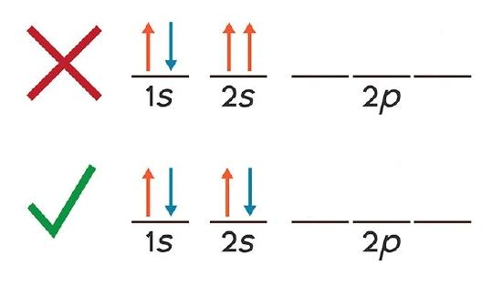
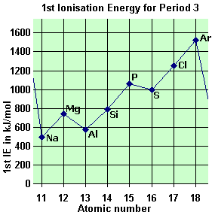


Module2: Atomic Structure
2. Time of Flight Mass Spec.
1 | Ionisation | Sample dissolved and pushed through nozzle at high pressure and 4000v. As solvent evaporates particles gain a H+ ion
2 | Acceleration | + ions accelerated by -5000v electric field. Have a fixed kinetic energy
3 | Ion drift | Region of no electric field, so drift (lighter move faster, heavier ions slower.)
4 | Detection | + ions discharge creating a flow of electrons in the detector which registers the current and plots the mass spectrum.
1. Keywords
Mass Number: | Total number of protons and neutrons (bigger no.)
Atomic number: | number of protons (smaller no.) also the number of electrons in an atom.
Isotope: | An atom that has the same number of protons but a different number of neutrons
Ionisation: | Removal of one or more electrons (endothermic)
First Ionisation Energy: | The energy needed to remove 1 electron from each atom in 1 mole of gaseous atoms. M(g) → M⁺ (g) + e⁻
Second ionisation energy: | The energy needed to remove 1 electron from each atom in 1 mole of gaseous +1 ions. M⁺ (g) → M²⁺ (g) + e⁻
Successive ionisation energies: | Removing each electron in turn from a mole of gaseous atoms. Provides evidence of energy levels and orbitals
Mass spectrometry | Technique used to calculate the mass of atoms and molecules
3. Rules for electron configuration
1 | Aufbau “building up” principle | Electrons always fill the lowest energy level first
2 | Hund’s rule of maximum multiplicity (bus rule) | Electrons will fill the empty orbital of an energy level before pairing
3 | Pauli’s exclusion principle | When electrons pair in an orbital they have opposite spin
4. Energy levels
Energy level | Sub levels | Orbitals | Electrons
1 | s | 1 | 2
2 | s,p | 1,3 | 8
3 | s,p,d | 1,3,5 | 18
4 | s,p,d | 1,3,5 | 18
REMEMBER the 4s fills before the 3d (use you periodic table to remind you)
5. Drops in 1st ionisation energies across period 3
Ar | symbol | Electron config | Reason for drop?
13 | Al | 3s² 3p¹ | Electron is in p orbital further from nucleus to easier to remove
16 | S | 3s² 3p⁴ | Electron is paired in 3p orbital so easier to remove

Slide 2
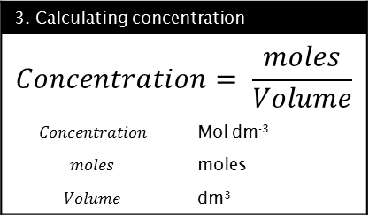
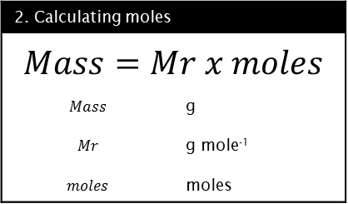
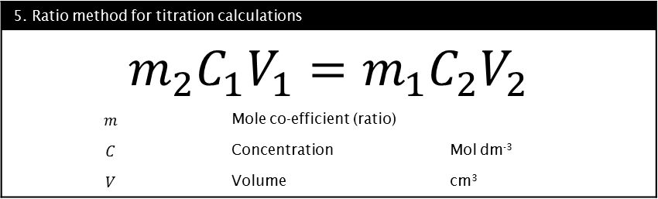
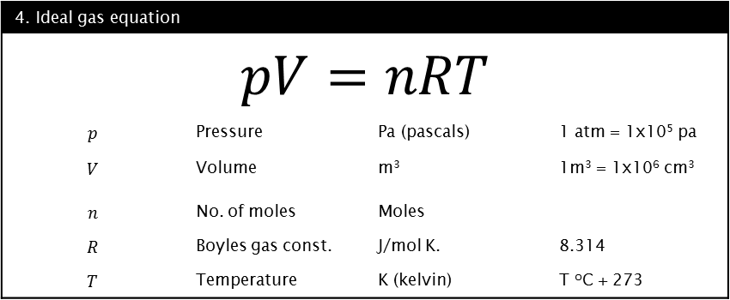
Module2: Amount of substance
1. Keywords
Relative Atomic Mass: (Ar) | Average mass of an atom ¹/₁₂ th Carbon 12
Relative Molecular Mass: (Mr) | Average mass of a molecule ¹/₁₂ th Carbon 12
Relative Isotopic Mass: | Average mass of an isotope ¹/₁₂ th Carbon 12
Avogadro's constant | The number of particles that make up 1 mole of a substance.
Mole | The unit the amount of a substance is measured in. The number of particles need to make 12.00g of Carbon-12
Concentration | The amount of particles in a fixed volume. Measured in moles per litre (Mol dm⁻³ )
Ideal gas | Idea gases are any gas which behaves in accordance with the ideal gas equation. It does not matter what substances are in the gas.
Empirical formula | Simplest whole number ratio of the elements in a compound
Molecular formula | The actual ratio of elements in a specific compound. Should add up to the Mr.
Balanced full equation | A balanced chemical equation showing all atoms and their relative amounts and states
Ionic equation | An equation which only shows the species which change during a chemical reaction
Spectator ions | The ions omitted from an ionic equations because they are not involved
Atom economy | Mr desired product x100 Mr of all reactants
2. Calculating moles
$$Mass=Mr x moles$$
$$Mass$$ | g
$$Mr$$ | g mole⁻¹
$$moles$$ | moles
3. Calculating concentration
$$Concentration= \frac{moles}{Volume}$$
$$Concentration$$ | Mol dm⁻³
$$moles$$ | moles
$$Volume$$ | dm³
4. Ideal gas equation
$$pV=nRT$$
$$p$$ | Pressure | Pa (pascals) | 1 atm = 1x10⁵ pa
$$V$$ | Volume | m³ | 1m³ = 1x10⁶ cm³
$$n$$ | No. of moles | Moles
$$R$$ | Boyles gas const. | J/mol K. | 8.314
$$T$$ | Temperature | K (kelvin) | T ºC + 273
5. Ratio method for titration calculations
$$m_{2}C_{1}V_{1}=m_{1}C_{2}V_{2}$$
$$m$$ | Mole co-efficient (ratio)
$$C$$ | Concentration | Mol dm⁻³
$$V$$ | Volume | cm³

Slide 3
Module2: Bonding
1. Keywords
Ionic bond | Bond formed by the transfer of electrons from a metal to a non-metal. Strong attraction between oppositely charged ions.
Covalent bond | Bond between non-metals. A shared pair of electrons
Metallic bond | Positive metal ions in a ‘sea’ of delocalised electrons
Macromolecular (Giant covalent) | Large covalently bonded molecule. Eg diamond, graphite, silicon dioxide
Molecular covalent molecule | Small covalently bonded molecules that are held together by intermolecular forces. Eg Iodine, water, carbon dioxide.
Co-ordinate bond | A type of covalent bond where both electrons are donated by one atom.
Bonding pair | A pair of electrons in a covalent bond
Lone pair | A pair of un-bonded electrons. Repel more than bonding pairs
Electronegativity | The power of an atom to attract the electrons in a covalent bond
Polar covalent bond | A bond with a unequal distribution of electrons due to a difference in electronegativity of the bonding atoms
Intermolecular forces | The forces between molecules. They are responsible for the trends in melting and boiling points of substances
3. Intermolecular forces
 | Van der Waals | Temporary dipoles induce complimentary dipoles in neighbours | Happens in all molecules | Eg. Alkanes
 | Permanent dipole- dipole | Attraction between slightly positive and negative ends of bond | Happens in any asymmetric bond with different electronegativity | Eg. Hydrogen chloride
 | Hydrogen bonding | Attraction between slightly positive and negative ends of bond | Happens when H bonded to O, N, F only | Eg. Water, Ammonia, Alcohol
Increasing strength
4. VSEPR molecular shapes
Electron pairs | Geometry | Bonding pairs | Lone pairs | Shape | Angle | Example
2 | Linear | 2 | 0 | Linear | 180 | BeCl₂
3 | Trigonal planar | 3 | 0 | Trigonal planar | 120 | SO₃
4 | Tetrahedral | 4 | 0 | Tetrahedral | 109.5 | CH₄
 |  | 3 | 1 | Trigonal pyramidal | 107 | NH₃
 |  | 2 | 2 | V-shape | 104.5 | H₂O
5 | Trigonal bipyramidal | 5 | 0 | Trigonal bipyramidal | 120, 90 | PCl₅
 |  | 4 | 1 | See-saw | 120, 90 | TeCl₄
 |  | 3 | 2 | T-shape | 87.5 | ClF₃
6 | Octahedral | 6 | 0 | Octahedral | 90 | SF₆
 |  | 4 | 2 | Square planar | 90 | ICl₄⁻
2. Common anions
Sufate | SO₄²⁻ | Hydroxide | OH⁻
Carbonate | CO₃²⁻ | Ammonium | NH₄⁺
Nitrate | NO₃⁻

Slide 4
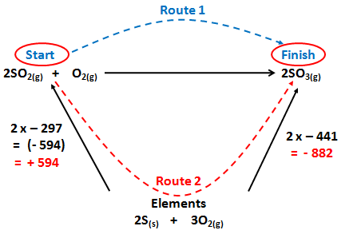
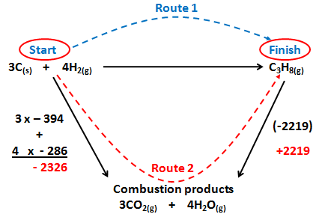

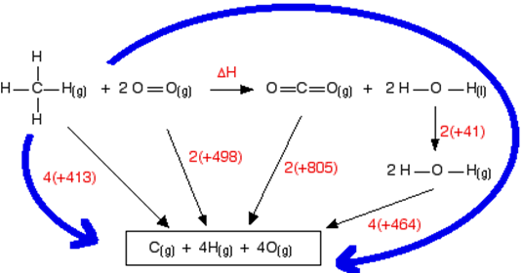
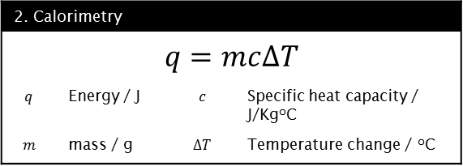
Unit 4: Enthalpy
3. Enthalpy of formation cycle | 4. Enthalpy of combustion cycle
Formation: Arrows go up | Combustion: Arrows go down
1. Keywords
Enthalpy change ∆H | Heat energy change at constant pressure
Standard enthalpy change ∆H₂₉₈º | Enthalpy change under standard conditions eg 100Kpa and 298K
Standard enthalpy change of formation ∆_{f}H^{º} | The enthalpy change when one mole of substance is formed from it’s elements under standard conditions
Standard enthalpy change of combustion ∆_{c}H^{º} | The enthalpy change when one mole of substance is completely burnt in oxygen. Reactants and products in their standard states under standard conditions.
Calorimetry | The process of measuring the heat from a chemical reaction
Hess’ law | The enthalpy change of a reaction is independent of the route taken
Mean bond enthalpy | The average enthalpy change when one mole of a specific bond is broken in a range of different gaseous compounds
5. Bond enthalpies
Shopping list approach |  | Cycle approach
= +2348 - +3466 = -1118kJmol⁻¹ |  | = +2348 - +3466 = -1118kJmol⁻¹
values
C-H | 4x (+413) | C=O | 2x (+805)
O=O | 2x (+498) | O-H | 4x (+464)
 | = +2348 |  | = +3466
2. Calorimetry
$$q=mc∆T$$
$$q$$ | Energy / J | $$c$$ | Specific heat capacity / J/KgºC
$$m$$ | mass / g | $$∆T$$ | Temperature change / ºC

Slide 5
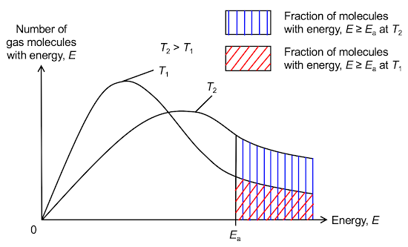
Module3: Kinetics
1. Keywords
Collision theory | For a reaction to occur the reactants have to collide with sufficient energy and in the correct orientation
Activation energy | The minimum energy needed for a collision to create a successful reaction
Rate of reaction | The amount of product made or reactant used up in a given time
3. Maxwell-Boltzmann distribution
Line starts at origin | No particles have no energy
Asymptotic | some particles have infinite energy
Area under the curve | Number of particles
Height of curve | Most probable energy
2. Factors the increase the rate of reaction
concentration | More particles in a given spec so more collisions and increased rate
Pressure | More particles in a given spec so more collisions and increased rate
Surface area | High surface area increases the number of particles available to collide so increases rate
Temperature | Increases the kinetic store of the particles so they collide more frequently and with a greater proportion above the activation energy
Catalyst | Speed up reaction by providing an alternative route with a lower activation energy

Slide 6


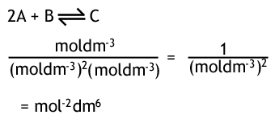
Module3: Equilibria Kc
1. Keywords
Equilibrium | When a reversible reaction has the same rate in both directions and the concentrations do not change. Happens in a closed system
Le Charteliers principle | If a change is made to a system at equilibrium then the equilibrium will shift to oppose that change
2. Le Charteliers principle
Factor | Effect on equilibrium | Reason | Example
Pressure Increase | Shifts to side with least moles | To decrease the pressure to reach the equilibrium pressure again | It will shift to the right as it has the least moles
Pressure Decrease | Shifts to side with most moles | To increase the pressure | It will shift to the left as it has the most moles
Concentration Increase | Shifts to other side | To decrease the concentration of what was increased | If the concentration of A is increased it will shift to the right
Concentration Decrease | Shifts to the same side | To increase the concentration of what was decreased | If the concentration of A is decreased it will shift to the left
Temperature Increase | Shifts in the endothermic direction | To cool down the reaction | It will shift to the left as this is the endothermic direction
Temperature Decrease | Shifts in the exothermic direction | To heat up the reaction | It will shift to the right as it is the exothermic direction
3. Kc
[ ] | Concentration / mol dm⁻³
Kc >1 | In favour of products
Kc<1 | In favour of reactants
4. Units of Kc

Slide 7
Module2: Redox
1. Keywords
Oxidation | The loss of electrons, gain of oxygen, increase in oxidation number
Reduction | The gain of electrons, loss of oxygen, decrease in oxidation number
Disproportionation | When one species is both oxidised and reduced simultaneously
Half equation | A balanced equation which only shows either the oxidation or reduction during a redox reaction
Oxidising agent | A substance which oxidises another substance and in doing so becomes reduced
Reducing agent | A substance which reduces another substance and in doing so becomes oxidised
3. Steps to balance half equations
1 | Balance the existing atoms
2 | Determine the oxidation state before and after the reaction
3 | Add electrons to balance the change in oxidation state
4 | If it is a complex ion add H⁺ ions to produce 1 water for every oxygen
5 | Check the atoms and charge balance both sides
4. Steps to combine half equations
1 | Determine which is being oxidised and which is being reduced
2 | Write out the balanced half equations
3 | Factor up the half equations until the number of electrons balance
4 | Combine the half equations
5 | Cancel any redundant species
2. Rules to assign oxidation numbers
Element | 0
Mono atomic ion | Charge on the ion
Hydrogen | +1 (unless hydride = -1)
Oxygen | -2 (unless peroxide = -1)
Fluorine | -1
Group 1 | +1
Group 2 | +2
Group 7 | -1 mostly

Slide 8
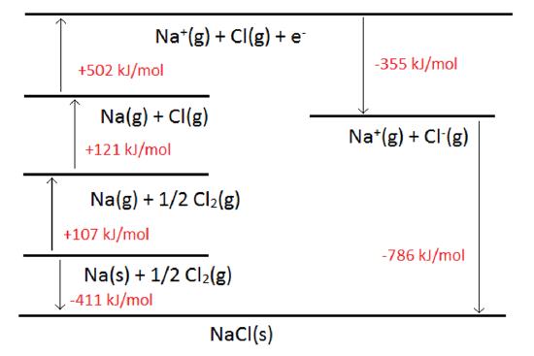
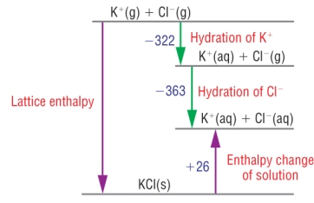
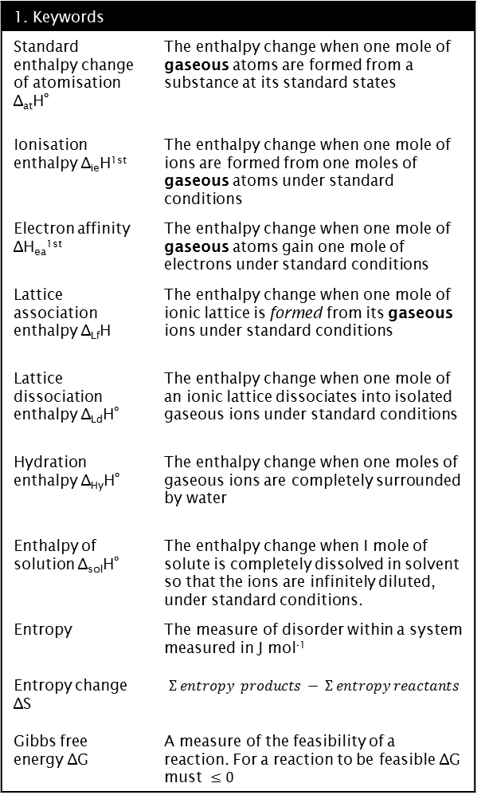
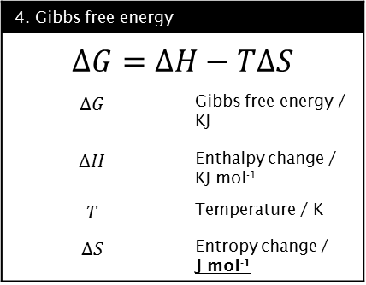
Unit 8: Thermodynamics
1. Keywords
Standard enthalpy change of atomisation ∆_{at}H^{º} | The enthalpy change when one mole of gaseous atoms are formed from a substance at its standard states
Ionisation enthalpy ∆_{ie}H^{1st} | The enthalpy change when one mole of ions are formed from one moles of gaseous atoms under standard conditions
Electron affinity ∆H_{ea}^{1st} | The enthalpy change when one mole of gaseous atoms gain one mole of electrons under standard conditions
Lattice association enthalpy ∆_{Lf}H | The enthalpy change when one mole of ionic lattice is formed from its gaseous ions under standard conditions
Lattice dissociation enthalpy ∆_{Ld}H^{º} | The enthalpy change when one mole of an ionic lattice dissociates into isolated gaseous ions under standard conditions
Hydration enthalpy ∆_{Hy}H^{º} | The enthalpy change when one moles of gaseous ions are completely surrounded by water
Enthalpy of solution ∆_{sol}H^{º} | The enthalpy change when I mole of solute is completely dissolved in solvent so that the ions are infinitely diluted, under standard conditions.
Entropy | The measure of disorder within a system measured in J mol⁻¹
Entropy change ∆S | $$Σ entropy products − Σ entropy reactants$$
Gibbs free energy ∆G | A measure of the feasibility of a reaction. For a reaction to be feasible ∆G must $≤0$
2. Born-Haber cycle: basic layout
1 | Atomise
2 | Atomise
3 | Ionise
4 | Electron affinity
5 | Lattice enthalpy
6 | Enthalpy of formation
4. Gibbs free energy
$$∆G=∆H−T∆S$$
$$∆G$$ | Gibbs free energy / KJ
$$∆H$$ | Enthalpy change / KJ mol⁻¹
$$T$$ | Temperature / K
$$∆S$$ | Entropy change / J mol⁻¹
3
4
2
1
6
5
3. Born-Haber cycle: enthalpy of solution

Slide 9
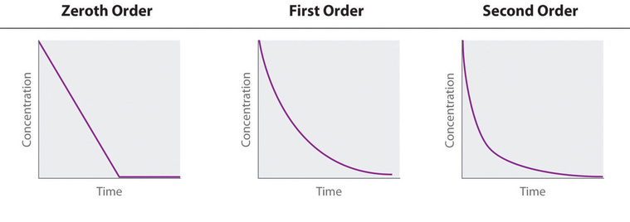
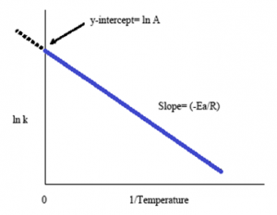
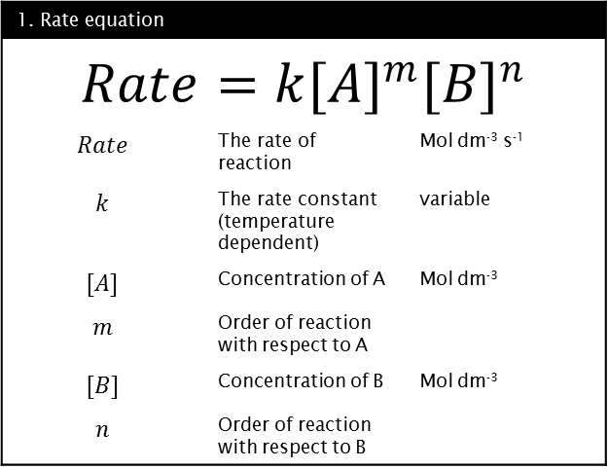
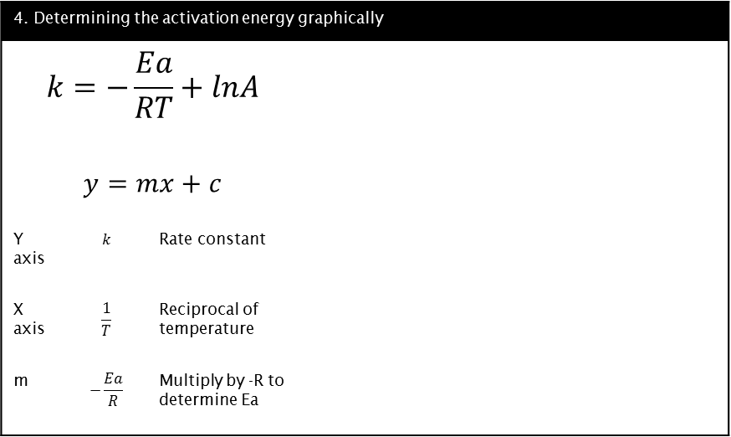
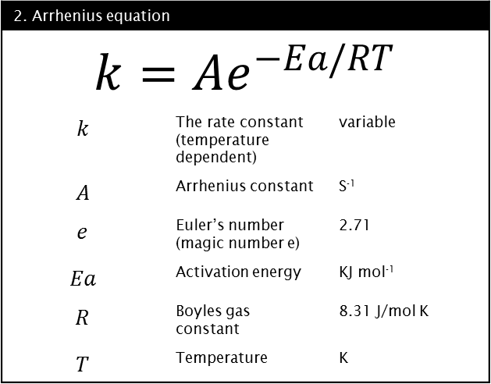
Unit 9: Rate equations
3. Determining order of reaction graphically
1. Rate equation
$$Rate=k{[A]}^{m}{[B]}^{n}$$
$$Rate$$ | The rate of reaction | Mol dm⁻³ s⁻¹
$$k$$ | The rate constant (temperature dependent) | variable
$$[A]$$ | Concentration of A | Mol dm⁻³
$$m$$ | Order of reaction with respect to A
$$[B]$$ | Concentration of B | Mol dm⁻³
$$n$$ | Order of reaction with respect to B
4. Determining the activation energy graphically
$$k=−\frac{Ea}{RT}+lnA$$
$$y=mx+c$$
Y axis | $$k$$ | Rate constant
X axis | $$\frac{1}{T}$$ | Reciprocal of temperature
m | $$−\frac{Ea}{R}$$ | Multiply by -R to determine Ea
2. Arrhenius equation
$$k=Ae^{−Ea/RT}$$
$$k$$ | The rate constant (temperature dependent) | variable
$$A$$ | Arrhenius constant | S⁻¹
$$e$$ | Euler’s number (magic number e) | 2.71
$$Ea$$ | Activation energy | KJ mol⁻¹
$$R$$ | Boyles gas constant | 8.31 J/mol K
$$T$$ | Temperature | K

Slide 10
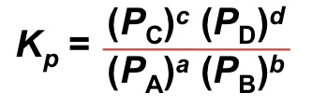
Unit 10: Equilibria Kp
1. Keywords
Mole fraction | The number of moles of a species The total number of moles
Partial pressure | The mole fraction of a species x total pressure
2. Kp Expression
Kp | Equilibrium constant | Variable units
(P_{c}) | Partial pressure of C | Pascals
^{c} | Order with respect to C
(P_{D}) | Partial pressure of D | Pascals
^{d} | Order with respect to D
(P_{A}) | Partial pressure of A | Pascals
ª | Order with respect to A
(P_{B}) | Partial pressure of B | Pascals
^{b} | Order with respect to B

Slide 11

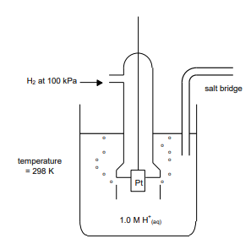
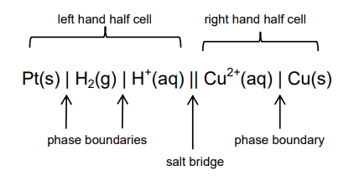
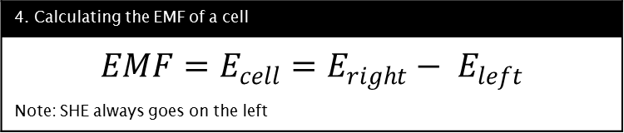
Unit 11: Electrode potentials and electrochemical cells
1. Keywords
Potential difference | The difference in voltage between two points.
Electrode potential Eº | The is the potential difference of a cell built of two electrodes: on the left-hand side of the cell diagram is the standard hydrogen electrode (SHE), and. on the right-hand side is the electrode in question under standard conditions (1mol dm⁻³, 100kpa, 298k)
Standard hydrogen electrode (SHE) | The electrode given the electrode potential of 0.00v to establish all other electrode potentials
Platinum electrode | Unreactive electrode used in half cells when neither species is a solid metal
Electrochemical cell | A cell produced when 2 half cells of different electrode potentials are linked by a salt bridge
Salt bridge | A medium connecting two half cells. Contains inert ions to allow charge to flow without interfering with the electrochemistry
EMF | Electro motive force. The potential difference of a cell when no current flows
Feasible reaction | A spontaneous redox reaction which generates a positive Eº for the cell
Anode | The electrode where oxidation happens. In an electrochemical cell this is the negative terminal
Cathode | The electrode where reduction happens. In an electrochemical cell this is the positive terminal. Often on the right
Non-rechargeable cell | A cell with a spontaneous reaction which cannot be reverse
Rechargeable cell | A cell with a spontaneous reaction which can be reversed by applying an electric current
Fuel cell | A cell which generates an EMF providing a continuous flow of chemicals are provided
Hydrogen fuel cell | A fuel cell which uses hydrogen and oxygen to generate an EMF. Water is the only waste product
2. Standard hydrogen electrode
Half cell equation:
Cell notation:
3. How to write conventional cell notation
Highest oxidation state is nearest the salt bridge
If platinum electrode is present it goes on the far edges
4. Calculating the EMF of a cell
$$EMF=E_{cell}=E_{right}− E_{left}$$
Note: SHE always goes on the left

Slide 12
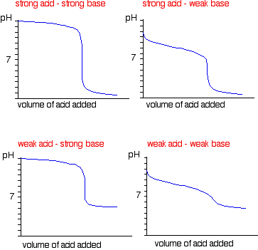
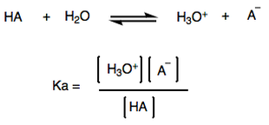
Unit 12: Acids and Bases
1. Keyword
Bronsted-Lowry acid | Proton donor
Bronsted-Lowry base | Proton acceptor
Conjugate base | An acid that has donated its hydrogen
Conjugate acid | A base with a hydrogen ion added to it.
Strong | Fully ionises/dissociates in solution
Weak | Partially ionises/dissociates in solution
pH | -Log₁₀ [H⁺]
Kw | Ionic product of water = [H⁺] [OH⁻] = 1x10⁻¹⁴ At 298k
Ka | Acid dissociation constant. A measure of dissociation of a weak acid. Units = Mol dm⁻³
Half equivalence point | Half the volume required to neutralise and acid or base = pKa
Indicator | A compound or compounds that change colour when pH changes. Should fall in the vertical rise on a pH curve
10^{x} | Inverse log button on your calculator duh!
Buffer | Solution which resists small changes in pH. Made from a weak acids and its salt.
3. pH curves
2. Useful acids
Name | Formula | Strength | Protic
Hydrochloric | HCl | Strong | Mono
Sulphuric | H₂SO₄ | Strong | Di
Nitric | HNO₃ | Strong | Mono
Phosphoric | H₃PO₄ | Strong | Tri
Ethanoic | CH₃COOH | Weak | Mono
Ethanedioic | HOOCCOOH | Weak | Di
4. Ka Expression

