Slide 1
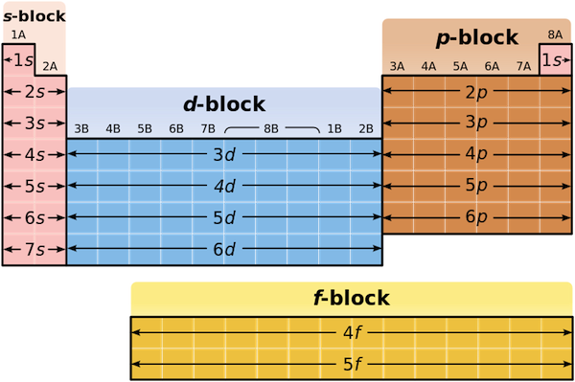
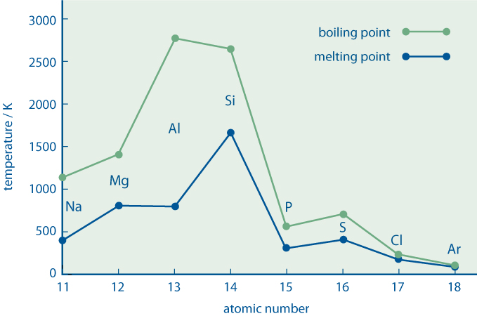
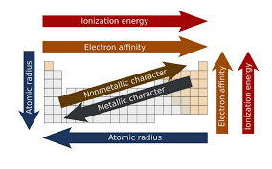
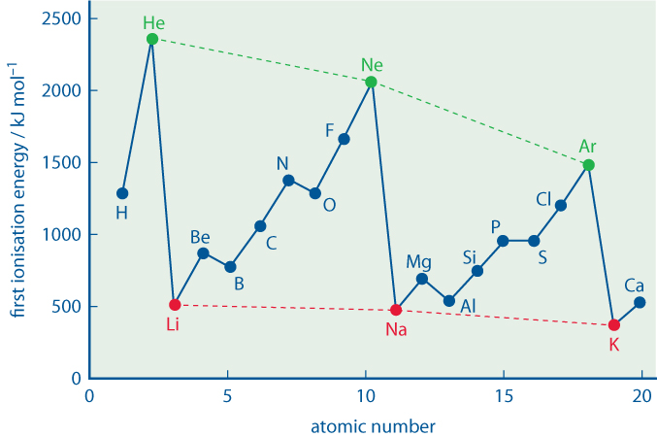
Module3: Periodicity
2. The periodic table.
An element is classified as s, p, d or f block according to its position in the Periodic Table, which is determined by its proton number so on the nature of the orbital into which the last electron of the atom enters.
1. Keywords
Periodicity | The quality or character of being periodic; the tendency to recur at intervals.
First ionisation energy | The energy needed to remove 1 electron from each atom in 1 mole of gaseous atoms. M(g) → M⁺ (g) + e⁻
Second ionisation energy: | The energy needed to remove 1 electron from each atom in 1 mole of gaseous +1 ions. M⁺ (g) → M²⁺ (g) + e⁻
Successive ionisation energies: | Removing each electron in turn from a mole of gaseous atoms. Provides evidence of energy levels and orbitals
Atomic radius | a measure of the size of its atoms, usually the mean or typical distance from the center of the nucleus to the boundary of the surrounding shells of electrons.
3. Melting and boiling point across period 3
Trends in melting and boiling point are explained based on the intermolecular forces between the molecules.
 | Structure | MP/BP
Metal (Na,Mg,Al) | Electrostatic | Low
Semi Metal (Si) | Macromolecular | High
Non Metal (P4,S8,Cl2) | Small molecules substances | Low
Noble gas (Ar) | Monoatomic | Low
4. Atomic radius
The atomic radii are taken to be the half distance between the centres of a pair of atoms. Atomic radius decreases across each period and increases down a group
5. Ionisation energy
Ionisation energy increases across a period. Ionisation energy decreases going down a group.

Slide 2
Module3: Group II
1. Physical properties
Trends in group II, Beryllium is not typical of the group and it is not considered here.
Symbol | Z | Atomic radius (nm) | Melting point (K) | 1st ionisation energy (kJ/mol) | Density ρ
Mg | 12 | 0.160 | 650 | 738 | 1.74
Ca | 20 | 0.197 | 842 | 590 | 1.54
Sr | 38 | 0.215 | 777 | 550 | 2.60
Ba | 56 | 0.218 | 727 | 503 | 3.52
2. Reactivity with water
Reactivity with water INCREASES down the group. Magnesium reacts slowly with liquid water, but rapidly when heated in the presence of steam.
0 +1 +2 0 M(s) + 2H₂O(l) → M(OH)₂(aq) + H₂(g)
3. Hydroxides and sulphates - solubility
Hydroxides – M(OH)₂
Varying solubility in water. Solubility INCREASES as you descend the group. pH of the hydroxide in water varies. pH increases as you descend the group.
Sulphates – MSO₄
Colourless solids Solubility DECREASES as you descend the group. Thermal Decompose to form MO(s) and CO₂(g). Thermal stability increases as you descend the group.
4. Application of group II compounds
Chemical | Common name | Applications
Mg(OH)₂ | Milk of magnesia | Treat indigestion, heartburns and wind.
Ca(OH)₂ | Slaked lime | Neutralise fields and polluted lakes.
BaSO₄ | Barium meal | Contrast medium for gut X-ray.

Slide 3
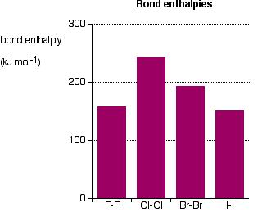
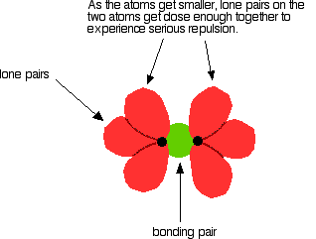
Module3: Group VII
Keywords
Mean bond Enthalpy: | The average enthalpy change when one mole of a specific bond is broken in a range of different gaseous compounds.
Displacement: | A displacement reaction is a type of reaction in which part of one reactant is replaced by another reactant.
Electronegativity: | The power of an atom to attract the electrons in a covalent bond.
2. Physical properties
Trends in group VII. A number of properties of Fluorine are untypical, this mainly stem from the fact that the mean bond enthalpy of the F-F bond is unexpectedly low. This is due to electron repulsion.
Symbol | Z | Electronegativity | Atomic (covalent) radius (nm) | Melting point (K) | Boiling point (K)
F | 9 | 4.0 | 0.071 | 53 | 85
Cl | 17 | 3.0 | 0.099 | 8172 | 238
Br | 35 | 2.8 | 0.114 | 266 | 332
I | 53 | 2.5 | 0.133 | 387 | 457
3. Physical states
The physical state of the halogens are summarised below.
Symbol | In pure form | In non-polar solvents | In water
F | Pale yellow gas | (Reacts with solvents) | (Reacts with water)
Cl | Pale green gas | Pale green solution | Pale green solution
Br | Dark red liquid | Orange solution | Orange solution
I | Grey solid | Purple solution | Insoluble
4. Oxidising abilities – Displacement reactions
The oxidising ability of the halogens decreases down the group. You cannot investigate the oxidising ability of Fluorine in aqueous solution because it reacts with water.
 | F ⁻ | Cl ⁻ | Br ⁻ | I ⁻
F₂ | - | yes | yes | yes
Cl₂ | no | - | yes | yes
Br₂ | no | no | - | yes
I₂ | no | no | no | -

Slide 4
Module3: Reactivity of halide ions and chlorine.
Keywords
Disproportionation: | a reaction in which a substance is simultaneously oxidized and reduced, giving two different products..
Precipitate (ppt): | deposited solid formed in a solution.
3. Reaction with concentrated sulphuric acid
Solid halides react with concentrated sulphuric acid giving different products based on their reducing powers.
Summary table
Chemical reactions. | Reaction A | Reaction B | Reaction C | Reaction D | Observations
Products | MeHSO₄ | SO₂ | S | H₂S
Cl ⁻ | √ | × | × | × | Steamy fumes (HCl) Ppt (MeHSO₄)
Br ⁻ | √ | √ | × | × | Steamy fumes (HBr) Brown fumes (Br₂) Pungent gas (SO₂)
I ⁻ | √ | √ | √ | √ | Steamy fumes (Hl) Black ppt (I₂) Rotten egg smell (H₂S) Yellow ppt (S)
Reaction A | MeX(s) + H₂SO₄(l) → MeHSO₄ (s) + HX(g) |  |  |  |  | Types of reaction
Reaction B | 2H⁺ (aq) + 2X⁻ (aq) + H₂SO₄ (l) → SO₂ (g) + 2H₂O (l) +X₂ (l) |  |  |  |  | Acid-base
Reaction C | 6H⁺ (aq) + 6X⁻ (aq) + H₂SO₄ (l) → S(s) + 4H₂O (l) + 3X₂ (s) |  |  |  |  | Acid-base and redox
Reaction D | 8H⁺ (aq) + 8X⁻ (aq) + H₂SO₄ (l) → H₂S(g) + 4H₂O (l) + 4X₂ (s) |  |  |  |  | Acid-base and redox
2. Reducing strength
The reducing ability of the halide ions increases down the group.
Symbol | Atomic radius (nm)
F ⁻ | 0.133
Cl ⁻ | 0.180
B r⁻ | 0.195
I ⁻ | 0.215
4. Reaction with silver ions
All metal halides (but fluoride) react with silver ion to form an insoluble precipitate. Dilute nitric acid is added before the reaction to get rid of any carbonate or hydroxide impurities. Ag⁺ (aq) + X⁻ (aq) → AgX (s)
Symbol | Observation | Halide salt solubility
Cl ⁻ | White ppt | Dilute NH₃
B r⁻ | Cream ppt | Concentrated NH₃
I ⁻ | Pale yellow ppt | Insoluble in NH₃
5. Reactivity of chlorine
Reactivity with water:
Cl₂(g) + H₂O(l) ⇋ HCl(aq) + HClO(aq) "chlorine water“ | Disproportionation reaction
Reactivity with water in sunlight:
2Cl₂(g) + 2H₂O(l) → 4HCl(g) + O₂ (g) | Goes from pale green to colourless
Alternative chlorination of swimming pools:
NaClO(s) + H₂O(l) ⇋ Na⁺(aq) + OH⁻(aq) + HClO(aq) | Water is kept slightly acidic
Reactivity with alkali:
Cl₂(g) + 2NaOH(aq) → Cl⁻(aq) + NaClO(aq) + H₂O(l) | Disproportionation reaction

Slide 5
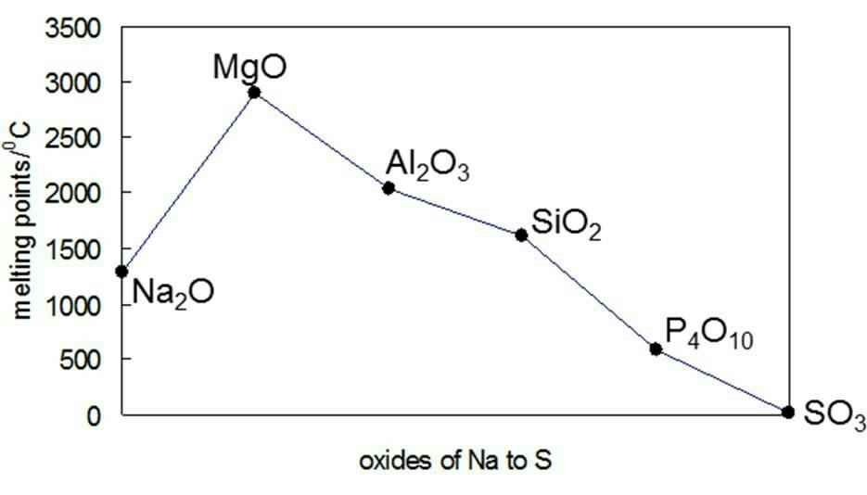
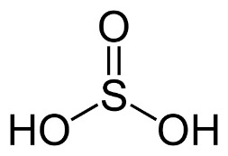
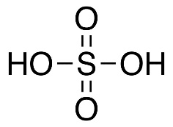
Module3: Period 3
2. Reactivity
Reactivity with water (only Na, Mg, Cl₂):
2Na(s) + 2H₂O(l) → 2NaOH(aq) + H₂(g) Mg(s) + 2H₂O(l) →Mg(OH)₂(aq) + H₂(g) Mg(s) + H₂O(g) →MgO(s) + H₂(g) Cl₂(g) + H₂O(l) ⇋ HCl(aq) + HClO(aq) |  | Faster with steam
Reactivity with oxygen:
4Na(s) + O₂(g) → 2Na₂O(s) | Bright yellow flame forming white sodium oxide
2Mg(s) + O₂(g) → 2MgO(s) | Bright white flame forming white magnesium oxide.
4Al(s) + 3O₂(g)→ 2Al₂O₃(s) | Bright white flame in a gas jar forming white Al₂O_{3.}
Si(s) + O₂(g) → SiO₂(s) | Reacts only when heated.
4P(s) + 5O₂(g) → P₄O₁₀(s) | Red P reacts when heated. White P reacts spontaneously + white smoke.
S(s) + O₂(g) → SO₂(g) | Reacts when heated and lowered in a gas jar forming a colourless gas.
1. Keywords
Amphoteric: | able to react both as a base and as an acid.
4. Reactivity of Period 3 oxides with acids/bases
Na₂O | Na₂O(s) + 2HCl(aq) → 2NaCl(aq) + H₂O(l) | Alkali
MgO | MgO(s) + 2HCl(aq) → MgCl₂(aq) + H₂O(l) | Alkali
Al₂O₃ | Al₂O₃(s) + 6HCl(aq) → 2AlCl₃(aq) + 3H₂O(l) Al₂O₃(s) + 2NaOH(aq) + 3H₂O(l) → 2NaAl(OH)₄(aq) | Amphoteric
SiO₂ | SiO₂(s) + 2NaOH(aq) → 2Na₂SiO₃(aq) + H₂O(l) | Weak acid
P₄O₁₀ | P₄O₁₀(s) + 12NaOH(aq) → 4Na₃PO₄(aq) + 6H₂O(l) | Acid
SO₂ | SO₂(g) + 2NaOH(aq) → Na₂SO₃(aq) + H₂O(l) | Acid
5. Reactivity of Period 3 oxides with water
Na₂O | Na₂O(s) + H₂O(l) → 2NaOH(aq) | pH = 14
MgO | MgO(s) + H₂O(l) → Mg(OH)₂(aq) | pH = 9
Al₂O₃ | Insoluble no reaction | pH = 7
SiO₂ | Insoluble | pH = 7
P₄O₁₀ | P₄O₁₀(s) + 6H₂O (l) → 4H₃PO₄(aq) | pH = 1-2
SO₂ | SO₂(g) + H₂O(l) → H₂SO₃(aq) | pH = 2-3
SO₃ | SO₃(g) + H₂O(l) → H₂SO₄(aq) | pH = 0-1
3. Period 3 oxides melting points
Na₂O/1548 K | Ionic structure = high melting points.
MgO/ 3125K | Ionic structure = high melting points. Smaller and more highly charged than Na giving a stronger attraction to the oxygen ions
Al₂O₃ /2345K | Ionic structure with covalent character. Very high charge density on the small Al
SiO₂/1883K | Giant covalent structure. Strong covalent bonds Si-O.
P₄O₁₀ /573K | Simple molecular compounds = low melting points.
SO₃/290K | Simple molecular compounds/weak intermolecular forces = low melting points
SO₂/200K | Simple molecular compounds/weak intermolecular forces = low melting points
SO₂
Sulfuric(IV) acid – H₂SO₃
Sulfuric(VI) acid – H₂SO₄
Phosphoric(V) acid – H₃PO₄

Slide 6
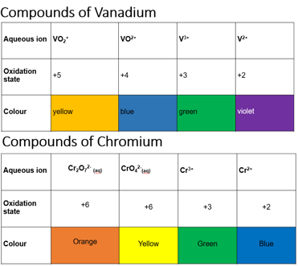
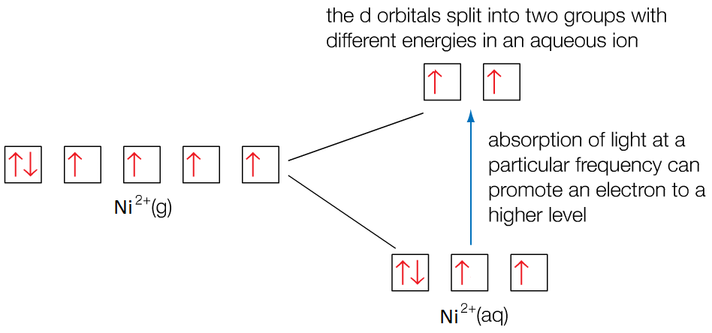
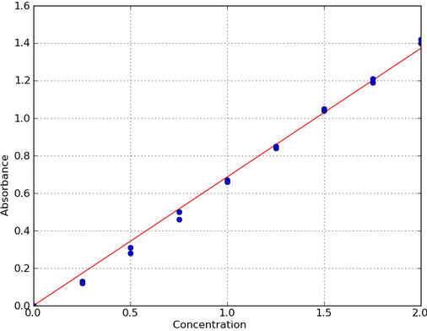
Unit 5a: Transition metals
3. Coloured ion formation
Ions with d¹⁰ or d⁰ are colourless, those partly filled tend to be coloured. Energy is absorbed when an electron is promoted to a higher energy level. The frequency of light is proportional to the energy difference. Electrons in lower 3d sublevels absorb energy from visible light which promotes them to a higher 3d sublevel. The rest of the frequencies are transmitted hence the complementary colour is observed. Factors affecting colour Size & type of ligand Oxidation state Complex shape Coordination number Strength of metal-ligand bond
The size of the energy gap can be calculated if we know the frequency (v) or wavelength (λ) of the light absorbed: ΔE = hv = hc λ ΔE = energy absorbed (J) c = speed of light (3.00 x 10⁸ m s⁻¹) h = Planck’s constant (6.63 x 10⁻³⁴ J s) λ = wavelength of light absorbed (m) v = frequency of light absorbed (Hz)
Colorimetry: we can then determine the concentration by comparing our sample against known concentrations of the same metal ion / ligand. Make up solutions of known concentration. Measure absorption of each known solution Plot a graph of absorption vs concentration Measure absorption of unknown and compare on the graph to give a concentration reading
1. Keywords
Colorimetry: | scientific technique that is used to determine the concentration of coloured compounds using its absorbance
Complex ions: | metal ion surrounded by dative covalently bonded ligands.
Coordination number: | is the number of dative covalent bonds that are formed with central transition metal ion.
2. Classification
A transition metal is an element that forms at least one stable ion with a partially full d-shell. Transition metals have incomplete d sub-shells. When the fourth period metals form ions the 4s electrons are the first to be lost then 3d electrons. Scandium and Zinc are not considered to be transition metals. Scandium forms only a 3+ ion [Ar] 4s⁰ 3d⁰ Zinc forms only a 2+ ion [Ar] 4s⁰ 3d¹⁰ Copper is a transition metal because its +2 ion has an incomplete d orbital. [Ar] 4s⁰ 3d⁹
Chemical properties Form coloured ions Form complex ions Act as good catalysts Variable oxidation states. | Physical properties Shiny Strong Hard Good conductors

Slide 7
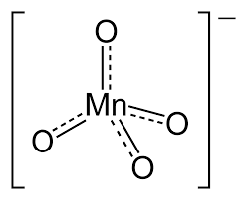
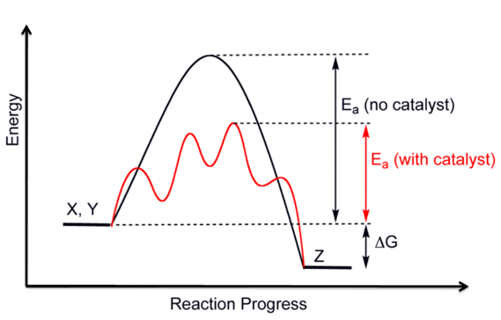
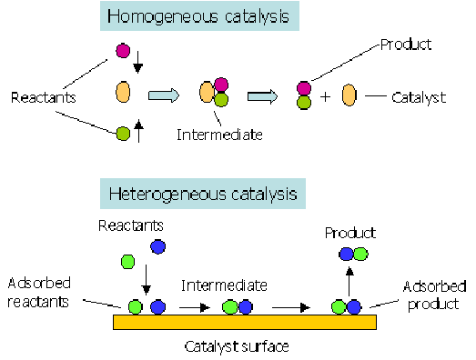
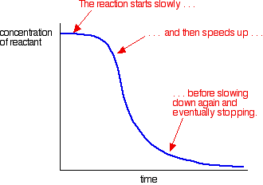
Unit 5b: Transition metals
1. Keywords
Catalyst: | is a substance that increases the rate of a chemical reaction by providing an alternative route with a lower activation energy. The catalyst is unchanged by the reaction.
Heterogeneous catalyst: | is in a different phase from the reactants.
Homogeneous catalyst: | is in the same phase as the reactants.
Ligand: | is an atom, ion or molecule that donates a pair of electrons to a central transition metal .
Redox potential (electrode potential): | is a measure of the intensity of its oxidising power, > affinity for electrons = more positive value.
2. Variable oxidation state
The table shows the oxidation states of the transition metals. (red indicates the most common oxidation states found for that element). Not all of them are stable, only the lower oxidation states exist as stable ions (i.e. Mn 7+ exists only when in a covalent bond). The redox potential for a transition metal ion influenced by pH and by the ligand. In general, oxidation is favoured by alkaline conditions (since there is a higher tendency to form negative ions) and reduction is favoured by acidic conditions.
 |  |  |  | +7
 |  |  | +6 | +6 | +6
 |  | +5 | +5 | +5 | +5 | +5
 | +4 | +4 | +4 | +4 | +4 | +4 | +4
+3 | +3 | +3 | +3 | +3 | +3 | +3 | +3 | +3
 | +2 | +2 | +2 | +2 | +2 | +2 | +2 | +2 | +2
 | +1 | +1 | +1 | +1 | +1 | +1 | +1 | +1
Sc | Ti | V | Cr | Mn | Fe | Co | Ni | Cu | Zn
5. Catalytic activity
Transition metals are good as catalysts either due to a change in oxidation state or they adsorb other substances onto the surface. A partially filled d orbital can be used to form bonds with adsorbed reactants.
Types of catalysts: Heterogeneous catalyst: The reaction occurs at active sites on the surface. Homogeneous catalyst: The reaction proceeds through an intermediate species. Autocatalysis: where the catalyst is a product of the reaction. As a result the rate of reaction increases over time as more product, and therefore catalyst, is produced. Heterogeneous catalysts can become poisoned by impurities blocking the active sites, reducing efficiency. Catalyst can also be lost from the support. This has a cost implication.
Autocatalysis

Slide 8
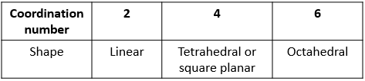
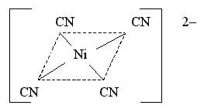
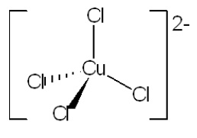
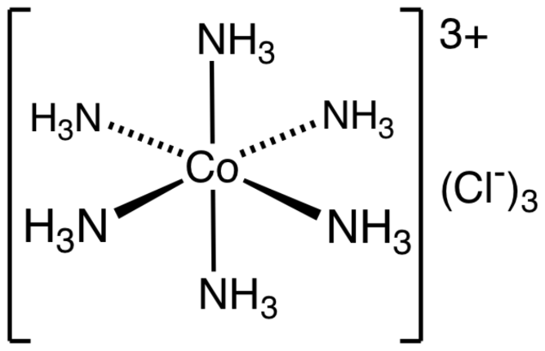
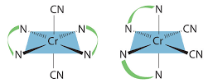
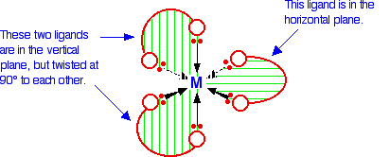
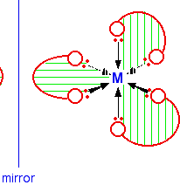
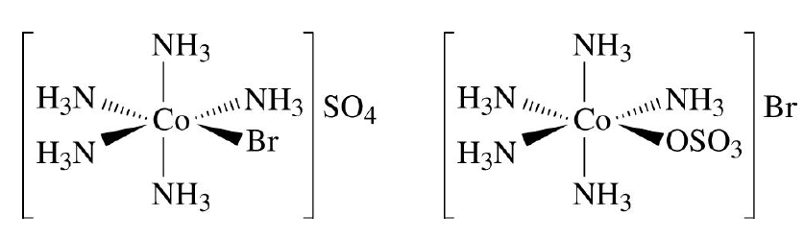
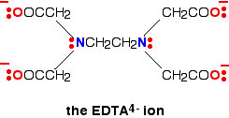
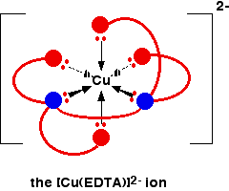
Unit 6: Complex ions
2. Complex ion formation
All transition metals for co-ordinate bonds by accepting electron pairs from other ions or molecules generally called ligands. Different ligands form different strength bonds.
Monodentateligands (single co-ordinate bond): H₂O (Aqua) NH₃ (Ammino] CN⁻ small OH⁻ (Hydroxi Cl⁻ large | Bidentate (two co-ordinate bonds): H₂NCH₂CH₂NH₂ ethane 1,2 diamine (en) C₂O₄²⁻ ethanedioate (oxalate) Benzene 1,2 diol | Multidentate (can form many co-ordinate bonds): Haem EDTA ⁴⁻ which can form 6 co-ordinate bonds
The charge of the complex ion depends on th charge of the transition metal and on the charge and number of the ligand.
1. Keywords
Chelate: | compound containing a ligand bonded to a central metal atom at two or more points.
Coordinate (dative) bond : | a covalent bond where both electrons in the shared pair come from the same atom
Coordination number: | is the number of dative covalent bonds that are formed with central transition metal ion.
Ligand: | is an atom, ion or molecule that donates a pair of electrons to a central transition metal .
Optical isomerism: | when two or more forms of a compound with the same structure are mirror images of each other and typically differ in optical activity.
3. Complex ion shapes
The coordination number dictates the shape of the complex ions.
Types of isomerism can occur in complex ions: Geometrical isomerism – when two molecules have ligands in different position in space. Optical isomerism - when two or more bidentate ligands are in a complex. Ionisation isomerism - when a ligand has exchanged places with an anion or neutral molecule that was originally outside the coordination complex.
Geometrical isomers
Optical isomers
4. Chelate effect
When bidentate or multidentate ligands take the place of monodentate, there are more products than reactants hence entropy of system increases, so products are thermodynamically more stable. The enthalpy change of these reaction is very small but the increase in entropy makes the reaction possible.
[Cu(H₂O)₆]²⁺(aq) + EDTA⁴⁻ (aq) ) ⇋ [CuEDTA]²⁻(aq)+ 6H₂O(l) 2molecules 7 molecules | Gibbs free-energy equation ΔG = ΔH – TΔS Entropy increases = favourable reaction
Ionisation isomers

Slide 9
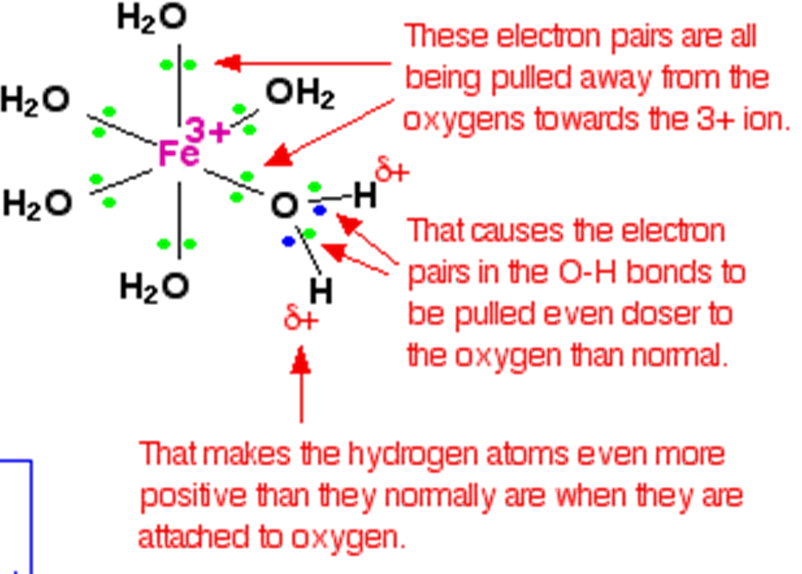
Unit 7a: Reactivity of complex ions
2. Acidity of aqua ion
In general the acidity of M³⁺ will be greater than that of M²⁺; i.e.Fe³⁺ has a greater charge density than Fe²⁺ , there are more positive charges on the same ion and the ion is smaller. So the Fe³⁺ aqua ion (pKa 2.2) is more acidic than the Fe²⁺ (pKa 5.9) aqua ion.
Reaction with OH⁻ (same with NH₃ M³⁺ aqua ion | [M(H₂O)₆]³⁺ (aq) + OH ⁻(aq) -> [M(H₂O)₅(OH)]²⁺ (aq) + H₂O(l) [M(H₂O)₅(OH)]²⁺ (aq) + OH ⁻(aq) -> [M(H₂O)₄(OH)₂]⁺ (aq) + H₂O(l) [M(H₂O)₄(OH)₂]⁺ (aq) + OH ⁻(aq) -> [M(H₂O)₃(OH)₃] (s) + H₂O(l)
M²⁺ aqua ion | [M(H₂O)₆]²⁺ (aq) + OH ⁻(aq) -> [M(H₂O)₅(OH)]⁺ (aq) + H₂O(l) [M(H₂O)₅(OH)]⁺ (aq) + OH ⁻(aq) -> M(H₂O)₅(OH)₂ (s) + H₂O(l)
Reaction with CO₃²⁻ M³⁺ aqua ion | 2[M(H₂O)₆]³⁺ (aq) + 3CO₃²⁻(aq) -> 2[M(H₂O)₃(OH)₃](s) + 3H₂O (l) + 3CO₂(g)
M²⁺ aqua ion | [M(H₂O)₆]²⁺ (aq) + CO₃²⁻(aq) -> MCO₃(s) + 6H₂O (l) CO₃²⁻ does not remove the proton from the complex, it is not a strong enough base. In general carbonates of M³⁺ do not exist, M²⁺ ones do.
1. Keywords
Amphoteric | means can behave as an acid and as a base.
Hydrolisis | the chemical breakdown of a compound due to reaction with water.
2. Aluminium
Aluminium hydroxide is the most often quoted example of an amphoteric hydroxide.
Acting as an acid | [Al(H₂O)₆]³⁺ (aq) + OH⁻ (aq) → [Al(H₂O)₅OH]²⁺ (aq) + H₂O (l) [Al(H₂O)₅OH]²⁺ (aq) + OH⁻ (aq) → [Al(H₂O)₄(OH)₂ ]⁺ (aq) + H₂O (l) [Al(H₂O)₄(OH)₂ ] ⁺ (aq) + OH⁻ (aq) → [Al(H₂O)₃(OH)₃] (s) + H₂O (l) This ion will dissolve. What you see occurring is the precipitation of neutral aluminium hydroxide and then the re-dissolving of it. The aluminium hydroxide has acted as an acid. [Al(H₂O)₃(OH)₃](s) + OH⁻(aq) → [Al(OH)₄]⁻(aq) + 3H₂O(l)
Acting as a base. | [Al(H₂O)₃(OH)₃] (s) + 3HCl (aq) → [Al(H₂O)₆ ]³⁺ (aq) + 3Cl⁻ (aq) [Al(H₂O)₃(OH)₃](s) + H⁺(aq) → [Al(H₂O)₄ (OH)₂]⁺ (aq) [Al(H₂O)₄ (OH)₂]⁺ (aq) + H⁺(aq) → [Al(H₂O)₅ (OH)]²⁺ (aq) [Al(H₂O)₅ (OH)]²⁺ (aq) + H⁺(aq) → [Al(H₂O)₆ ]³⁺ (aq)

Slide 10
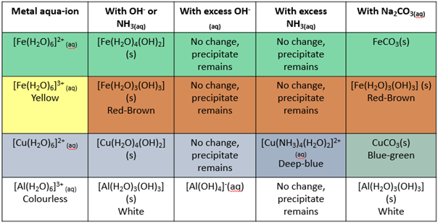
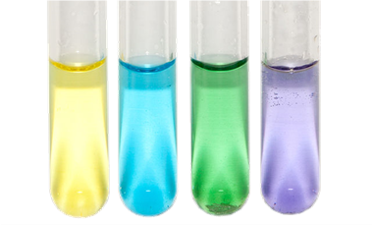
Unit 7b: Reactivity of complex ions
1. Ligand exchange
Ligands can be swapped around, this is called ligand exchange. It usually results in a colour change. This happens when: The new ligand can form stronger bonds with the metal ion The new ligand is more concentrated
Replacing water as a ligand
with a neutral ligand Complete substitution | [M(H₂O)₆]²⁺ (aq) + NH₃(aq) ⇋ [M(NH₃)₆]²⁺ (aq) + 6H₂O (l) the coordination number doesn’t change and neither does the shape.
with a neutral ligand Partial substitution (Cu²⁺) | [Cu(H₂O)₆]²⁺_{(aq)} + 4NH_{3(aq)} ⇋ [Cu(NH₃)₄(H₂O)₂]²⁺_{(aq)} + 4H₂O_{(l} Ammonia first will acts as a base and then as a ligand. the coordination number doesn’t change and the shape is still octahedral but it is now a distorted octahedral, this is because water has longer bonds with Cu since it has less affinity.
with other charged ligands (Cu²⁺) | [Cu(H₂O)₆]²⁺ (aq) + 4Cl⁻ (aq) ⇋ [CuCl₄]²⁻ (aq)+ 6H₂O (l) Change in the coordination number and in the shape
with a multidentate ligand | See chelate effect Unit 6 Change in the coordination number and in the shape forming more stable complex.
Colours of Vanadium oxidation states
V IV III II

