Slide 1

BTEC National Sport
Level 3
Unit 6: Sport Psychology

Slide 2
Learning Aims
A – Understand how personality, motivation and competitive pressure can affect performance
B – Examine the impact of group dynamics in team sports and its effect on performance
C – Explore psychological skills training programmes designed to improve performance

Slide 3
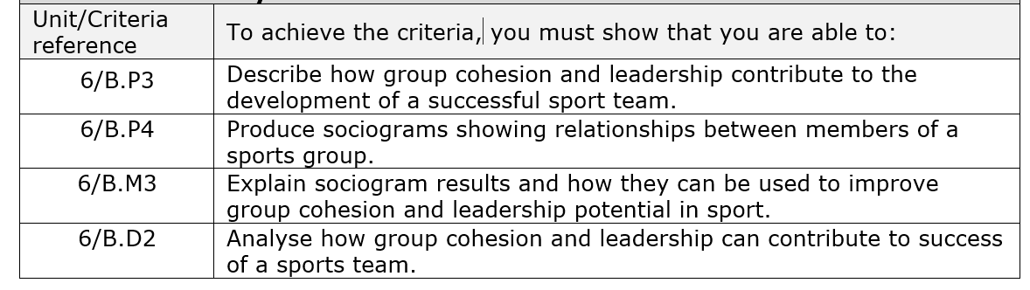
Impact of Processes, Cohesion and Leadership on Team and Performance
Impact on performance is always key concern when thinking about group effectiveness, there can be positive and negative impacts…

Slide 4
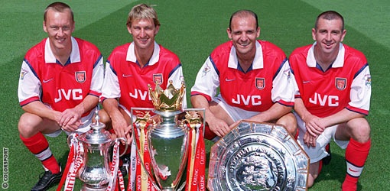
Impact of Processes, Cohesion and Leadership on Team and Performance - Positive
Increase in performance
Everyone having clear and assigned roles that they understand and fulfil well
Work towards common goal
Maintain clear communication

Slide 5
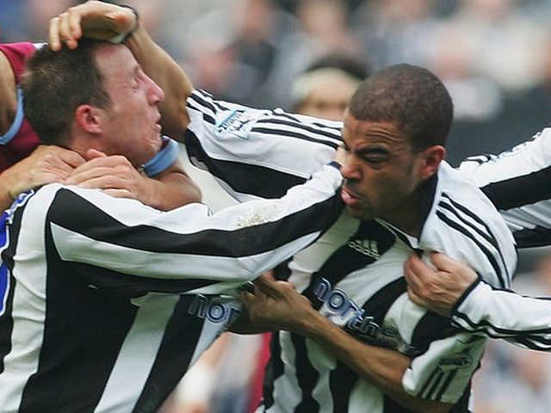
Impact of Processes, Cohesion and Leadership on Team and Performance - Negative
Lack of cohesion, poor level of leadership (decrease in performance)
Misunderstandings of roles & responsibilities
Poor or lack of communication
Selfish or greedy members
Increased chance of social loafing

Slide 6
Sociograms

Slide 7
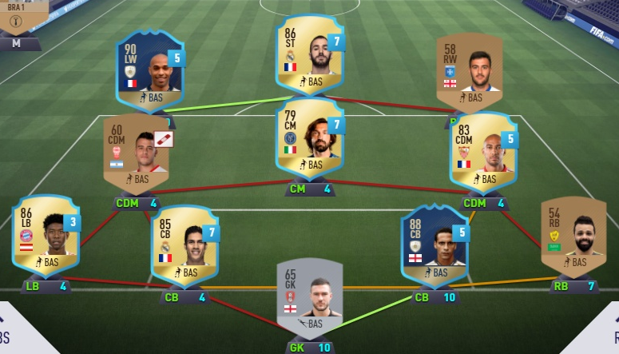
Sociograms
Way of measuring group cohesion by showing ways in which different team members relate to each other.
Monitor group interactions
Athlete’s choices
Preferences of individuals in group
Identify relationships in team
Identifying leadership potential
Instances of ATTRACTION & REJECTION in a group

Slide 8
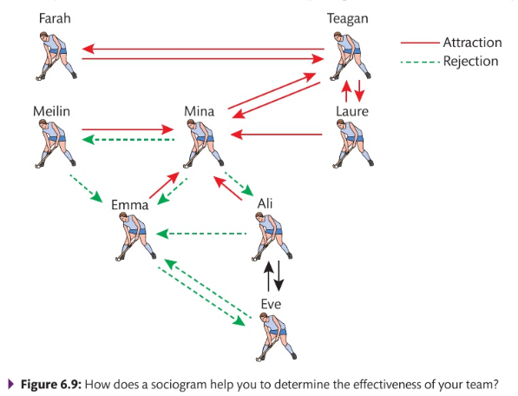
Constructing Sociograms
Asking team members questions (anonymously) responses into diagram
For accuracy: HONESTY – reinforced by confidentiality
Questions and statements could include:
- Name 3 people that you enjoy training with the most and 3 that you enjoy training with the least.
Name 3 people you would most like to share a room with on trip and 3 that you would not like to.
Most frequently selected individuals go towards the middle of the sociogram & least towards the outside.

Slide 9
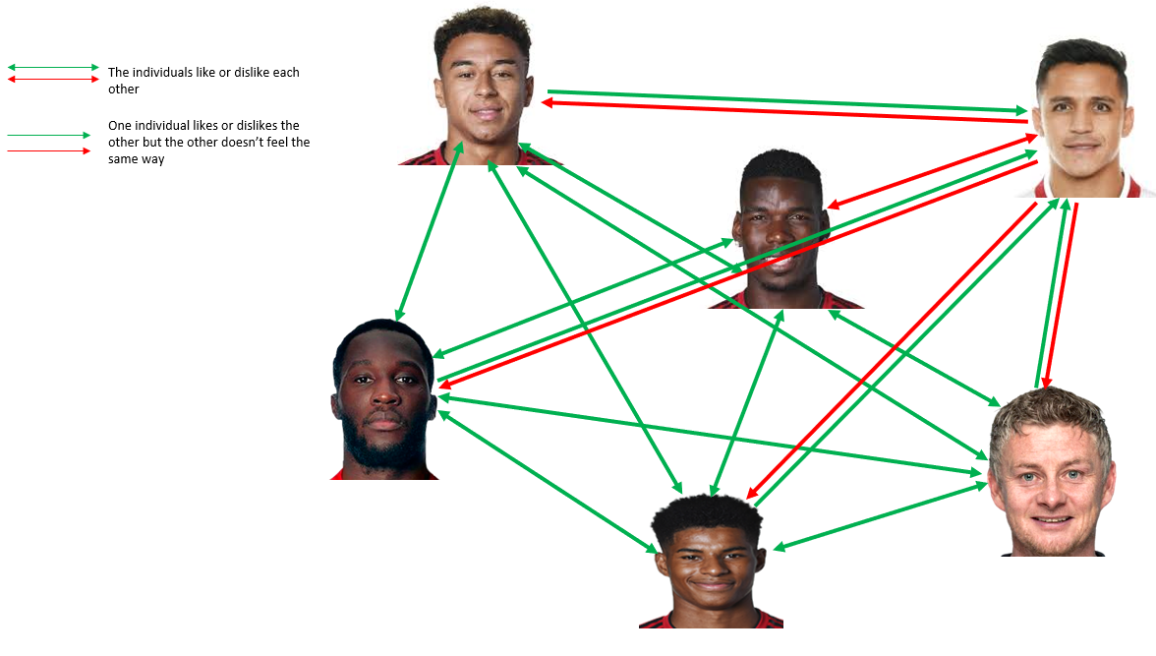
Example Sociogram – Manchester United

Slide 10
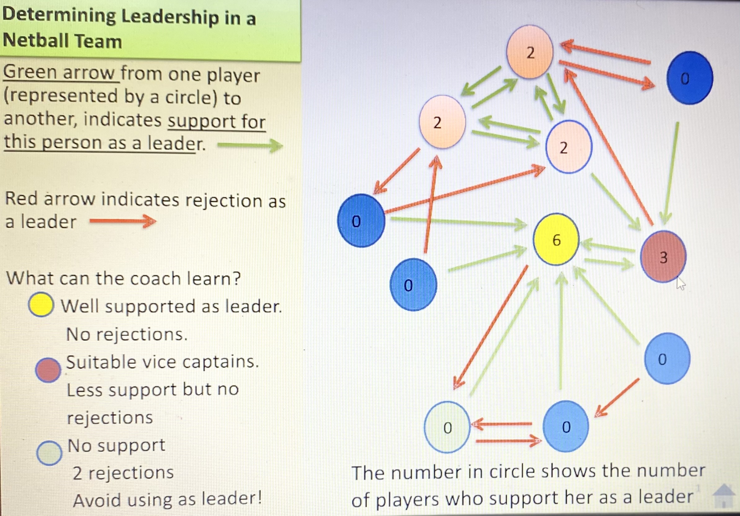

Slide 11

TASK
Construction of the sociograms should include the following features:
Relationships in a team
Effectiveness of group processes, group cohesion and leadership potential in the group
Social relations
Channels of influence
Lines of communication
Using any sports team of your choice and then yourself and your own team, design two sociograms like the Manchester United example and then try to analyse what they show.
When analysing what they show and the impact it could have on the teams performance , try to link to the following areas and any other relevant content you have already covered in unit 6:
Once you’ve analysed your sociograms, think of what a coach or manager would do with this information. What does it show the manager? What would he / she need to change on and off the pitch? Why would they need to change anything?

