Slide 1

BTEC National Sport
Level 3
Unit 6: Sport Psychology

Slide 2

Learning Aims
A – Understand how personality, motivation and competitive pressure can affect performance
B – Examine the impact of group dynamics in team sports and its effect on performance
C – Explore psychological skills training programmes designed to improve performance

Slide 3
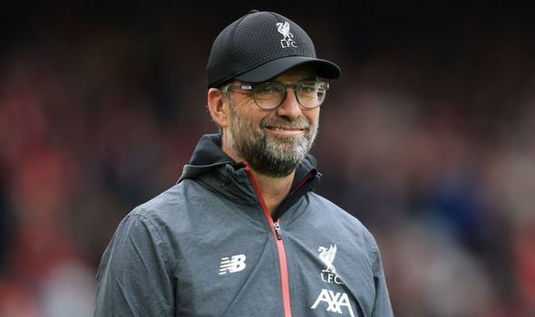
LEADERSHIP IN CREATING EFFECTIVE GROUPS
Leadership is an important aspect of creating effective groups. Leaders need passion and they need to inspire people. However, being a leader is difficult, so the first stage of understanding leadership is understanding some of the theories behind leadership.
This Photo by Unknown Author is licensed under CC BY-NC-ND

Slide 4
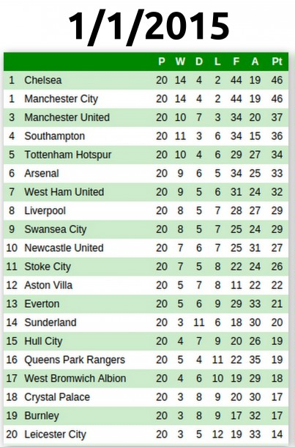

Slide 5
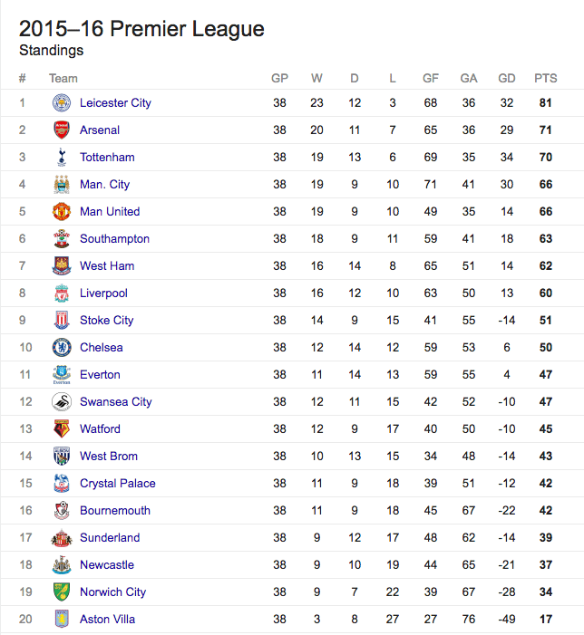
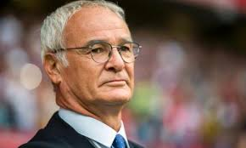
Did this mans leadership make the difference?????

Slide 6
Assignment Brief 2
Section 3: Leadership in creating effective groups
Analyse Theories of leadership – trait approach, behavioural approach, interactional approach, multi-dimensional model.
Analyse the difference between prescribed and emergent leaders and how this might affect a sports group.
Analyse leadership styles – autocratic, democratic and laissez-faire

Slide 7
Theories of Leadership
There are four main theories of leadership, they are as follows:
TRAIT
BEHAVIOURAL
INTERACTIONAL
MULTI-DIMENSIONAL

Slide 8

Trait Approach
Certain personality characteristics that predispose an individual to be a good leader.
Leaders are born, not made
Innate and good leader will be good in any situation
No definitive traits that characterise a good leader

Slide 9
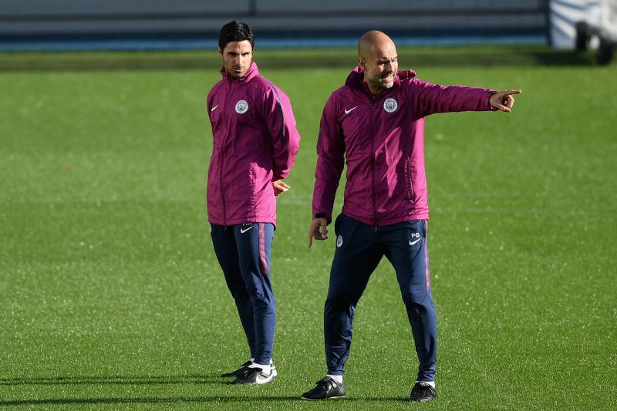
Behavioural Approach
Good leader is made, not born.
Anyone can learn to be a good leader.
Observing good leaders’ behaviours in different situations
Discovering leadership by all great leaders
Mutual trust, earn/show respect, communicate, organisational skills & clear examples of how things can be done
Observation → Reproduction → Reinforcement
TASK 1 - Explain why each of the behaviours listed under ‘Behavioural Approach’ demonstrates good leadership. Can you think of any other behaviours that might be important?

Slide 10

TASK 2
Using 2 sporting examples describe how might both the Trait and Behavioural approach work?
Is there a type of theory in which you think is best?
Pause and this task to your notes.

Slide 11
Interactional Approach
Considers interaction between individual and their situation
2 main types of leader:
TASK ORIENTATED
Concerned with meeting goals & objectives
Create plans, decide on priorities
Assign members to task
Ensure they stay on task
Increasing group productivity
Effective with less experienced/skilled performers who need constant feedback
RELATIONSHIP ORIENTATED
Work hard to maintain communication with members
Develop respect and trust
More effective with experienced, highly skilled athletes

Slide 12
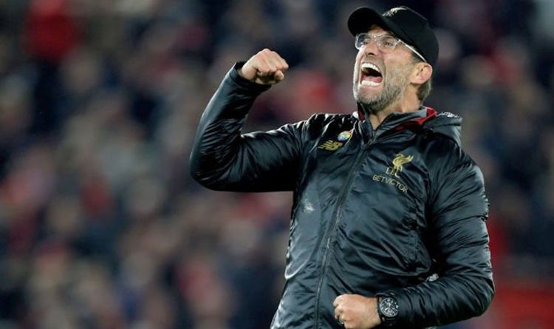
Interactional Approach
Different athletes will prefer task or relationship leaders
Leader who gets right balance – providing support & getting job done is most effective leader
Important to know your performers so know where to concentrate efforts.
Most leaders will adapt between task and relationship based on situation.

Slide 13
TASK 3
Other than my Jurgen Klopp example can you provide 2 different sporting examples of the interactional approach? Ensure you give detail in your explanations.
Pause and add this task to your notes.

Slide 14
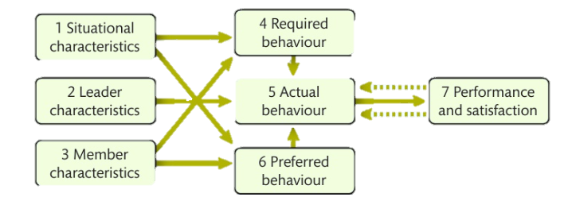
Multidimensional Model of sport leadership – Chelladurai, 1978
Antecedents
Leader Behaviour
Consequences

Slide 15
Multidimensional Model
Chelladurai’s 1978 Model, states that team’s performance and satisfaction with the leader will be highest if the leader’s required, preferred and actual behaviours all agree.
Leader must use interactive approach to balance aspects of situation, leader and group.
Leader to use approach that suited the situation and needs of group = more satisfaction from group
Individual sport could result in different style than a team game
Difficult or complex task may require more time to explain – short turn around (efficient approach)
Size of group – Large: Authoritarian approach to maintain control, Small: Opportunity for discussion
Dangerous situation: Autocratic – why?

Slide 16
The leader's required behaviours are generally determined by the situation the leader is in (e.g. the sporting organisation) and the expectation that the leader conforms to the expected norms.
For example, how many times have you seen a football manager punished by the Football Association for criticising a referee after a game? The established norm is that leaders should not criticise match officials, so that is the behaviour expected of the leader.

Slide 17
The preferred behaviour is determined by the people within the group or team Their preferences relate to factors including personality, experience and skill of the athletes; and non-sport related aspects such as age and gender.
For example, a senior elite athlete might expect their coach to behave differently towards them than they would towards a youth-level athlete just starting their career.

Slide 18
The actual behaviour is directly determined by the characteristics of the leader, and indirectly by the situational factors and the preferences of the group.
For example, a grass roots sports coach might adopt more relationship-orientated behaviours because their primary goal is to enhance enjoyment and maintain young people's sport participation, whereas a coach in a world championship final might display more task-orientated leadership to try to maintain the team's focus on winning.

Slide 19
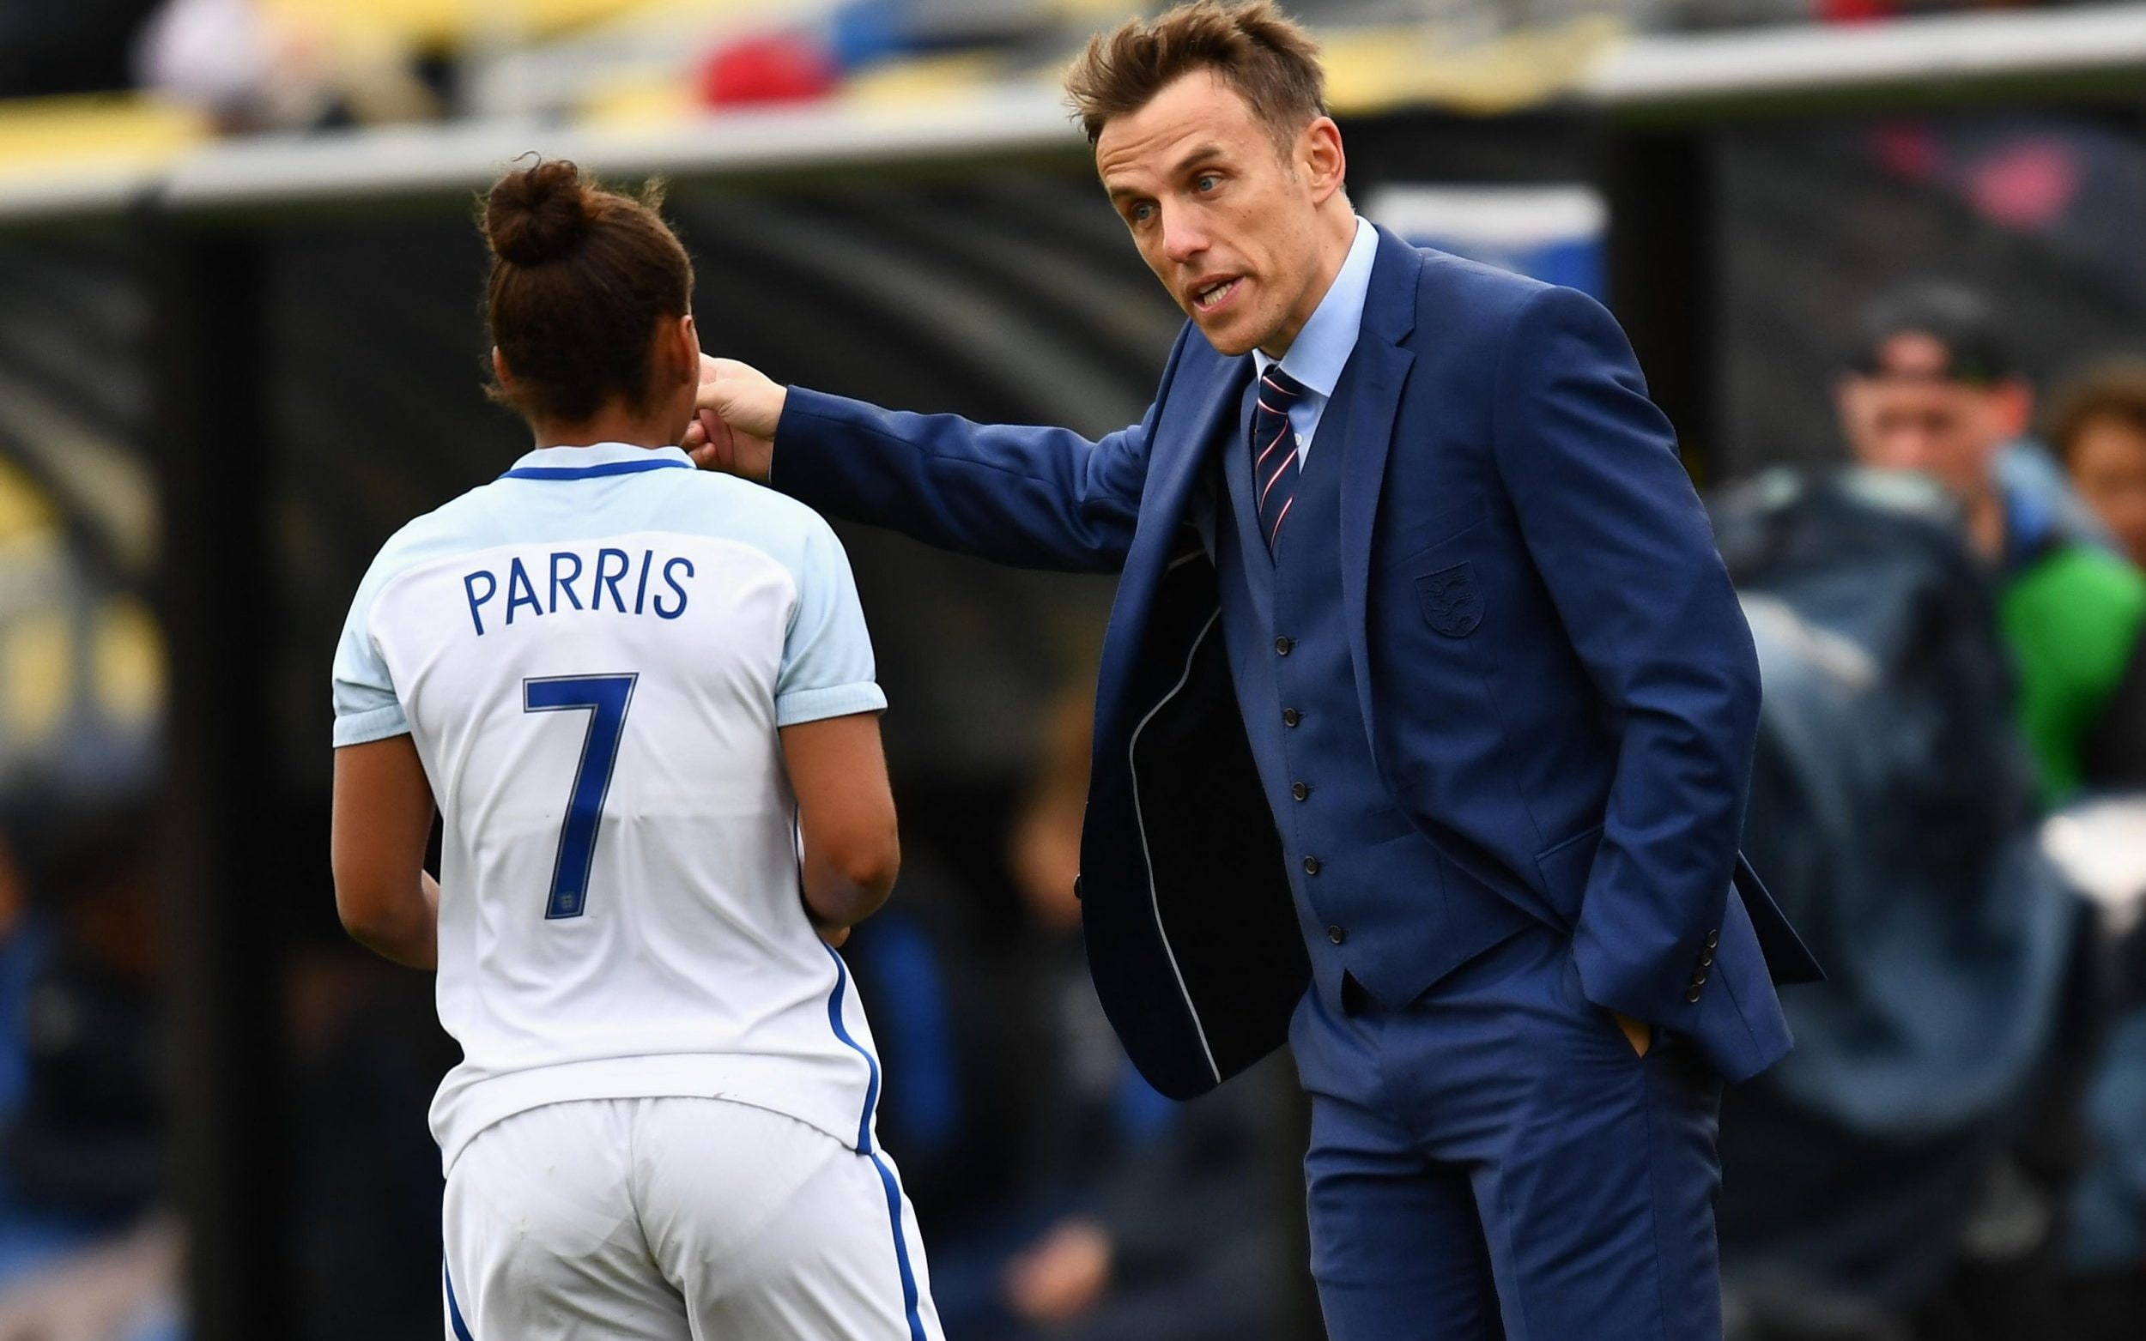
Multidimensional Model
Features of group may affect choice of leadership,
Women – empathy and consultation as opposed to autocratic approach to training
An able group – allow some flexibility, allowing group to use experience to decide, beginners being told what to do.
Age of group – older group = more experience, younger group – welcome new information

Slide 20
TASK 4
How can you relate Chelladurai’s model using at least two different sporting examples?
Pause and write this task in your notes.

Slide 21
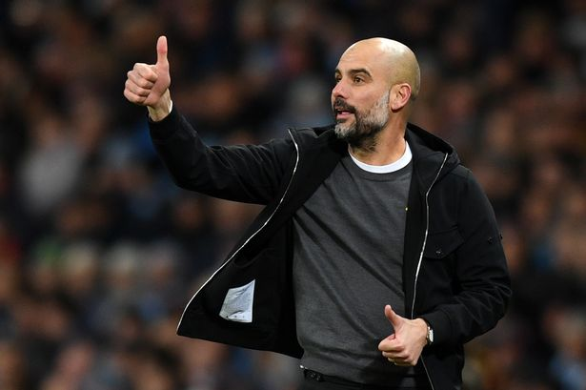
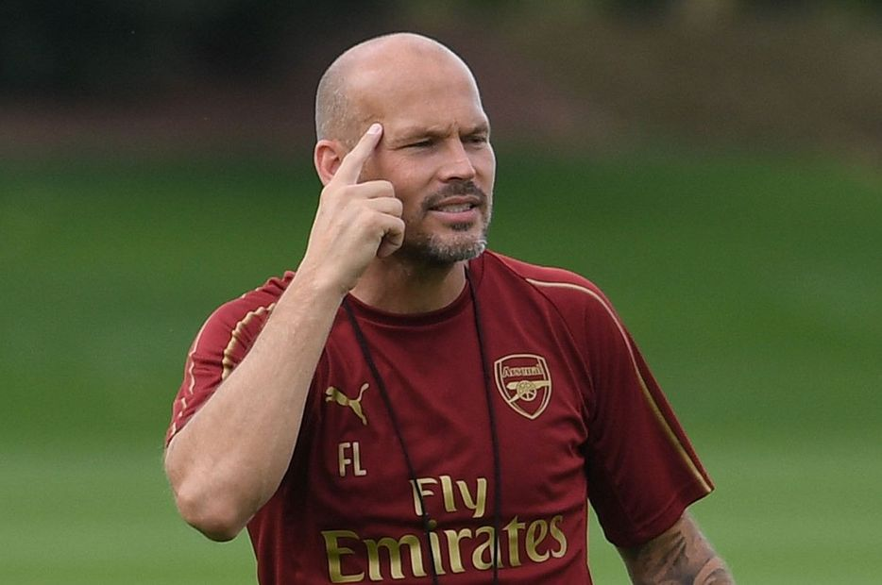
Prescribed vs Emergent Leaders
PRESCRIBED
Appointed from outside the group, perhaps from another group or higher authority. Often because group may wish to take on new ideas and learn new methods
EMERGENT
Achieve leadership status by showing skills or being skilful at their sport, gaining respect and support of the group.

Slide 22

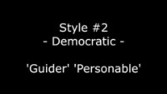
Leadership Styles
There are 3 main styles of Leadership:
Autocratic
Democratic
Laissez-Faire
TASK 5 - WATCH these YouTube clips on these styles and make notes on the different styles.

Slide 23
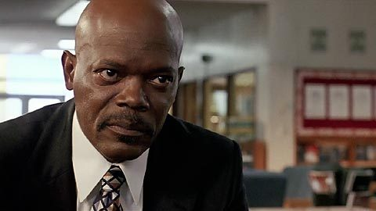
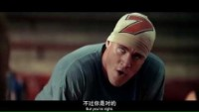
Autocratic
Firm views – how & when things should be done
Inflexible in approach
Dictates who does what
Does not seek views of the group
Concern of leader is to get results and reach targets
Will need to stay with the group / maintain
Coach Carter is a prime example of

Slide 24
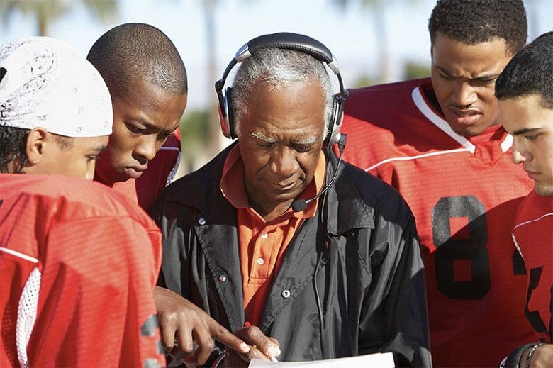
Democratic
More sympathetic approach to leadership
Decisions made after consulting group
Encourage group involvement
Informal and relaxed approach
Value groups input but maintain position as leader by making final decision
Quality of empathy to listen to senior players
Group usually continue to work when coach isn’t present

Slide 25

Laissez-Faire
Does very little and leaves group to it
Tells players what they want, goes away conducts other business
Safe in knowledge that senior players will prepare the team
Less motivated players will stop working if they’re left alone

Slide 26
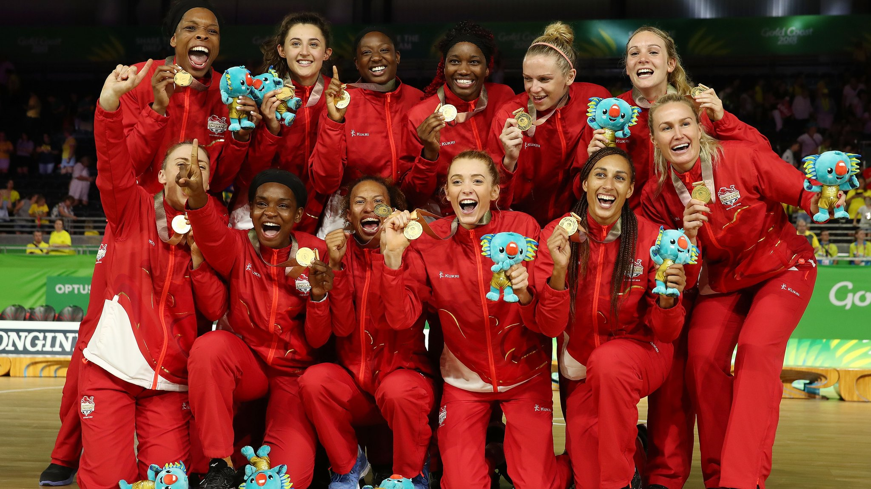
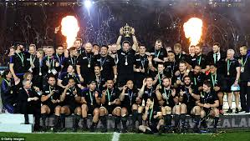
TASK 6
Think of a highly successful sports team over the past few years. Analyse that team and explain why they were so successful using what you have learnt from your section 3 notes on Leadership?

