Slide 1

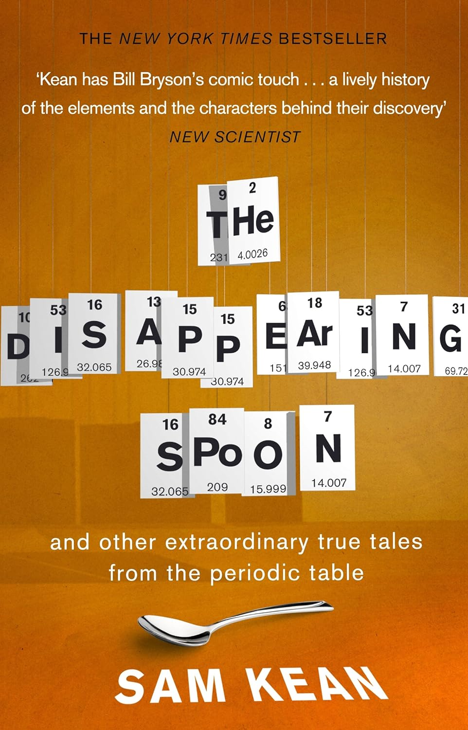
Chemistry at A Level
1. Lessons in Chemistry Bonnie Garmus
2. The Disappearing Spoon Sam Kean
3. The Water Book Alok Jha
4. Ten Drugs Thomas Hager
5. Chemistry for Breakfast Mai Thi Nguyen-Kim
6. Obsessive Genius: The inner world of Marie Curie Barbara Goldsmith
7. Uncle Tungsten Oliver Sacks

