Slide 1

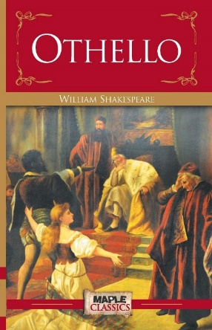




Introduction to A Level English Literature

Slide 2
What can I do over the summer to help prepare me for the course?
READ
WATCH
LISTEN/FOLLOW
RESEARCH

Slide 3

What can I do to prepare?
1. READ!
Classics
Suggested ‘pre-reading’ list
TASK: Choose three books to read before starting Year 12. Ideally, one dystopian novel, one 19th century novel and one Gothic novel – all of which will help prepare you for the A-Level Literature course. Reading some literature from American authors would be a good idea, too.
There are also, of course, other books that do not fall into any of the three categories above but that you may also wish to read for added enjoyment.
Also, consider reading literature by authors who are NOT white and male!
The Big Jubilee Commonwealth Read

Slide 4
Novel and author | Category
Pride and Prejudice – Jane Austen | Romance
To Kill a Mockingbird – Harper Lee | ‘Southern’ gothic
Jane Eyre – Charlotte Bronte | 19th century |  | Gothic
The Great Gatsby – F. Scott Fitzgerald | Tragedy
Birdsong – Sebastian Faulks | War story
1984 – George Orwell | Dystopian
Lord of the Flies – William Golding | Allegory
Brace New World – Aldous Huxley | Dystopian
The Grapes of Wrath – John Steinbeck | American realist, historical
Wuthering Heights – Emily Bronte | 19th century | Gothic
The Catcher in the Rye – J. D. Salinger | Coming of age novel
The Picture of Dorian Gray – Oscar Wilde | 19th century | Gothic
A Passage to India – E.M. Forster | Modernist, psychological
The War of the Worlds – H.G . Wells | Sci-fi | 19th century
The Quiet American – Graham Greene | War story
The Bell Jar – Sylvia Plath | Semi autobiography
Anna Karenina – Leo Tolstoy | 19th century
Frankenstein – Mary Shelley | 19th century | Gothic
Life of Pi – Yann Martel | Philosophical
Catch-22 – Joseph Heller | Satirical war novel
The Curious Incident of the Dog in the Night-Time – Mark Haddon | Mystery
Heart of Darkness – Joseph Conrad | Colonial lit
A Bend in the River – V.S. Naipaul | Post colonial lit
The Count of Monte Carol Cristo – Alexandre Dumas | 19th century | Adventure
Robinson Cruso – Daniel Dafoe | Adventure, historical
The Way We Live Now – Anthony Trollope | 19th century | Satirical
Money – Martin Amis | Satirical
Ulysses –James Joyce | Modernist
Memoirs of a Geisha – Arthur Golden | Historical fiction
The Colour Purple – Alice Walker | Epistolary, historical
Men Without Women – Ernest Hemingway | Short story collection
One Flew over the Cuckoo’s Nest – Ken Kesey | Allegorical
Gulliver’s Travels – Jonathan Swif | Satire, fantasy
The Adventures of Huckleberry Finn – Mark Twain | 19th century
A Christmas Carol – Charles Dickens | 19th century
The Stranger – Albert Camus | Philosophical
The Lord of the Rings – J.R.R. Tolkein | Fantasy
His Dark Materials – Philip Pullman | Fantasy
DYSTOPIA
1984
Brave New World
The Power by Naomi Alderman (2016)
19th CENTURY/GOTHIC
Jane Eyre
Wuthering Heights
The Picture of Dorian Gray
Frankenstein
Dracula
Great Expectations
AMERICAN LITERATURE
Edgar Allan Poe
James Baldwin
Harper Lee
John Steinbeck

Slide 5
What can I do to prepare?
2. WATCH!
Watch a Shakespeare play.
Watch a different version of the same Shakespeare play.
Use youtube to watch a National Theatre Live production of a modern play or adaptation of a literary novel.
Watch a film version of a literary text – search NETFLIX categories, eg:
  “Action and Adventure based on classic literature”
Go to the theatre.
Go and see some live poetry.

Slide 6
What can I do to prepare?
3.
LISTEN/FOLLOW!
Podcasts: Top ten podcasts on literature…
https://blog.feedspot.com/british_literature_podcasts/
Download an audiobook
Tiktok for book recommendations
Instagram to follow poets (@jackcollinspoet – ex-PHGS!)
Join Goodreads.com

Slide 7
What can I do to prepare?
4. RESEARCH!
SOCIAL/HISTORICAL CONTEXT RESEARCH: Do a project on attitudes in Shakespearean/Victorian times
LITERARY CONTEXT RESEARCH: Create an English Literary Heritage timeline (see next slide)
WRITER’S CONTEXT: Write your own mini-biography of a famous author you have heard of
Visit Haworth

Slide 8
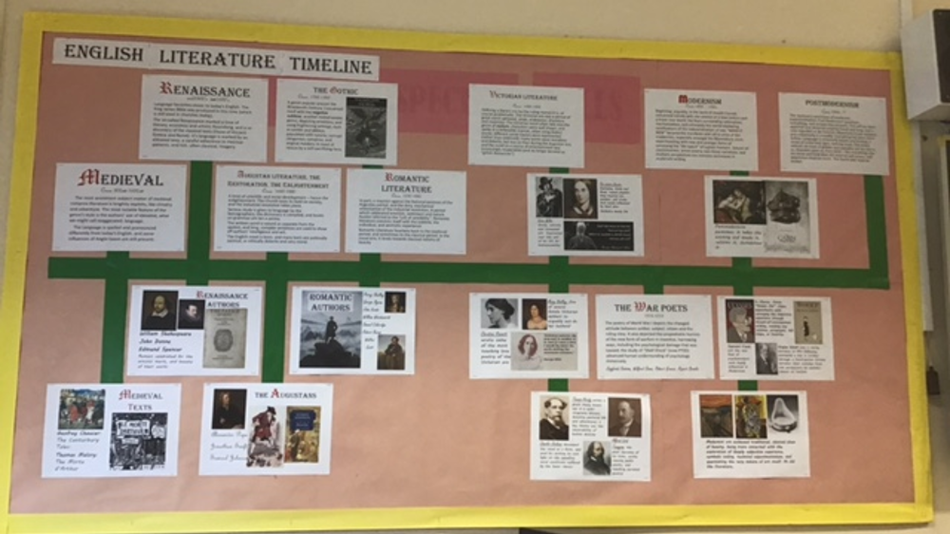

Slide 9

What can I expect from September?
There are a number of new skills you will need to develop to be successful at A-Level and which will be required for Higher Education. These are:
Reading independently
Note-taking in lessons, and writing up notes (laptop)
Filing, and managing a folder
Proof-reading and editing your own drafts
Meeting non-negotiable deadlines
Independent learning and resilience
Revision and re-reading texts

