Slide 1

KS5: Ethics, Philosophy and Religion
Preparing for the course

Slide 2
Aims of today...
What?
To understand how to prepare for starting studying A-level Philosophy, Religion and Ethics
Why?
To have a clear idea of what to expect in September so that you can make a smooth transition onto the course.

Slide 3
Eduqas A-level EPR or Religious Studies
Course Structure: Year 12
Component 1 – Buddhism
Key figures and sacred texts
Central concepts in Buddhism
Buddhist Life
Buddhist Practices
Component 2 – Philosophy
Inductive arguments for the existence of God (Cosmological and teleological)
Deductive arguments for the existence of God (Ontological)
The Problem of Evil
Religious Experience
Component 3 – Ethics
Ethical Thought
Aquinas’ Natural Law theory
Situation Ethics
Utilitarianism
Assessment Structure
3 x 2-hour exams in Year 13 (1 per component)
4 questions per exam
2 questions are knowledge & understanding (AO1) 20 marks each
2 questions are analysis & evaluation (AO2) 30 marks each

Slide 4
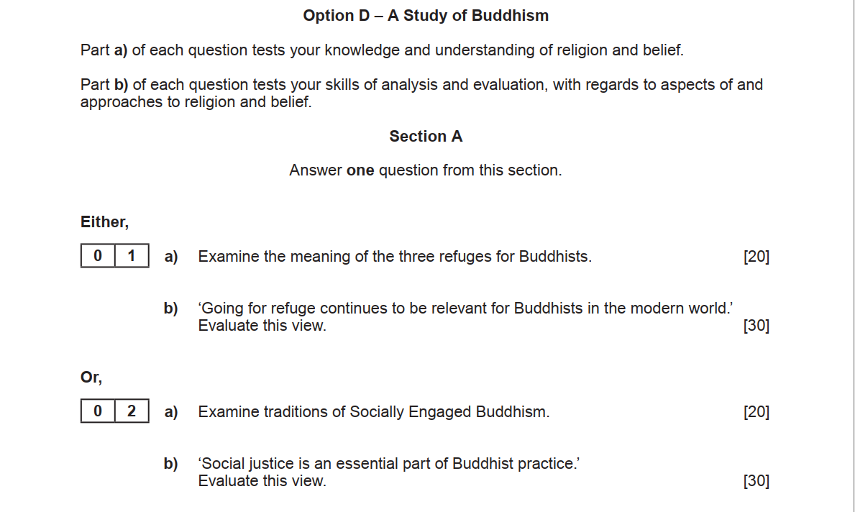

Slide 5
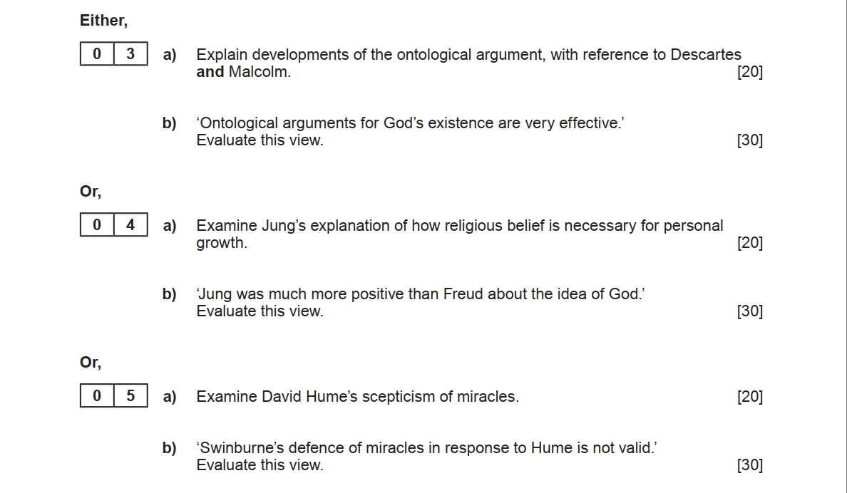

Slide 6
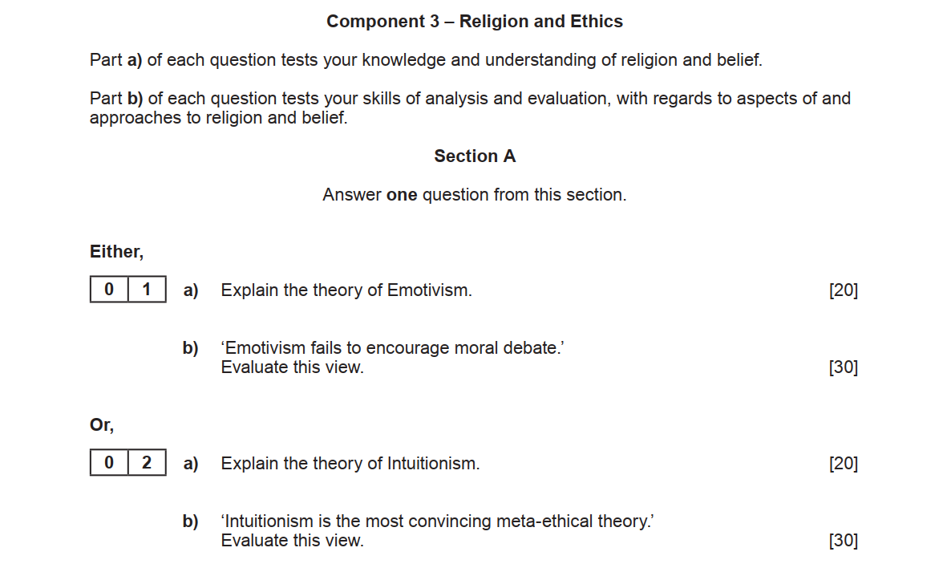

Slide 7
Teaching 2024-25...
Ethics/Buddhism taught by Mrs Willis
Six lessons per fortnight
Philosophy taught by Miss Lenton
Three lessons per fortnight

Slide 8
Internal assessment...
Regular essays throughout the course.
Eg. Philosophy = 20 mark and a 30 mark question for each topic
Year 12 exam week: June 2024
Year 13 exam week: March 2025

Slide 9
Key equipment...
3 x A4 ring binders – one for each component
Plastic wallets
A4 lined paper
Optional:
WJEC AS level/Year 1 textbooks
Philosophy of Religion and Ethics by Gray and Lawson. ISBN 978-1-908682-99-4
Buddhism by Gray. ISBN 978-1-908682-97-0
Available in the library; you do not need to buy these, but some students like to have them for wider reading.

Slide 10
Preparation work...
Key aims of the Summer preparation work:
Become familiar with some of the main ideas in Buddhism.
Recap some of the philosophical arguments covered in Year 9.
Think about your own approach to ethical decision-making.
All available on Sharepoint.

Slide 11

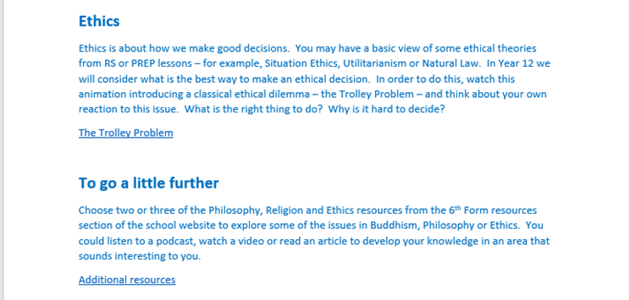

Slide 12
Ethics
(Based on your current level of understanding, how would Situation Ethics and Utilitarianism respond?)
Your close friend has confessed to you that they are cheating on their partner, with whom you are also close. You have been sworn to secrecy, but you hate being a party to their deception. Whichever course you choose will mean betraying a friendship. What would you do?
You’ve been offered a prestigious job at a large multinational company. It’s your ideal role at an increased salary, but the company has a chequered record, having been implicated in several humanitarian disasters in underdeveloped countries. What would you do?
An old friend you have not seen in several years calls you up to say that they need you to lend them a high but ultimately manageable sum of money to help cover the cost of their mother’s funeral. Although they may well be telling the truth, your knowledge of their slightly chaotic past makes you suspect they may have another purpose in mind. What would you do?

Slide 13
Philosophy
Can you make a case for why it is okay to eat some animals (like cows, pigs and lambs) and not others (like dogs, cat or goldfish)?
Imagine that you and your best friend swapped brains: your brain was inserted into their body, and their brain was inserted into yours. Which person would be ‘you’ – the one with your brain in their body, or their brain in yours? Or would it be neither? Or both?
Should people be allowed to keep all the money they can earn? Or should they be made to give some money away to help others? Explain why?

