Slide 1
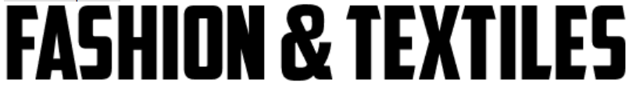
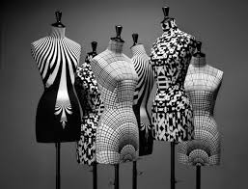

PREPARING FOR
Summer 2024

Slide 2
Considering A level F&T in September 2024?
If you are, then these are activities that you should complete over the summer to prepare yourself for the very large step up to A Level from GCSE.
These activities are designed not only to prepare you for the course but help develop skills which you will be able to draw upon throughout the course.
The activities are divided into:
Essential - suggested as good preparation for the course.
Recommended – suggested to support the essential activities for the course
Optional – suggested to support wider learning around the subject; you are expected to do this independently at A level.

Slide 3
Essential Activities for
Summer 2024

Slide 4
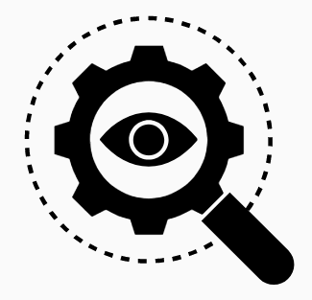
Investigating…
Visit a local gallery, mill or museum and take photos
Salts Mills Saltaire, Bankfield Museum Halifax, Sunnybank Mills Farsley, Hepworth Museum Wakefield, Leeds City Museum
Investigate an iconic fashion designer you admire
What are their most significant products? What made their products more desirable than preceding products? What influenced them? What are they doing now? How have they influenced their design genre and other genres in their time?
This case study should be presented in an creative manner of your choice using images and annotation to describe, explain and evaluate.
Useful links:
https://designmuseum.org/designers

Slide 5
Investigating…
Have you got access to a sewing machine at home?
Practical investigation activity:
Thread the upper thread/lower thread and fill the bobbin – photograph and present creatively.
Create a range of samples using your machine
Included are some suggestions below, but you can create your own range to show your skills. Collate your images using PicCollage and print off and bring in September to your first lesson
SEAMS/ HEMS/SINGLE POINT DART/RUFFLE/FREE MACHINE EMBROIDERY

Slide 6
Recommended activities for
Summer 2024

Slide 7
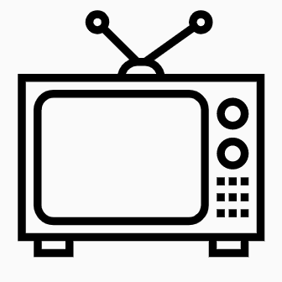
Watch these…
Disney - Becoming Karl Lagerfeld | In Becoming Karl Lagerfeld, a new six-part series from Disney+, audiences are made privy to a designer still ascending. Interpreted by the German-Spanish actor Daniel Brühl, this Lagerfeld finds pleasure in sartorial eclecticism, adorning himself in tall red boots, vibrant striped ties, and pyjamas speckled with sports figures. His subsequent, distinctive armour of sobering black and white receives only vague recognition via the show’s costume design, elsewhere informing an exchange with a potential business partner, as Lagerfeld highlights the appeal of ‘austerity, white, black, brown, timeless things’ before describing his would-be namesake label as ‘for those who like purity in clothing design’. | https://www.wallpaper.com/fashion-beauty/becoming-karl-lagerfeld-disney-plus-daniel-bruhl-interview
Movie - Westwood: Punk. Icon. Activist | This looks back over Westwood’s career arc, it also shows her to be a trailblazer in her final years, pushing her brand forward with the same anarchic enthusiasm that made her a legend to begin with. | https://www.amazon.co.uk/Westwood-Punk-Activist-Lorna-Tucker/dp/B07DR1ZSQF
McQueen | Detailing the life and work of celebrated British fashion designer Alexander McQueen this documentary draws on the personal accounts of those who knew him best, giving a detailed look at the lowly London boy who went on to achieve international success in a tough and uncompromising industry. | https://www.tvguide.com/movies/mcqueen/2000323896/
Valentino: The Last Emperor (2008) | Almost 50 years after founding his fashion house, in 1959, Valentino Garavani, one of the world’s most celebrated designers, announced his retirement in 2007. Valentino: The Last Emperor explores the professional and personal life of the designer, paying tribute to his career as he prepares for his final show, and taking a closer look at the relationship between him and his long-term partner in business and life, Giancarlo Giammetti. | Stream on Amazon Prime

Slide 8
Watch these…
Alexa Chung: The future of fashion (2015) | “The Future of Fashion is a mission to uncover the depth of the industry and the huge variety of roles that go towards sending clothes down the catwalk season after season,” explains Vogue contributing editor Alexa Chung, who set out to investigate the truth about the fashion industry with her Vogue Video series by asking the questions everybody wants answers to. From finding out first-hand from Olivier Rousteing how he rose to the ranks of fashion royalty at Balmain, to exploring how to secure a job at Vogue, Alexa brings her signature charm and wit to give an insider view of the ins and outs of the fashion world. *Watch the award-winning series on Vogue Video here. * | https://www.youtube.com/watch?v=Bi2nc_xxnvs
Lagerfield Confidential (2007) | What does a day in the life of Karl Lagerfeld look like? Lagerfeld Confidential gives you an idea, with its peek inside the everyday routine of the famously private designer. Karl opens up about his German upbringing and early career, allowing the camera to follow him to intimate spaces, from his chaotic Parisian apartment to a flight in a private jet, giving viewers an insight into the man behind the infamous dark glasses | https://www.youtube.com/watch?v=OyaQk_Iv-Yg&vl=en-GB (English subtitles)
Breaking fashion | Set within the Salford offices of In the Style, Breaking Fashion takes us inside Greater Manchester’s new world of ultra-fast fashion. | BBC IPlayer
Inside the factory series 6.2 Socks | A visit to a sock factory in Leicester and a cotton spinning factory in Manchester. Investigation into the 1980’s & the Great War when the ‘Kitchener stitch’ helped to save the feet of British soldiers in the trenches.. | BBC IPlayer
Inside Misguided | Missguided, one of Britain's biggest fast-fashion brands, lets cameras behind the scenes to see what life is like for their young, female-dominated workforce at their offices in Manchester | Inside Missguided: Made in Manchester - Episode Guide - All 4 (channel4.com) 4 episodes all 47mins each
Great British sewing bee | Series where home sewers demonstrate their skills in a range of different challenges – the challenges on each episode is excellent for helping develop essential pattern cutting knowledge and skills | BBC IPlayer

Slide 9
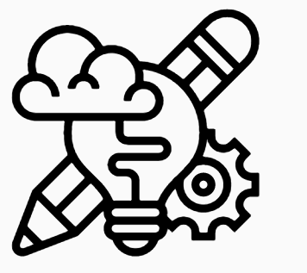
Try these…
Design in a nutshell
Design era talks plus try the quiz to find out which designer your design thinking is similar to.
http://www2.open.ac.uk/openlearn/design_nutshell/
Sketch-a-day
Spencer Nugent developing sketching skills
https://www.youtube.com/channel/UCBtSgEZk914z5InEs_U2J3w
Design Ventura Mini Challenge
https://ventura.designmuseum.org/2020/03/30/design-ventura-online-mini-challenge/
Virtual Museums
V&A London
Take a trip through their collections
https://www.vam.ac.uk/collections?type=featured
Design Museum
Digital Museum content
https://designmuseum.org/digital-design-calendar
Design information
https://designmuseum.org/design
Designers information
https://designmuseum.org/designers

Slide 10
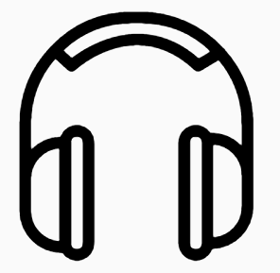
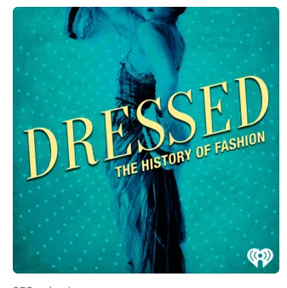


Listen to these…
https://podcasts.apple.com/gb/podcast/dressed-the-history-of-fashion/id1350850605
https://podcasts.apple.com/gb/podcast/the-business-of-fashion-podcast/id1225204588
https://thewardrobecrisis.com/podcast
Dressed: The History of Fashion
The Business of Fashion Podcast
WARDROBE CRISIS with Clare Press

Slide 11
Optional activities for
Summer 2024

Slide 12
Quick design thinking activities
#thinkdo activities
http://www.julieboyd.co.uk/free-resources/thinkdo-cards/thinkdo-quick-activities/
Techdoodle activities
http://www.julieboyd.co.uk/free-resources/techdoodle-resources.html
Skillshare activities
https://www.skillshare.com/en/

