Slide 1
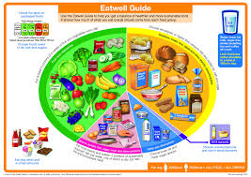
Thank you for choosing to follow the L3 Food Science and Nutrition course.
Our aim is for you to be able to access some of online certificates that will support you in the background learning of this course.
Many are free, however the ones that cost are worth doing for this course and are also useful for part time jobs when in the sixth form and Uni.
Your practical skills will be an excellent support to this qualification, however it is Nutrition that underpins the whole course.

Slide 2

Get Organised
You will need at least one large lever arch binder and a few sets of dividers, lined paper, highlighters and writing equipment

Slide 3
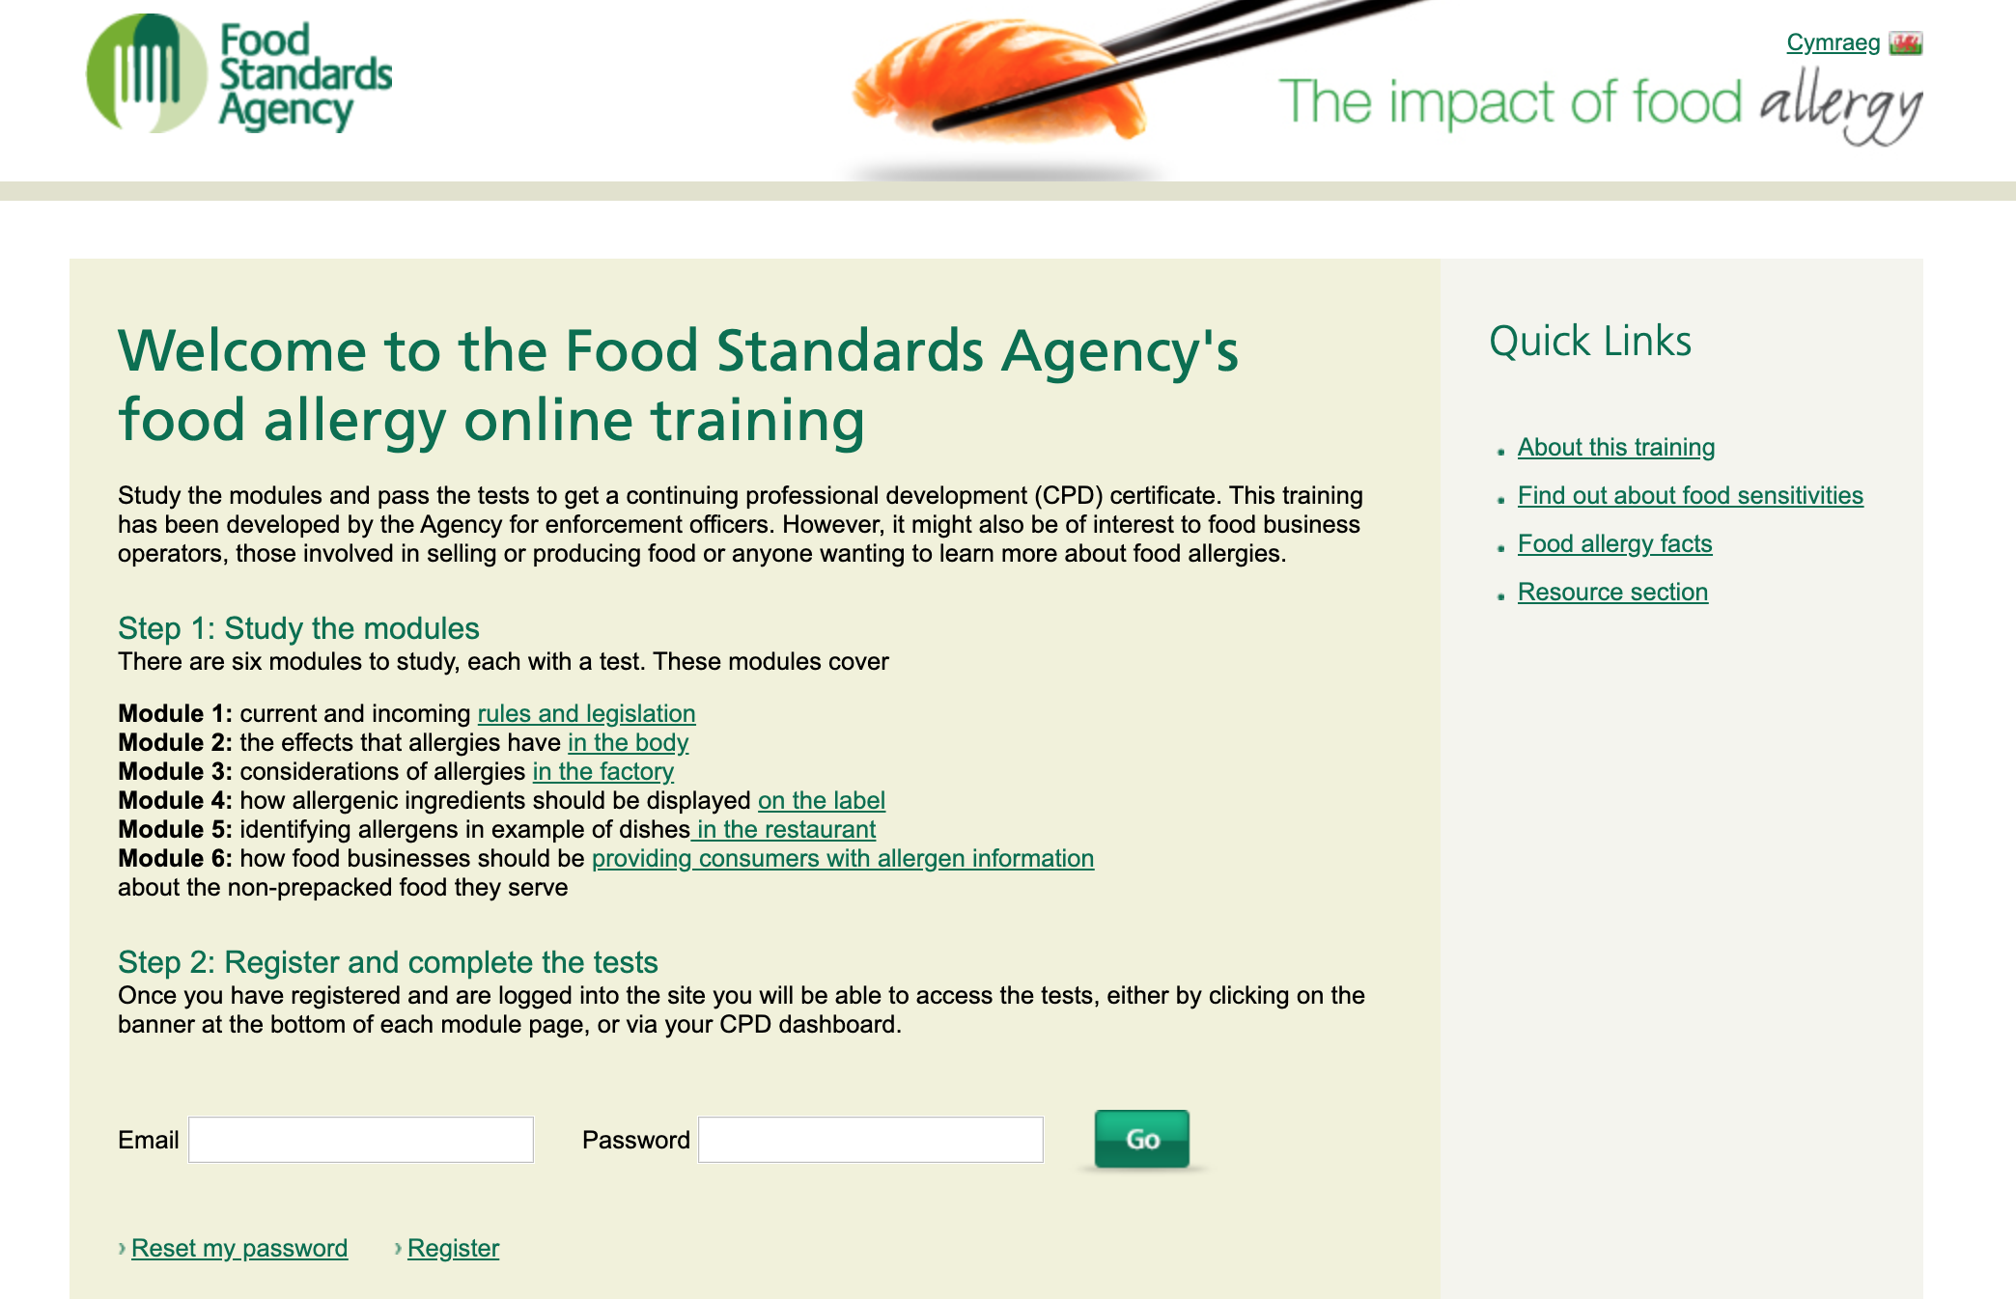
Food Allergens
This online course looks at Food Allergens.
This is knowledge you will need for Unit 1 & Unit 2 of the L3 Food Science and Nutrition Course.
It is free to sign up and when you have completed it, please send a copy of your certificate to me and print a copy for your folder.
Good Luck
https://allergytraining.food.gov.uk/​

Slide 4

Nutrition
Nutrition underpins the L3 Food Science & Nutrition Course.
This will be useful as good background and / or revision.
https://app.senecalearning.com/classroom/course/d59d0e60-4fa8-11e8-bbba-738ab127bed6/section/3a2ecae0-5aac-11e8-8337-b1fe33357061/session
Food Safety is another important area.
Please complete these sections in Seneca.
Also keep a look out for any news or magazine articles on nutritional issues.
Look at www.nutrition.org.uk

Slide 5

Food Safety
This online course leads to a Level 2 qualification in Food Safety
This course comes at a cost but is highly recommended for this course and part time work.
Due to the cost, it is optional, (but very worthwhile)
https://food-safety.org.uk/courses/

Slide 6

Food Safety
If you opt NOT to do online course, do this ….
Create Mini A5 fact sheets on Food poisoning bacteria:
Bacillus Cereus
Campylobacter
Clostridium perfringens
Clostridium Botulinum
Escherichia Coli
Listeria monocytogenes
Salmonella
Shigella
Staphyloccus aureus
Include: Foods it is likely to be found in, incubation period, symptoms, duration and severity of illness.

Slide 7

Research
Carry out research into a “Special Diet” of your choice:
Diabetes Type 1 or Type 2
Vegetarians
Sports nutrition
Iron deficient Anaemia
Lactose intolerance
Coeliac Disease
Hypercholesterolamia
Email me with any other ideas.

Slide 8

Practical work
Keep practicing high level practical skills.
Evidence: Take photographs (put into Practical assignment on google classroom) , keep a folder of successful recipes.
Please contact me if you want guidance on possible dishes. But at the moment I am happy for you to practice anything to keep you practicing skills, based on what ingredients you can get and will be helpful in feeding your families.

Slide 9

Suggested Practical work
Starters
Starter:
- Homemade pasta and a sauce (filled pasta, tricolo pasta)
- Spinach roulade
- Chicken liver pate
- Soup with particles: parmesan truile
- Chicken wings (portioned from a whole chicken) with marinade, spiralizer accompaniments
- Fish cakes: Moulding, fileting, pane, shallow frying, mayonnaise to serve
- Homemade mayonnaise: aioli
- Scallops and samphire
- Cheese soufflé
- Complex breads

Slide 10
Suggested Practical Skills
Mains
Boned and stuffed chicken: Kiev with pane
- Chicken Ballantine: Portioning, rolling, stuffing, poaching, sautéing, accompaniments (turned
or spiralizer vegetables and sauces)
- Duchess/dauphinoise/hassle back/fondant/turned potatoes
- Fish fillet: En papeout, filleting fish, knife skills (Julienne, brunoise)
- Chicken pie: Portioning Chicken, homemade stock, puff pastry, free standing with short crust
sides, knife skills with vegetable prep, possible roux sauce
- Fish cakes: Moulding, fileting, pane, shallow frying, mayonnaise to serve
- Fish fingers: homemade sauces
- Chicken goujons: portioned from a whole chicken
- Pea puree
- Beef wellington (puff pastry)
- Chutneys
- Puff pastry and vegetable wellington
- Burger: mincing, moulding, brioche bun?
- Vegetable crisps/game crisps
- Noodles (made from scratch), portioned chicken, knife cuts of vegetables.

Slide 11
Suggested Practical Skills
Desserts
Profiteroles
- Hazelnut brittle
- Caramel basket
- Panna-cotta
- Mini meringue
- Fondant (chocolate)
- Soufflé
- Fruit coulis
- Ice creams
- Sorbets
- Steamed cakes
- Individual free standing cheesecake (with gelatine)
- Poached pear
- Spun sugar
- Custard

Slide 12
Text Book
This is the text book for this course, available on Amazon!

