Slide 1
The Church encouraged the post-industrial game of football.
Explain how they achieved this and their reasons for encouraging the development of football. (8 marks)
The church was highly influential in the development and popularity of association football in the 19th century. It encouraged participation in the sport through the provision of facilities and equipment. Most churches were equipped with large plots of land and church halls which could be used to support the game of association football in a controlled environment, adhering to the changes of rules and regulations as the sport progressed from mob football to association football, post the industrial revolution. The church encouraged this as it was a form of rational recreation and a much better form of sport as opposed to ‘mob’ games.
Churches also encouraged parishioners to participate in the sport and set up Sunday teams, promoting muscular Christianity, and encouraging a variety of people to participate in association football but also to attract more people to the church. This also gave an opportunity for the clergy to come into contact with the wider community, this was further evident throughout the spread of the British Empire when missionaries and clergymen travelled in order to encourage Christianity however used the game of association football to promote the church.
The church promoted association football, over ‘mob’ games due to its new rules and regulation structure. The introduction of rules and improved the morals of the working class and provided a form of social control. Gambling and drinking had become popular past times within pre-industrial Britain and the church worked hard to eradicate these from society, encouraging and supporting association football was a fantastic tool to enable them to do this.
Task
Working independently.
1. Highlight AO1, AO2 and AO3 in this answer.
2. Where would you award marks? Remember AO1 = 2 AO2 = 3 AO3 = 3

Slide 2
Now use the mark scheme…
AO1 – Knowledge Identified reasons for how and why the Church encouraged the post-industrial game of football – simple statement, eg [How] the Church gave its approval by creating Sunday school teams. The Church teams were organised by the clergy for parishioners to play, they also provided facilities to play, eg land. [Why] the Church encouraged the game because it was a form of rational recreation and because it was a better form of the sport than mob games. It promoted muscular Christianity.
AO2 – Application Applied explanation for how and why the Church encouraged the post-industrial game of football, eg in order to attract more people to Church, the Church created and encouraged Sunday school football teams. They organised football matches to counter the vices that were reported in towns and cities. It gave an opportunity for the clergy to come into contact with the wider community.
AO3 – Analysis Linked explanation of reasons for how and why the Church encouraged the post-industrial game of football, eg the Church encouraged the rational form of football because it had been given rules; by encouraging playing to the rules this would improve the morals of the working classes and act as a form of social control. Meaning that less time was spent drinking, promoting muscular Christianity amongst the working classes.
Credit other relevant points explaining how the church encouraged the post-industrial game of football and their reasons for encouraging the development

Slide 3
The Church encouraged the post-industrial game of football.
Explain how they achieved this and their reasons for encouraging the development of football. (8 marks)
The church was highly influential in the development and popularity of association football in the 19th century. It encouraged participation in the sport through the provision of facilities and equipment. Most churches were equipped with large plots of land and church halls which could be used to support the game of association football in a controlled environment, adhering to the changes of rules and regulations as the sport progressed from mob football to association football, post the industrial revolution. The church encouraged this as it was a form of rational recreation and a much better form of sport as opposed to ‘mob’ games.
Churches also encouraged parishioners to participate in the sport and set up Sunday teams, promoting muscular Christianity, and encouraging a variety of people to participate in association football but also to attract more people to the church. This also gave an opportunity for the clergy to come into contact with the wider community, this was further evident throughout the spread of the British Empire when missionaries and clergymen travelled in order to encourage Christianity however used the game of association football to promote the church.
The church promoted association football, over ‘mob’ games due to its new rules and regulation structure. The introduction of rules and improved the morals of the working class and provided a form of social control. Gambling and drinking had become popular past times within pre-industrial Britain and the church worked hard to eradicate these from society, encouraging and supporting association football was a fantastic tool to enable them to do this.
Task
Working independently.
1. Highlight AO1, AO2 and AO3 in this answer.
2. Where would you award marks? Remember AO1 = 2 AO2 = 3 AO3 = 3

Slide 4
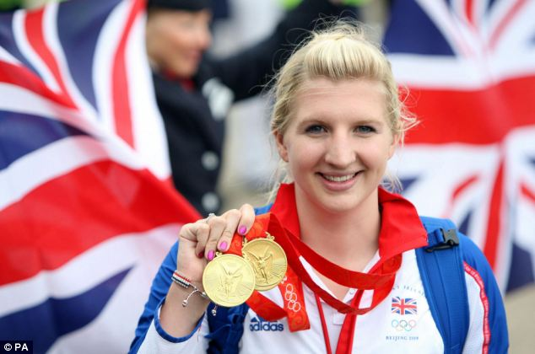
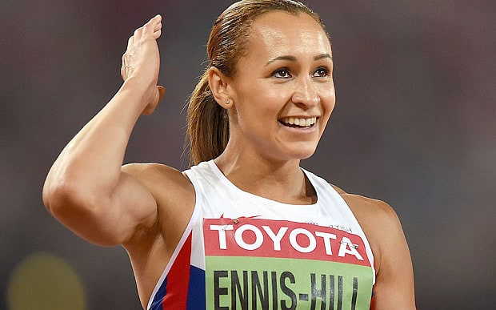

What: To identify the characteristics of amateurism in the 19th century
Why: In order to understand the development of popular recreation and sport and its links with society.
How: Identifying the differences between the 19th century and the 21st century amateur. Group discussions and research. Exam question.
Success Criteria
I can identify the characteristics of 19th century amateurism.
I can apply these characteristics, making links to 19th century society and sport.
I can successfully draw links between 21st century and 19th century amateurism and use these to compare differences in an exam question.

Slide 5
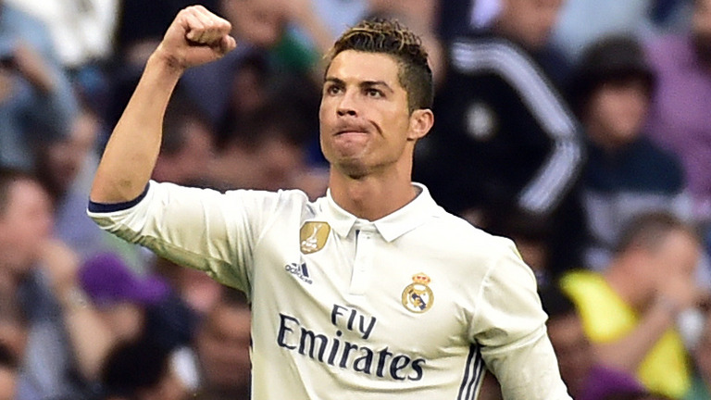

Vs

Slide 6
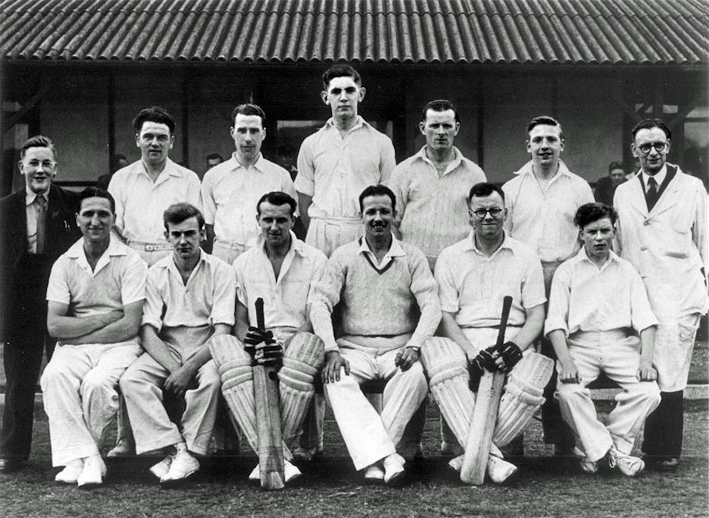
The 19th Century Sporting Amateur
THINK: What was important in society at that time?
Is this different in our society today?
. Manliness
. Appreciating value of health and fitness
. High moral integrity
. Respected member of society (public school background)
. Belonging to social elite – plenty of free time for sport
. Training was frowned upon – linked to professionalism
. Range of sport using natural talent
. High moral code when playing, excellent sportsmanship and respect

Slide 7
3
1
Compare and contrast – A03
Watch the two videos carefully. Can you compare and contrast the differences between the two sports, making specific links between professionalism and amateurism.
Characteristics of 19th Century Amateur – AO1
Watch the video and identify the key characteristics of the 19th century amateur. Use this information in order to identify the key characteristics of the 19th century professional.
Video 1 Link
https://www.youtube.com/watch?v=qgs85qiXDNQ
Watch from start – 5.30mins
Amateur | Professional
Video 2 Link
https://www.youtube.com/watch?v=Z3Mbd9W9u50
Watch from start – end
Question
Describe the differences between rugby union and rugby league. You must make links between 19th century society and include references to the amateur and professional sports performers.
___________________________________________________________________________________________________________________________________________________________________________________________________________________________________________________________________________________________________________________________________________________________________________________________________________________________________________________________________
https://www.youtube.com/watch?v=QULxRVly_nc
Watch from start – 3.00mins
2
How did society impact the amateur and professional sporting divisions in the 19th century?
AO2 – application of knowledge
____________________________________________________________________________________________________________________________________________________________________________________________________________________________

Slide 8
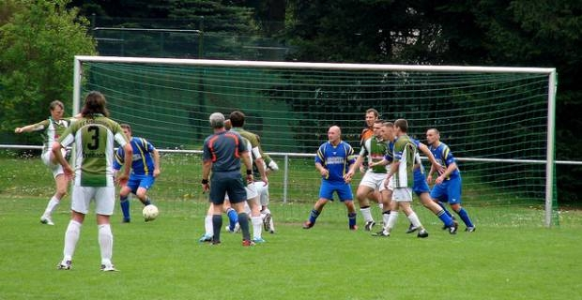
Amateurism
Sport purely for the sake of it – for the enjoyment and love of it.
R B T R P
Can you come up with a saying that helps you to remember the key characteristics of the 19th Century gentleman amateur.
Late 19th Century Amateur values:
. Manliness, striving for physical endeavour
. Appreciating the value of health and fitness
. High moral integrity
An upper/middle class gentleman amateur was:
. Respected member of society with a public school background, high status in sport reflected high status in society.
. Belonging to the social elite, wealthy with plenty of free time for sport.
. Training was frowned upon = professionalism
. Range of sports – highlighting natural talents
. Playing to a high moral code = a referee was highly unnecessary.
THINK – difference between ‘refing’ in football and rugby union.

Slide 9
https://www.youtube.com/watch?v=b26ZeVhezBE
Football
https://www.youtube.com/watch?v=43AdWFSXhgs
Rugby

Slide 10

Amateurism
Positive Impacts of amateurism…
. Elite sport was run by and dominated by the upper class and middle classes with a high status.
. The code of amateurism – playing to clearly set rules.
. Adhered to a code of ethics
. Not the winning – it was the taking part that counted.
. The all rounder- competing in a full variety of sports.
Discuss
What do you think the positive impacts of the gentleman amateur were?

Slide 11

Professionalism
Playing sport for the financial gain…
Late 19th Century Professionals:
. Had to make money from sport otherwise could not afford to play
. Perceived corruptible as came from working class background
. Paid according to results = winning counted
. Foul play and gamesmanship were used to try to gain an advantage

Slide 12
Professionalism
Positive impacts of nineteenth century professionalism…
. Broken time payments emerged – working class could play and be payed to play.
. Standards of performance increased – due to winning being so important.
. Working class could earn more money playing sport than working in the factories.
. Playing sport for money = social mobility.
Discuss
What do you think the positive impacts of the gentleman amateur were?

Slide 13
Modern Day
20th – 21st Century
Amateurism and Professionalism
Task:
Brain storm – using only 1 colour, what you think modern day amateurism/professionalism looks like.
You need to have at least 5 different points.

Slide 14
Amateurs of lower status to professionals
Some high level performers are still not professionals (gymnasts)
Professionals = celebrity status in high profile sports
Anyone can become professional, no class distinction
Professionals have more time to train = higher standards of performance
Modern Day
20th – 21st Century
Amateurism and Professionalism
In a different coloured pen.
Write the contrast/difference of amateurism/professionalism in the 19th Century.
E.G – Anyone can become professional
Only the working classes were professional
Some amateurs receive funding (UK Sport)
High rewards for professionals through media and sponsorship (high profile sports)
Blurring of amateur and professional distinctions
Professionals have become positive role models

Slide 15
Exam Application
Answer Q7 on your Practice Questions Sheet.
You do not need to write out the questions.
. Elite sport was for upper class
. Expense to participate meant limited opportunities for the working classes
. Lots of time was needed to participate – limited for working classes
. Limited public provision
. Upper/middle class controlled NGB’s
. Upper/middle classes selected teams/restricted access to clubs
. Less equality of opportunity in society in general
EXT – Take 2 of these AO1 points and extend them into an AO1 and AO2 point.

Slide 16
Complete the practice questions sheet.
Round 1
Do not use your class notes to help you answer these.
Round 2
Use your class notes and make any changes to your answers using your green pen.

Slide 17
The 19th Century Sporting Amateur
1. Identify 2 characteristics of the 19th century sporting amateur
2. Switch your paper with someone else
3. Explain how the 2 characteristics identified are reflective of 19th century society
4. Switch back, green pen your answer.

