Slide 1
BRAIN IN GEAR
Name and define the 4 different types of guidance.
Extension: Can you give a sporting example for each of the different types?
VERBAL:
An explanation
e.g. You are going to work in pairs and make 10 chest passes.
VISUAL:
Guidance that can be seen
e.g. a demonstration or a video
MANUAL:
Physical support
e.g. holding the legs of a gymnast during a handstand
MECHANICAL:
An artificial aid
e.g. armbands for swimming or a harness in gymnastics

Slide 2
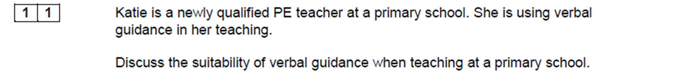
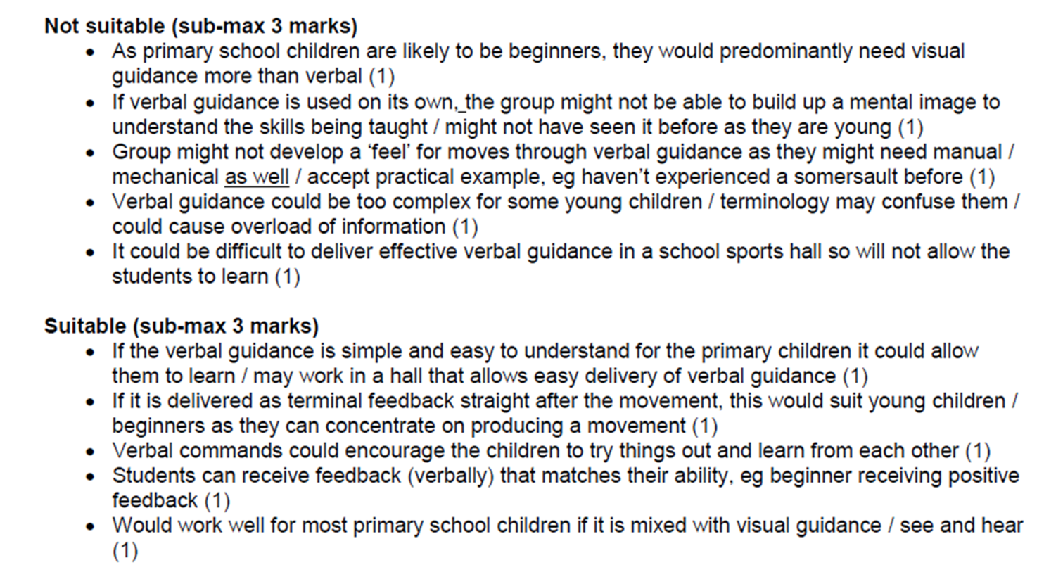
Task: Answer the below exam question from last lesson

Slide 3
Lesson Objectives
WHAT: Understand the theory of operant conditioning
HOW: Powerpoint, class discussion, past paper questions
WHY: To be able to develop knowledge of how we learn skills
C/D
I can define the term operant conditioning
B
I can explain the different principles to operant conditioning
A/A*
I can explain how operant conditioning can be used to learn a new skill

Slide 4
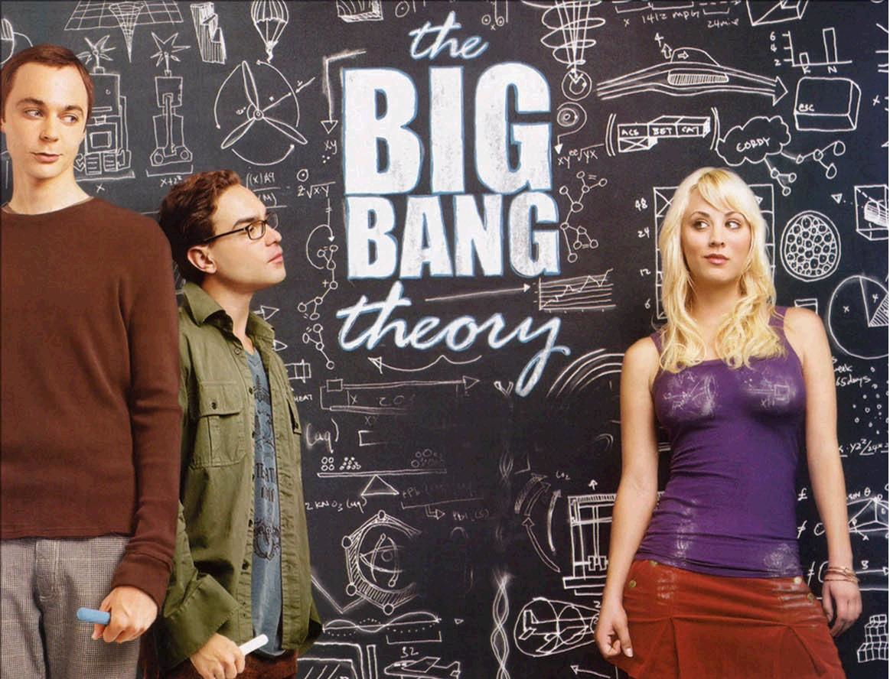
STARTER:
Watch the video clip from the Big Bang Theory and write down your own definition of Operant Conditioning.
https://www.youtube.com/watch?v=Mt4N9GSBoMI

Slide 5
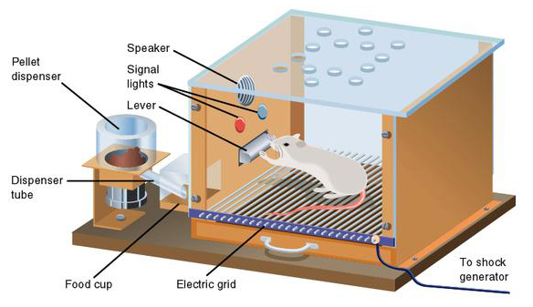
Operant Conditioning
The use of reinforcement to link correct responses to a stimulus.
Aims to shape or modify behaviour by manipulating the environment.
It is a behaviourist theory as it attempts to explain how actions can be linked to stimuli.
Based on the work of Skinner (1948)- he observed rats in a cage who learnt to hit a mechanism in order to gain a reward (food).

Slide 6
It can be characterised by the following three key features:
Operant Conditioning
Shapes behaviour using reinforcement
Based on trial and error learning
Manipulation of environment
Operant conditioning works on the principle that reinforced actions will be strengthened and incorrect actions can be weakened.
Works on the idea that success acts as a satisfier to strengthen correct actions
During trial and error learning if successful responses are rewarded then they are likely to be repeated.
If unsuccessful responses are ignored or given an annoyer (criticism) they may be avoided.

Slide 7
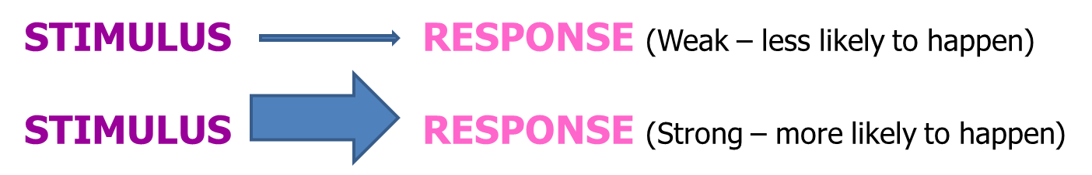
The stimulus-response bond
Operant Conditioning works by strengthening the link between stimulus and response.
This is known as the S-R bond.
E.g. In badminton when a shuttle is returned high in the air and mid court the best response is a smash shot. By linking this appropriate response to stimulus., actions can be learned. Coaches can link this stimulus to response by using three different types of reinforcement to shape behaviour.

Slide 8
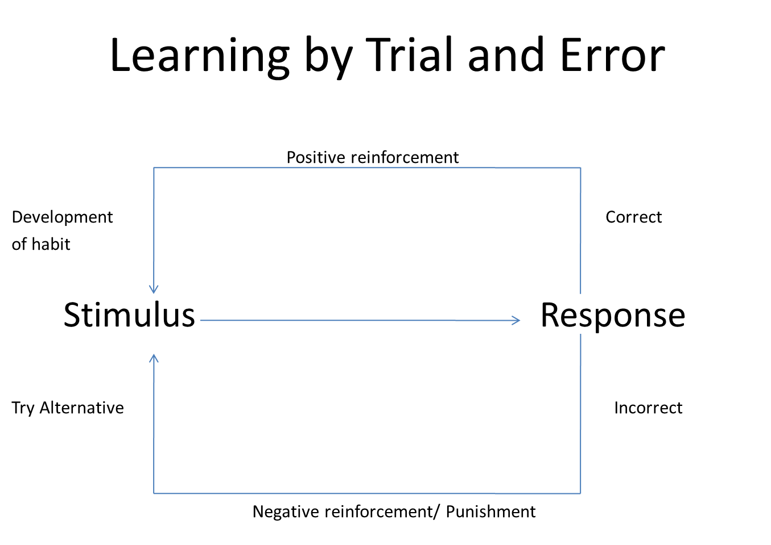

Slide 9
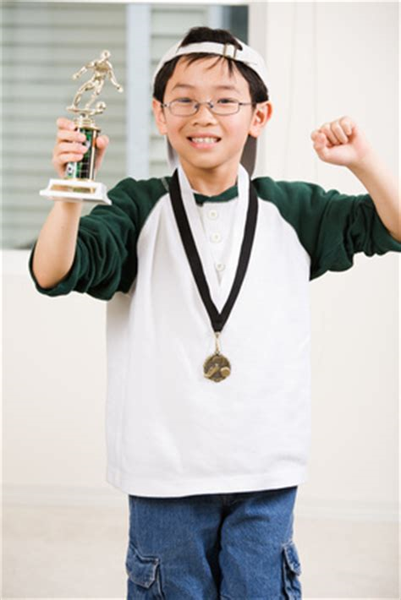
Positive Reinforcement
This is when a pleasant stimulus is given to increase the likelihood of a correct response occurring again in the future.
E.g. a coach offering praise to a swimmer for a correct leg action or giving a certificate to a beginner who achieves their first length. This will offer motivation to continue repeating success.

Slide 10
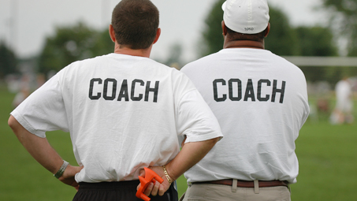
Negative Reinforcement
Promotes correct actions to a stimulus by taking away an unpleasant stimulus when the performer does it right.
Negative criticism is withdrawn when the performer does well.
E.g. a coach who has given a negative comment to a player who had incorrect technique would stop this negative feedback when they improve. The learner would know they are improving if this shouting stops.

Slide 11
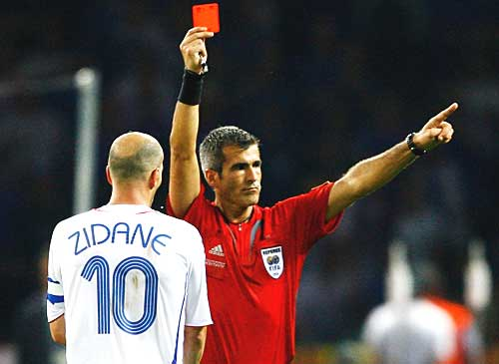
Punishment
This is giving a stimulus to prevent a response occurring, breaking the S-R bond. Eg, being dropped from a team, a yellow card, or fined.
Continually using punishment may cause resentment and have an adverse effect so should be used carefully.
E.g. A footballer committing a foul is red carded and sent off. Hopefully they will learn not to do it again.

Slide 12
Task:
Using a sport of your choice come up with your own examples for the following types of reinforcement:
NEGATIVE
POSITIVE
PUNISHEMENT

Slide 13
Questions:
Explain the meaning of the term ‘operant conditioning’. (2 marks)
How can a coach use operant conditioning to develop a gymnast’s skills? (3 marks)
Performers have to learn the various techniques involved in springboard diving. One form of learning is through operant conditioning. Describe operant conditioning theory and give an example of how a diving coach may use it to improve learning. (4marks)

Slide 14
Q1 2 marks for 2 of:
A Trial and error learning
B Successful response linked/associated with stimulus/strengthens S-R bond
C Use of reinforcement
Q2 3 marks for 3 of:
D. Using rewards/praise
E. Use of positive reinforcement
F. Shaping/altering environment to progress towards success
G. Use of target areas/mechanical feeders/equipment/etc
H. Use of negative reinforcement
I. Removal of criticism – explanation of negative reinforcement
J. Use of punishment to decrease probability of undesired response
K. Example of punishment

Slide 15
Q3
1. Manipulating/changing behaviour to shape the correct response using reinforcement.
2. E.g. – use of rewards/praise or removal of criticism to encourage learning/repeat successful performance/change behaviour (Sub max 1mark)
3. Trial and error learning
4. Strengthen S-R bond/successful response associated with stimulus
5. Use of (positive/negative) reinforcement
6. Shaping/altering environment to allow success

Slide 16
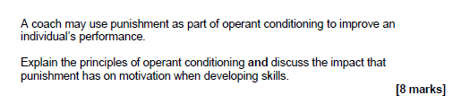
Apply it! Exam Question

Slide 17
PLAN!
AO1 –
Knowledge of principles of operant conditioning and motivation
AO2 –
Application for skill development in physical activity and sport
AO3 –
Analysis/ Evaluation of the impact of punishment on motivation

Slide 18
Mark Scheme
Possible content may include:
AO1 – Knowledge of principles of operant conditioning and motivation
Eg operant conditioning aims to shape or modify behaviour by changing the environment by using reinforcement if the actions are correct/successful. Motivation is the performers drive/desire to succeed.
AO2 – Application for skill development in physical activity and sport.
Coaches may use positive reinforcement and negative reinforcement to strengthen the stimulus-response bond and punishment to weaken to the S-R Bond. The coach will structure practices to use drills, targets, small-sided games to allow conditioned practices for trial and error learning to occur. They will provide positive reinforcement, eg praise, feedback or withdrawal of an adverse stimulus, stop shouting if using negative reinforcement. The coach would use punishment to weaken the S-R Bond.
AO3 – Analysis/Evaluation of the impact of punishment on motivation
Eg, overuse of punishment will have a negative impact because with excessive use of punishment the performer is no longer motivated to try to break the S-R bond and therefore there will be no skill development leading to further loss of motivation.
Appropriate use of punishment will lead to breaking the S-R bond (as motivated to avoid punishment) so that the correct skill can be learnt further enhancing motivation due to increased performance levels, especially if there is also appropriate use of reinforcement.
Credit other relevant explanations of the principles of punishment as part of operant conditioning and discussions on the impact of punishment on motivation when developing skills.

