Slide 1

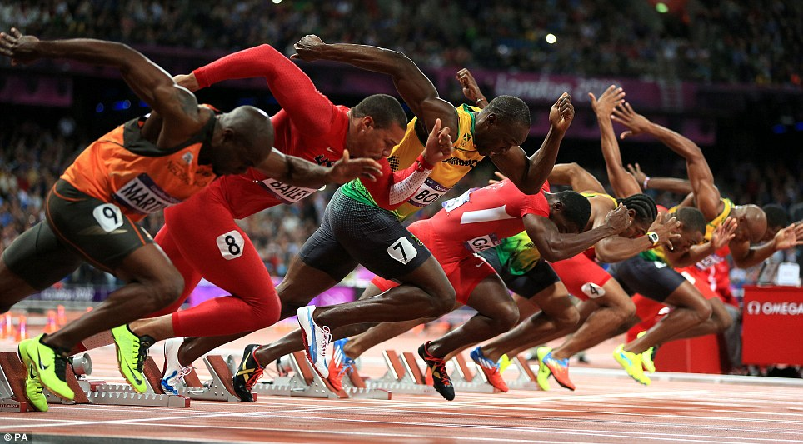
BIG IDEA:
Which muscle(s) in the body are most vital to a 100m sprinter?
Do you think that some athletes are born to perform their event?
How you got on the last time you did a long-distance run and/or a sprint. Why do you think you finished where you did in the race or how you felt at the end?

Slide 2
What? Why?
What?
Explain the characteristics of muscle fibres
Why?
To help explain muscle functioning and how different muscle fibre types can benefit different sports performers

Slide 3
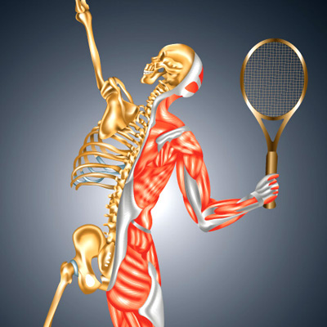
Starter Activity
Describe, to the best of your knowledge, how a muscle is able to cause movement within the body
Use one of the following examples in your answer:
The biceps to flex the arm
The triceps to extend the arm

Slide 4
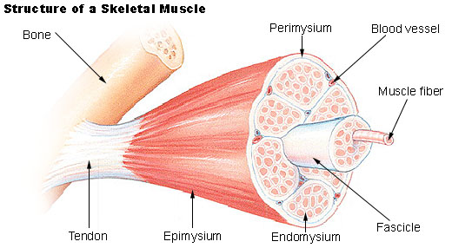
Outline of Muscle Structure
Skeletal muscle is made up of thousands of cylindrical muscle fibres that are bound together by connective tissue through which blood vessels and nerves run
Sarcoplasm – the liquid interior of a muscle fibre
Sarcoplasmic reticulum – Forms a network of channels that spread over the surface of the myofibrils and stores/releases calcium ions to allow muscle contraction

Slide 5
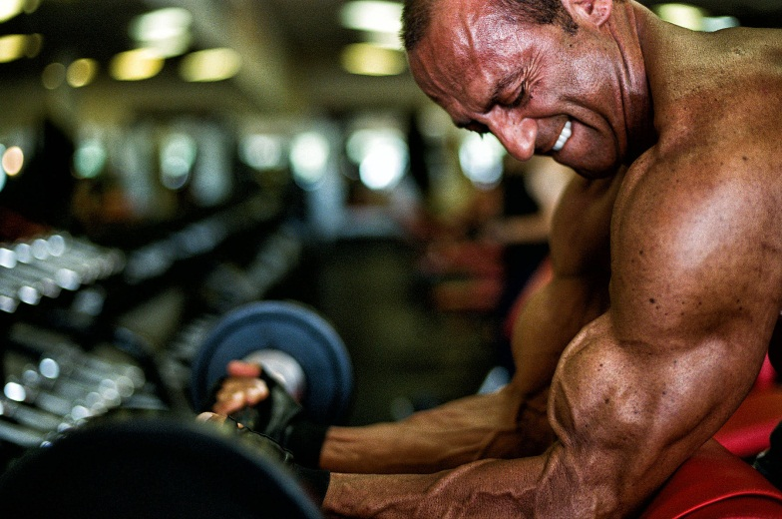
Muscle fibres
The number of muscle fibres
within a muscle is fixed
TASK:
Explain how an athlete could increase their muscular strength
If the number of muscle fibres are fixed, what would happen to them in order to make the athlete stronger?

Slide 6
TASK
Identify which athletic event you feel is your strongest
Describe why you think you are better at some events rather than others
EXTENSION:
Are there any events that you feel you could never be outstanding in, despite how much you could train?

Slide 7
Types of muscle fibre
What types of muscle fibre do you know?
Slow and fast twitch
We can break that down a little further into the following:
Slow oxidative (type I)
Fast oxidative glycolytic (type IIa)
Fast glycolytic (type IIb or type IIx)

Slide 8
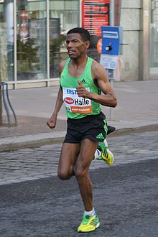
SLOW OXIDATIVE MUSCLE FIBRES: (TYPE I)
Reach peak force very slowly
Energy efficient
High fatiguing tolerance
Energy produced from aerobic pathways

Slide 9
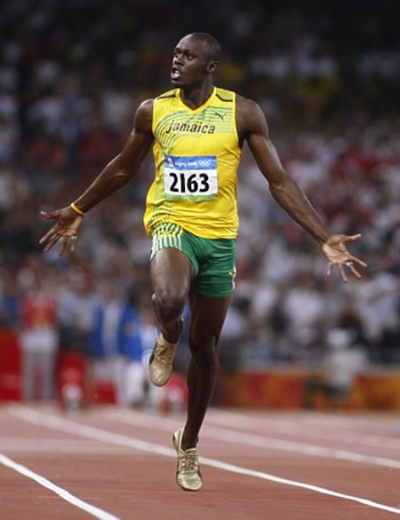
FAST TWITCH MUSCLE FIBRES (TYPE II):
Reach peak force very quickly
Generate a greater force of contraction
Energy produced from anaerobic pathways
Low fatiguing tolerance
Larger diameter due to more/thicker myosin filaments

Slide 10
FAST TWITCH MUSCLE FIBRES
Type IIa
Type IIa are fast oxidative glycolytic
- Used during short, high intensity endurance events
eg 1500m in athletics where a longer burst of energy is needed
Type IIb
Type IIb are fast glycolytic
They are used during highly explosive events
eg 100m sprint in athletics

Slide 11
MUSCLE FIBRES IN ACTION
TASK: Watch the video of the London 2012 highlights
Identify some events that you feel the athletes would have a higher proportion of;
slow oxidative (type I)
fast oxidative gycolytic (type IIa)
fast glycolytic (type IIb)
EXTENSION: For one of the activities from each muscle fibre type, explain your reasons for this
https://www.youtube.com/watch?v=KrffI0HjlEE

Slide 12
PLENARY:
EXAM QUESTION:
During a race, a swimmer has to dive off the starting blocks as quickly as possible
Identify the ‘muscle fibre type’ used to complete this action and justify your answer (3 marks)
A. Fast twitch fibres/type 2
B. Type 2b/fast twitch glycolytic
C. Fast speed of contraction
D. High force of contraction/powerful contraction/ strong contraction

Slide 13
Characteristics of Muscle Fibres
Characteristic | Type I Slow oxidative | Type IIa Fast oxidative glycolytic | Type IIb Fast glycolytic
Fibres per neurone | 10-180 | 300-800 | 300-800
Motor neurone size | Small | Large | Large
Type of myosin ATPase | Slow | Fast | Fast
Sarcoplasmic reticulum development | Low | High | High
Aerobic capacity | High | Moderate | Low
Anaerobic capacity | Low | High | Very high
Contractile speed | Slow | Fast | Fast
Fatigue resistance | High | Moderate | Low
Motor unit strength | Low | High | High

