Slide 1


Physics A level at PHGS

Slide 2
Why is Physics A level useful ??

Slide 3
From the Institute of Physics website October 2023
“So why physics?
You might think we’re biased – but we know what we’re talking about. Physics is a “facilitating subject”, meaning that it’s highly regarded whatever degree or career path you choose. It’s considered essential for science and engineering courses, so it keeps a lot of doors open for you.
Physics opens these doors because of the skills and ways of thinking it teaches you. You’ll pick up mathematical and analytical techniques that are valued in a huge range of careers – just look at these career options…
https://www.iop.org/careers-physics/your-future-with-physics/career-paths
You’ll become a critical and creative thinker, and a problem solver.”

Slide 4

The AQA A Level Physics Course at Prince Henry’s
A very quick ride through the topics…

Slide 5

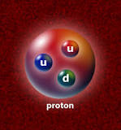
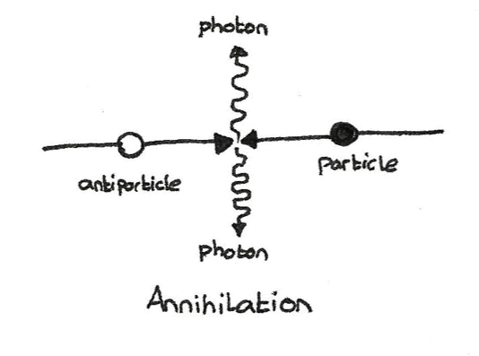
Particles
Quarks – (what protons and neutrons are made from)
Matter and Antimatter
Nuclear Glue – the Strong Nuclear Force holds the mucleus together
Particle Creation and Annihilation
How electrons are responsible for most of what we SEE around us (they make light)

Slide 6
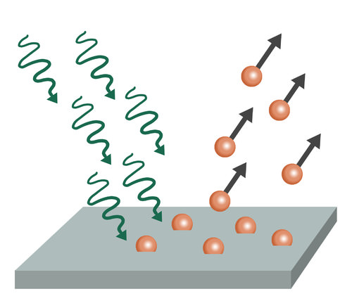
Wave-particle duality
Electromagnetic waves are weird
They travel like waves but arrive like particles (photons)
You never catch them being both at the same time

Slide 7
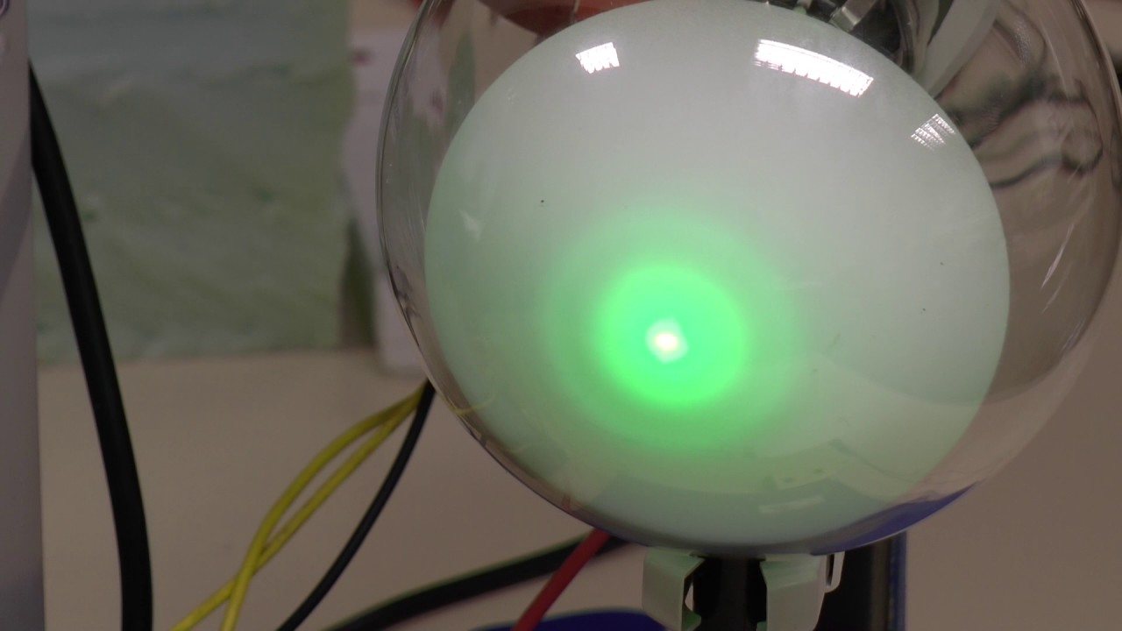
Wave-particle duality
Electrons are just as weird as electromagnetic waves
They also travel like waves and arrive like particles

Slide 8
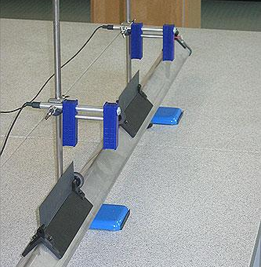
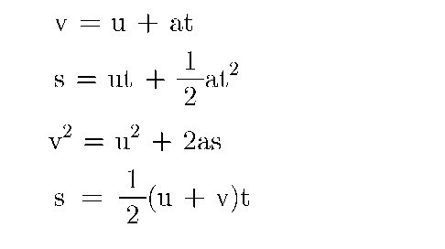
Mechanics – how things move
Equations of motion
Momentum and collisions
Projectiles
Energy transfers
Vectors and scalars
Work and power
Forces in equilibrium
Motion graphs

Slide 9
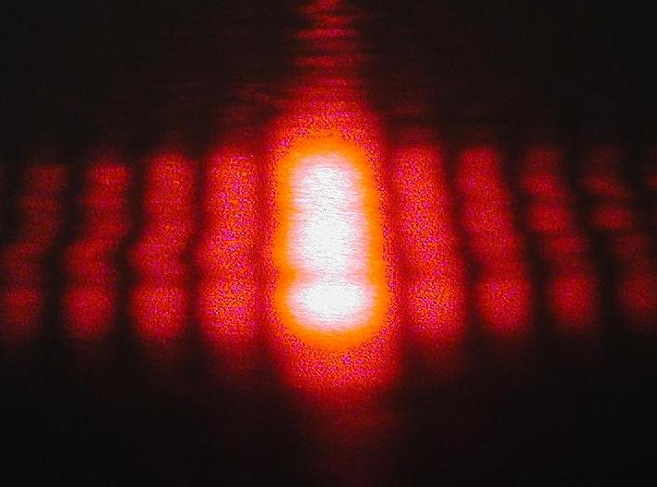

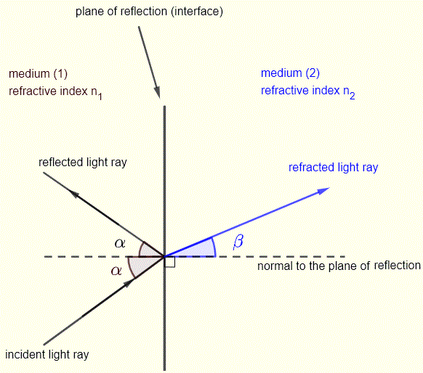
Waves
Wave calculations
Wave interference and diffraction patterns
Optics (how light refracts)

Slide 10

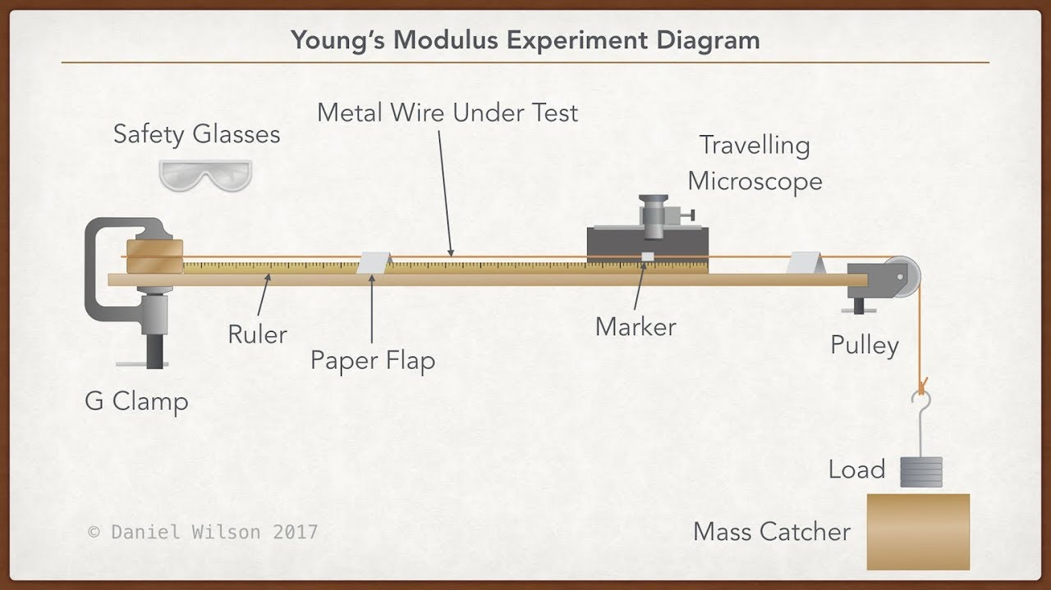
Materials
Investigating how ‘stretchy’ things (like springs) and materials (like copper) are
Hooke’s law and spring constants
The Young’s modulus

Slide 11
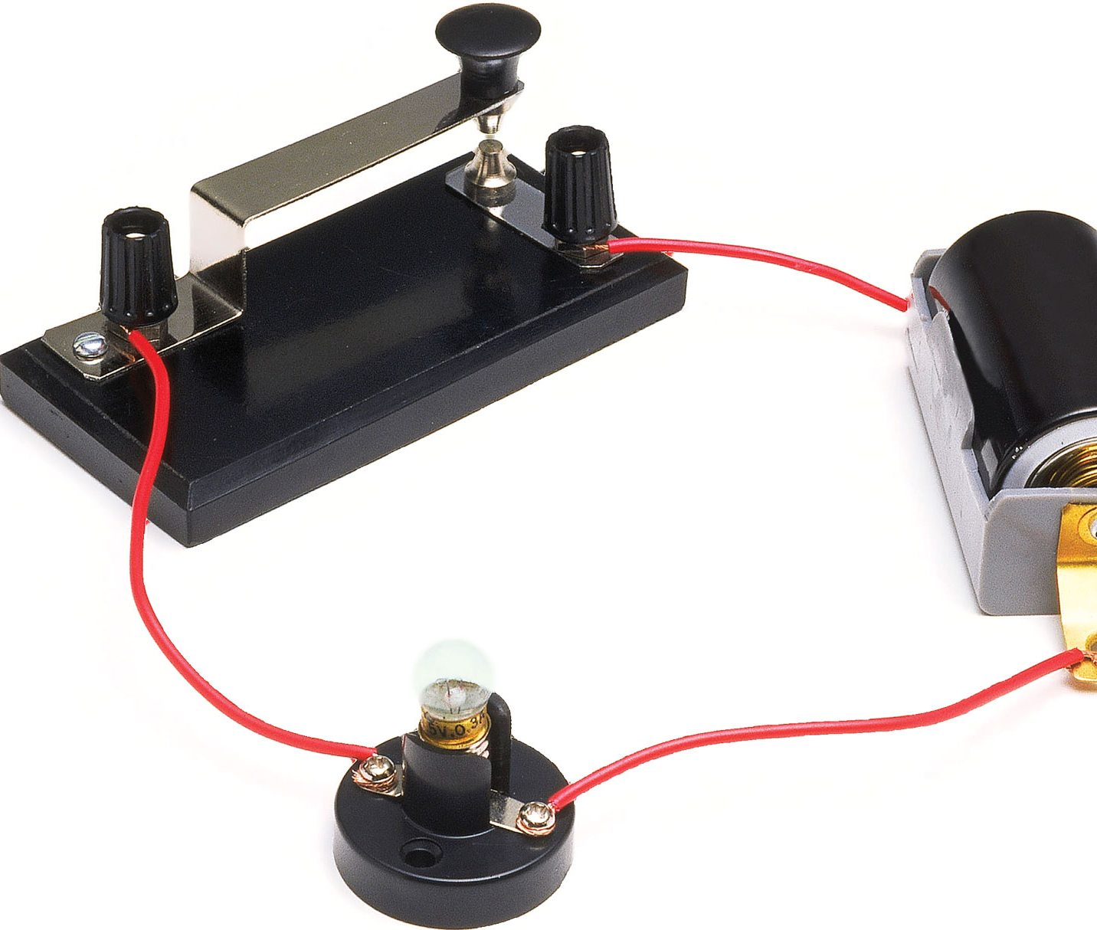
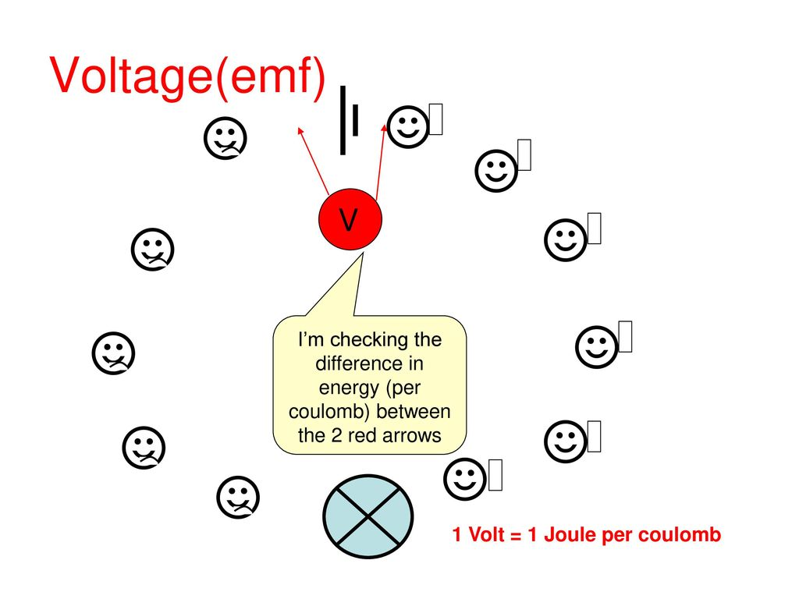
electricity
Building on GCSE, with ideas about power and energy transfer
You’re really going to know what a volt is and what an amp is!
Resistivity – how resistive a material is
Lots of practical work

Slide 12
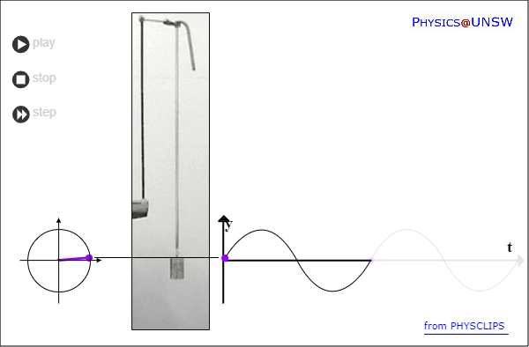
Further mechanics – cyclical motion (what happens when things oscillate or go around in circles)

Slide 13
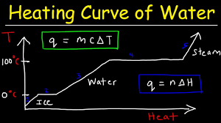
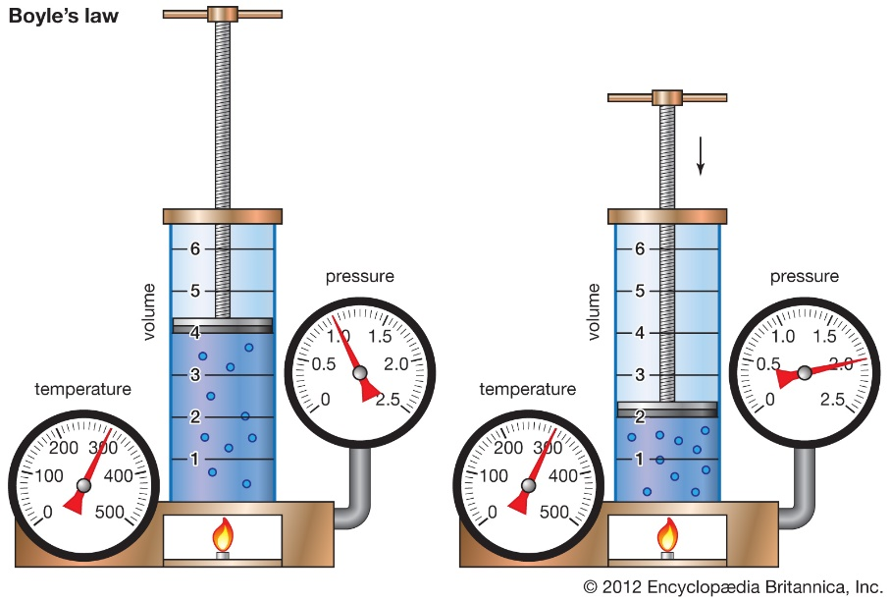
Thermal physics
What happens when materials heat up or cool down – energy considerations
How pressure, volume and temperature are all interconnected
Kinetic theory and ‘The derivation’ (from basic ideas about tiny bouncy particles to the observed behaviour of gases just by thinking and doing some maths)

Slide 14
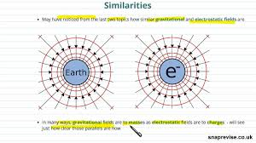
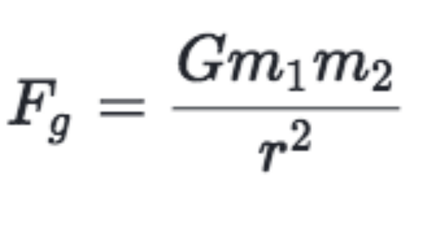
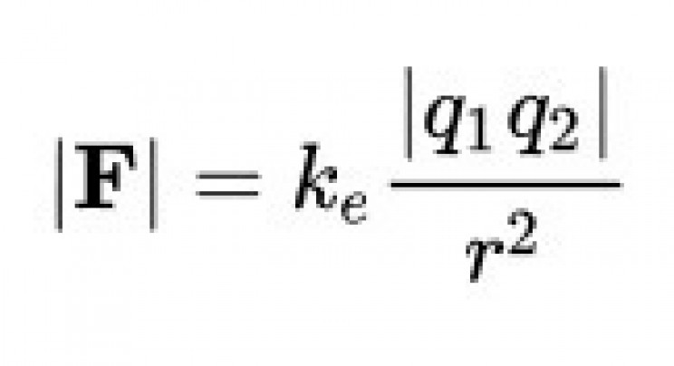

Gravitational and Electric Fields (are very similar)
Capacitors
‘the Physics of Non-Contact forces’
How these forces changes depend on the distance from the object
The potential energy in fields and how it varies
Lots of juicy physics maths…!

Slide 15

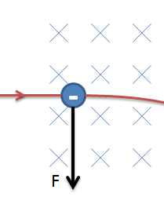
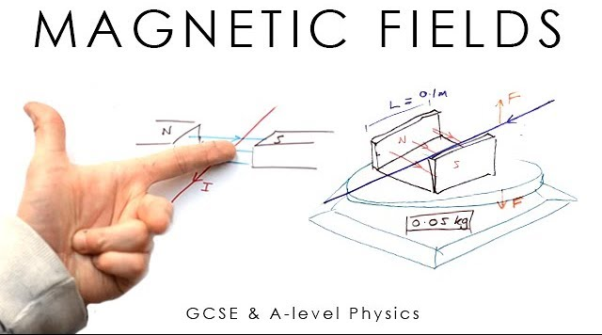
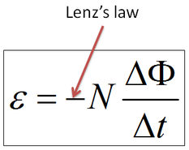
Magnetic fields – more non-contact forces
How charged particles behave in magnetic fields
Motors and generators (…are like opposites)
Lots of juicy maths
The Deep Connection between Magnetism and Electricity
Faraday’s Law

Slide 16
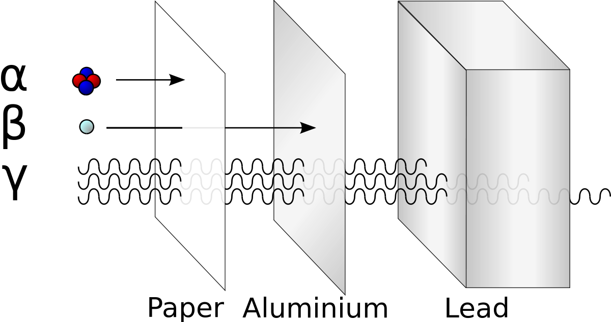
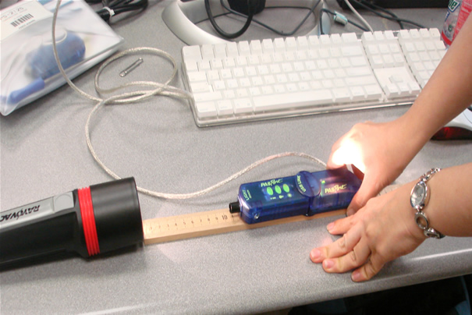
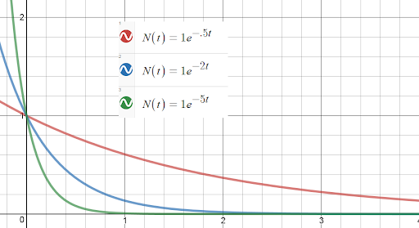
Nuclear physics
Alpha, beta and gamma radiation
The required practical – you finally get to handle radioactive materials (safely)
The maths of exponential decay

Slide 17
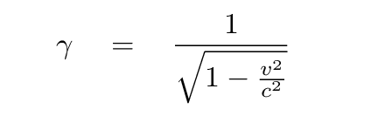
Turning points
Key discoveries in the history of physics
The discovery of the electron, the speed of light, relativity theory, electromagnetic waves and more
Turns out Newton wasn’t quite right..Einstein tidied it all up…

Slide 18
The AQA A Level Physics Course at Prince Henry’s

Slide 19
The way you are examined
At the end of y13 – 3 papers, 2 hours each
Paper 1 – Mechanics and Further Mechanics, Electricity, Materials and Waves
Paper 2 – Electric, Gravitational and Magnetic Fields, Capacitors, Nuclear Physics, Thermal Physics
Paper 3 – Practical Skills and Turning Points in Physics

Slide 20
AQA exam board
Paper 1
2 hours
34%
Paper 3
2 hours
32%
Paper 2
2 hours
34%

Slide 21
AQA exam board
Paper 1
2 hours
34%
Particles and radiation
Waves
Mechanics, further mechanics and materials
Electricity
Paper 3
2 hours
32%
Part 1 Practical skills and data analysis
Part 2 OPTION: Turning points in physics
Thermal physics and gases
Fields and their consequences
Nuclear physics
Paper 2
2 hours
34%

Slide 22
Your teachers
Mr Walker
Mr Drewett
Mr Murphy

Slide 23
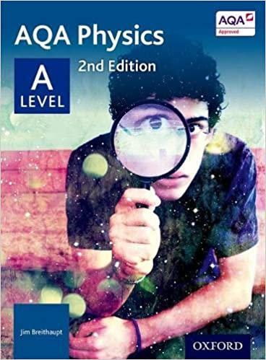
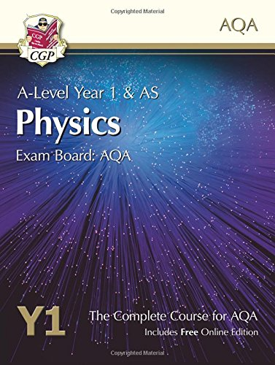
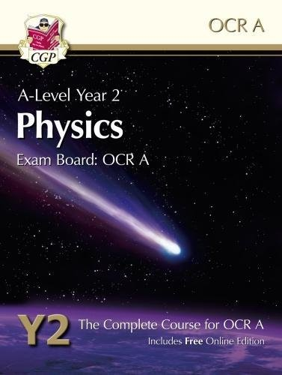
The text books
Used in school
Breithaupt
CGP (online version available)
You keep at home

Slide 24
Teaching Format
9 hours of lessons per fortnight
Each class will have 2 teachers
The Physics teachers are
Mr Walker
Mr Drewett
Mr Murphy

Slide 25

Entry requirements (non-negotiable, sorry)
Grade 6 or above in GCSE Trilogy or Physics
Grade 6 or above in GCSE Maths.
Grade 4 or above in English

Slide 26
Sharepoint resources – in the Induction folder
Resources for y11 students to prepare for A level physics
AQA's Transition Guide
PHGS's 'Bridging the Gap’
A Practical Skills Workbook

Slide 27
Results 2023
Grade | Students achieving | Cumulative percentages
A* | 3 | A* | 14.3%
A | 6 | A*-A | 42.9%
B | 4 | A*-B | 61.9%
C | 3 | A*-C | 76.2%
D | 3 | A*-D | 90.5%
E | 2 | A*-E | 100%

Slide 28
Possible beneficial subject combinations
Maths and Further Maths
Chemistry
Geography
PE
Biology

Slide 29

What will you learn?
Logical and structured thinking
Problem solving
Maths (approximately 40% of the content)
Data analysis and graphing
Visualising
Practical skills
Emotional intelligence (yes, really...)

Slide 30
Finally #emotional intelligence
Physics is rewarding but it isn’t an easy ride.
Are you enthusiastic, hard working and able to work independently?
Do you enjoy maths?
Are you resilient when the going gets tough??
Will you take responsibility for your progress? You need to KEEP UP…physics builds ideas upon ideas…

