Slide 1
Welcome to A-level Politics
What: provide an overview of the course and to give you an idea about what you will be studying in Year 12 and 13
Why: To help you to prepare for the transition from KS4 – KS5

Slide 2

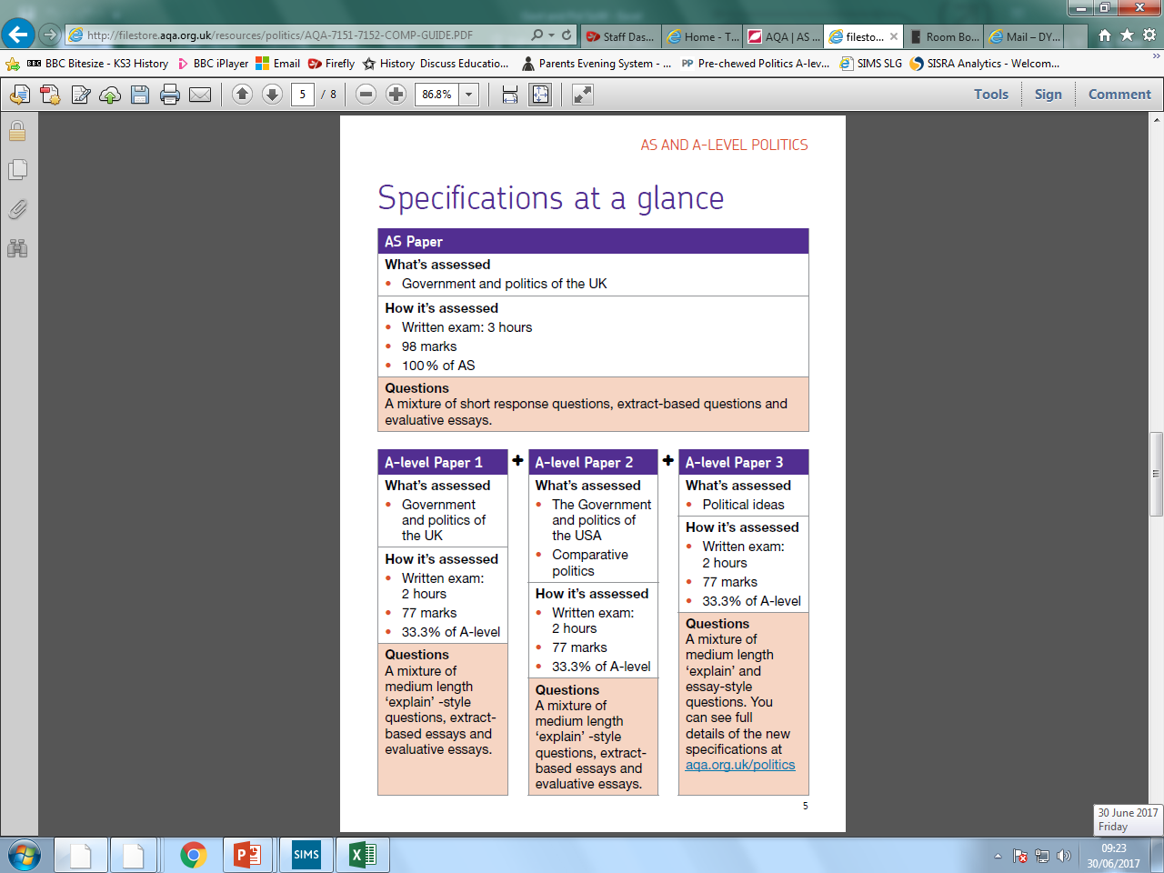
POLITICS @ PHGS
How is it assessed?
TO UPDATE

Slide 3






POLITICS @ PHGS
What work should you be doing?

Slide 4

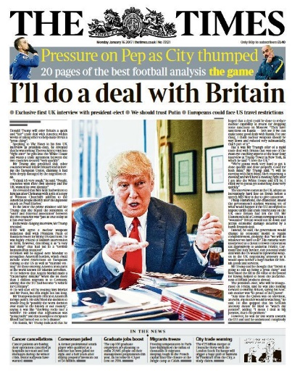





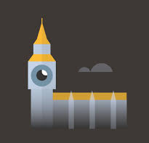



POLITICS @ PHGS
What can I do to stay up to date?

Slide 5
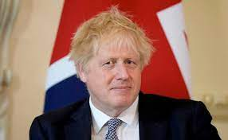
Why has the prime minister been under pressure?
https://www.theweek.co.uk/news/politics/957259/boris-johnson-and-his-trouble-with-the-truth
https://www.bloomberg.com/news/articles/2022-07-06/boris-johnson-s-no-10-sees-maximum-danger-as-top-ministers-quit
https://www.theguardian.com/politics/boris-johnson
Discussion: Watch this video and read one of these articles and be ready to discuss why the prime minister has been under pressure to resign.

