Slide 1
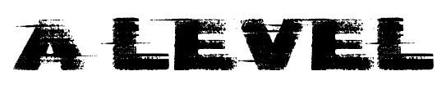
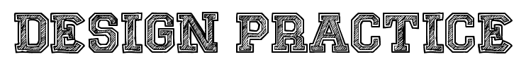

Slide 2
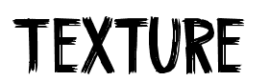
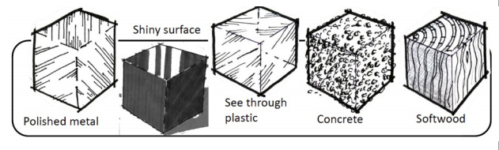
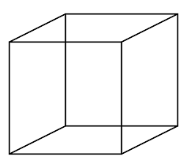
Pencils and Colour Only
A texture is how an object feels. How can we translate something we feel into something we see?
The material and surface dictate how much light is reflected.
Hard Surfaces like metal and glass are reflective so use sharp crisp edges with strong contrast.
Soft Surfaces like woods do not reflect much light so use soft shading and blending.
Rough Surfaces like fabrics will have mixed light reflection and so a mixture of sharp contrast with soft blending should be used.
Polished
Metal
Softwood
Shiny
Surface
Concrete
Clear
Plastic

Slide 3
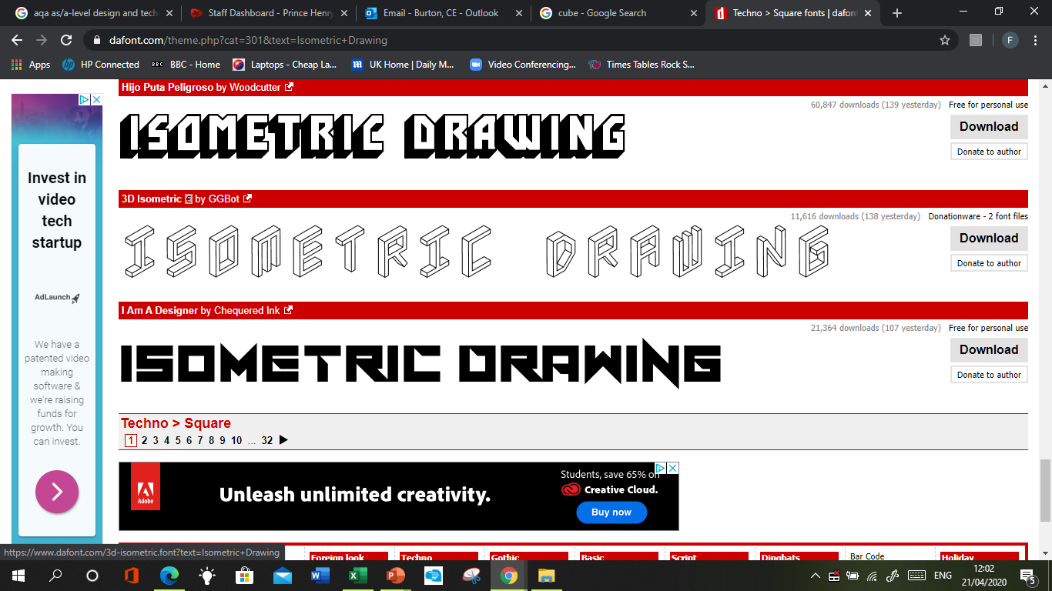
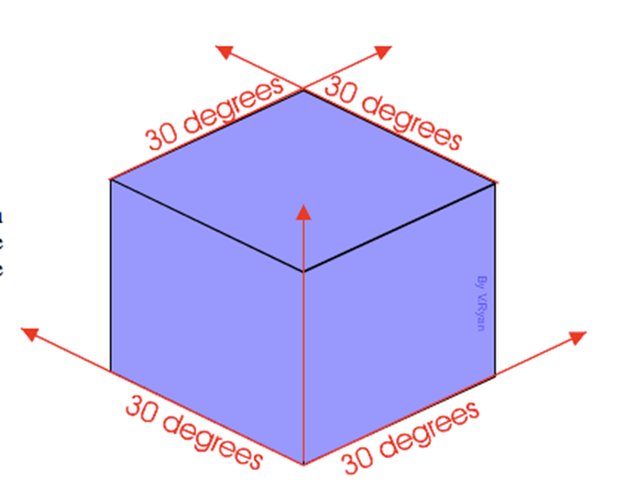
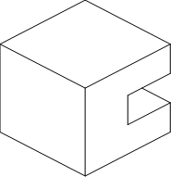
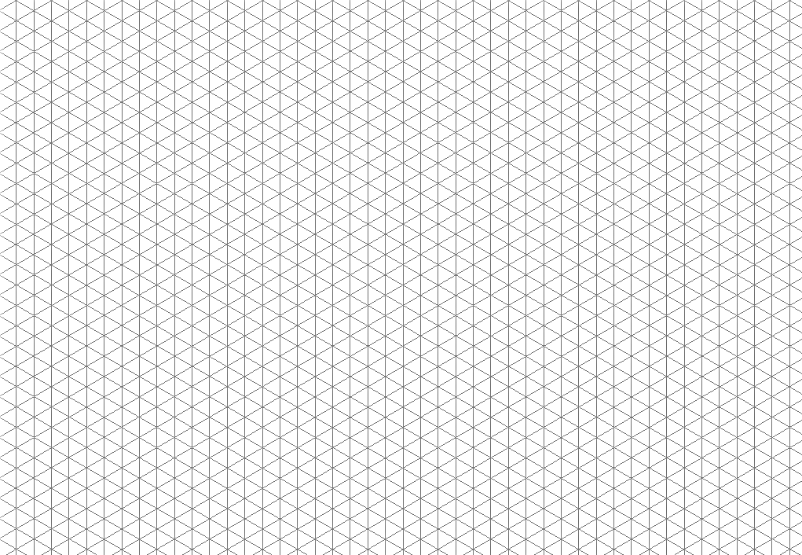
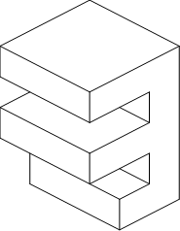
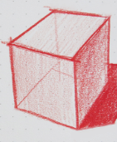
We have been working on isometric drawings since KS3 as this is the easiest way to create 3D drawings. They show three sides, all in dimensional proportion, but none are shown as a true shape with 90 degree corners. All the vertical lines are drawn vertically but all horizontal lines are drawn at 30 degrees to the base line.
Use the skills you already have to draw your initials and then move on to the 2 more complex shapes. Using the isometric grid if you need it. Try to render using one colour but show where the light, medium and dark faces of the shape would be.

Slide 4


Slide 5
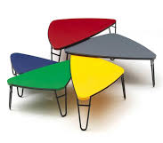
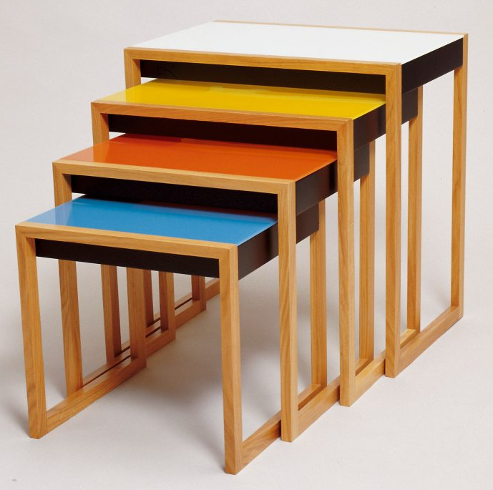
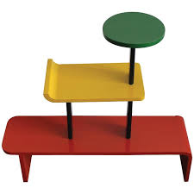
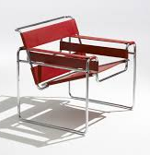
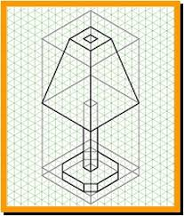
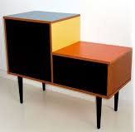
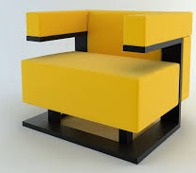
Now design a lamp. Draw it in an isometric format. Use the images from the Bauhaus movement to inspire the shapes and colours of your lamp. Remember to use the textures from the 1st slide to show the materials that you want to use. Would the materials fit the design movement?
Challenge: Can you get some curves in?

Slide 6
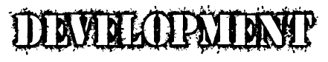
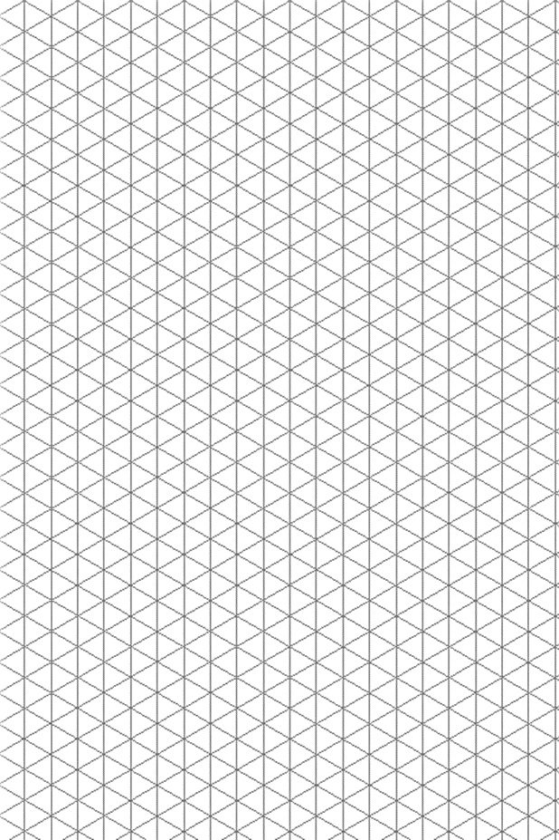
In order to improve design ideas you need them to evolve. You need to act on feedback and change and modify them to better fit your brief and client wants and needs. Show your lamp design to someone else and redesign the lamp twice based on feedback gathered from potential clients. Annotate neatly in pencil to explain the modifications and why they make the lamp more viable.

Slide 7
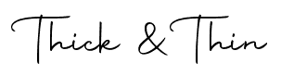
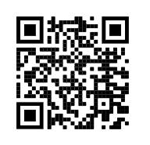
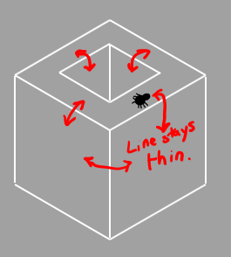
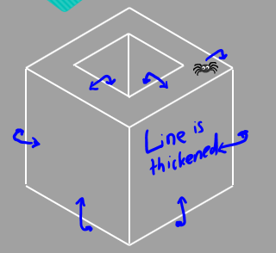
Depth can be shown using thick and thin lines. They help to define parts of a 3D shape to make it look more realistic.
Where the thick and thin lines are places is to do with whether the faces are visible or non visible in drawing. The best way I have always found to explain this is a method I use with KS3.
If the spider crawls over the edge and you can still see it, the line stays THIN
If it crawls over the edge and you can’t see it anymore, the line becomes THICK.
Go back to your developed drawings and add thick lines too define your drawing. Use this GCSE video to help if you get stuck.

Slide 8
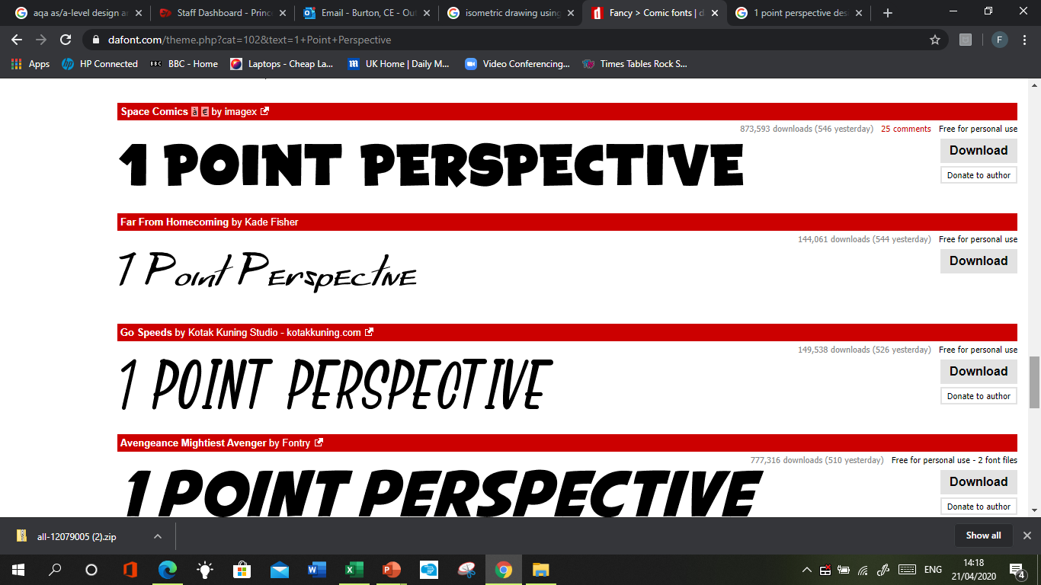
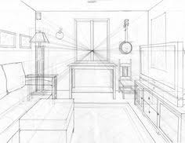
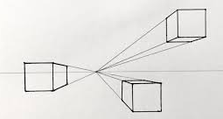
This technique is frequently used by architects and interior designers. It is ideal for room layouts and buildings. It makes drawings appear more real to life as what we would see in the distance would have a vanishing point. We can use this technique to create design ideas that we need to see from different angles. You start with one point where all lines will arrive at, this is called the vanishing point.
Start by making a dot at the top or bottom of your page towards the side. Draw a cube and use a ruler to make all edges that are visible meet at the one vanishing point. See if you can add more cubes.

Slide 9
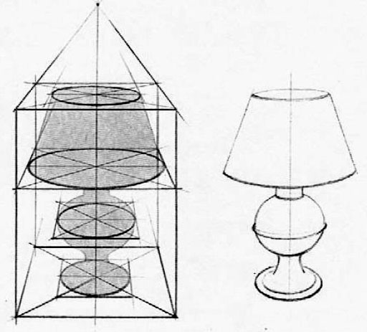
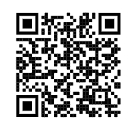
Now draw a dot to the side, above or below a drawing of your lamp and use a ruler to make all edges that are visible meet at the one vanishing point. Start by crating, which means drawing boxes to create an angular version of your lamp. The curves can come later.
Challenge – Try 2 point perspective by watching the video.

Slide 10
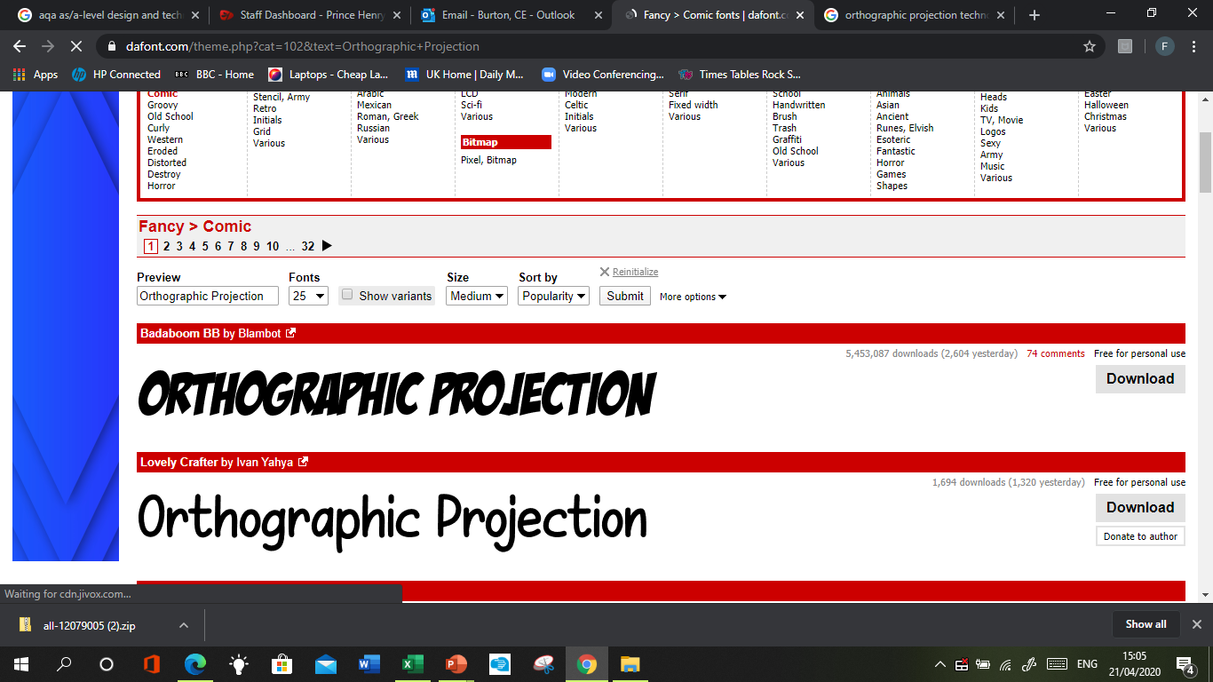
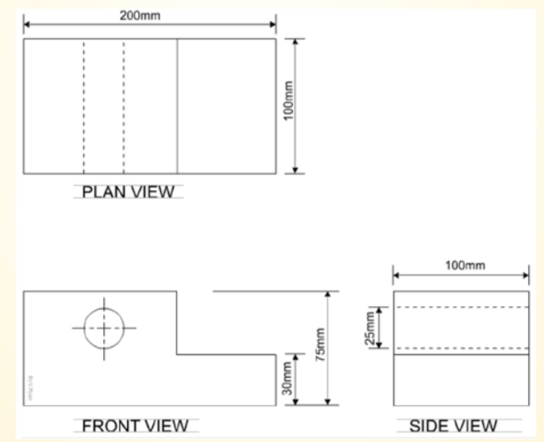
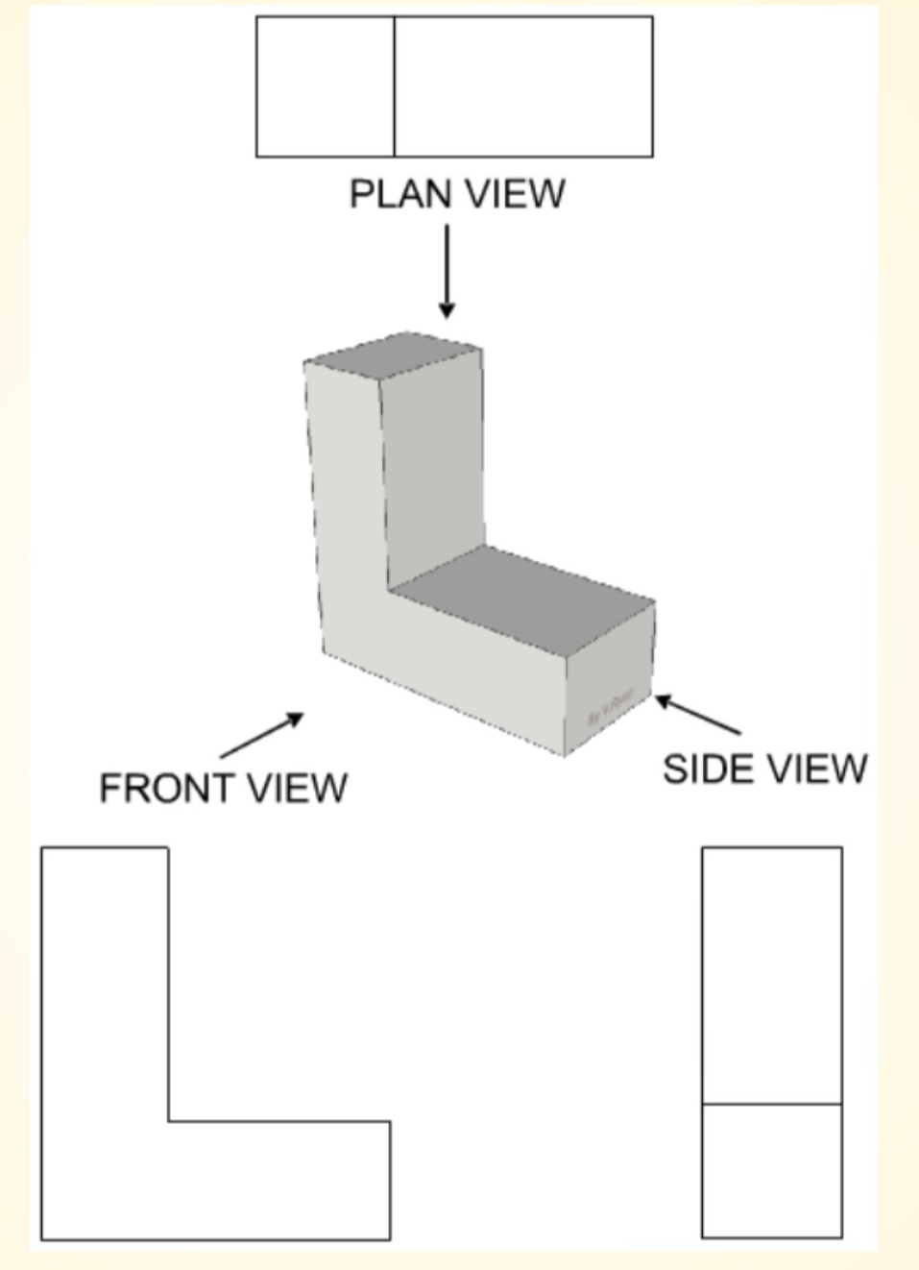
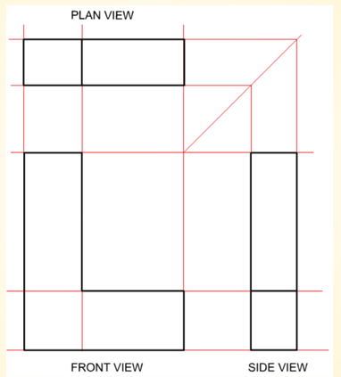
Orthographic Projection is a method of 2D drawing that is used across industry to standardise drawings for manufacturers and engineers to understand scale and dimensions.
This type of drawing shows a 2D view of a 3D object. There is a drawing of a 3D object, a front view, a plan view (above) and an end view (side).

Slide 11
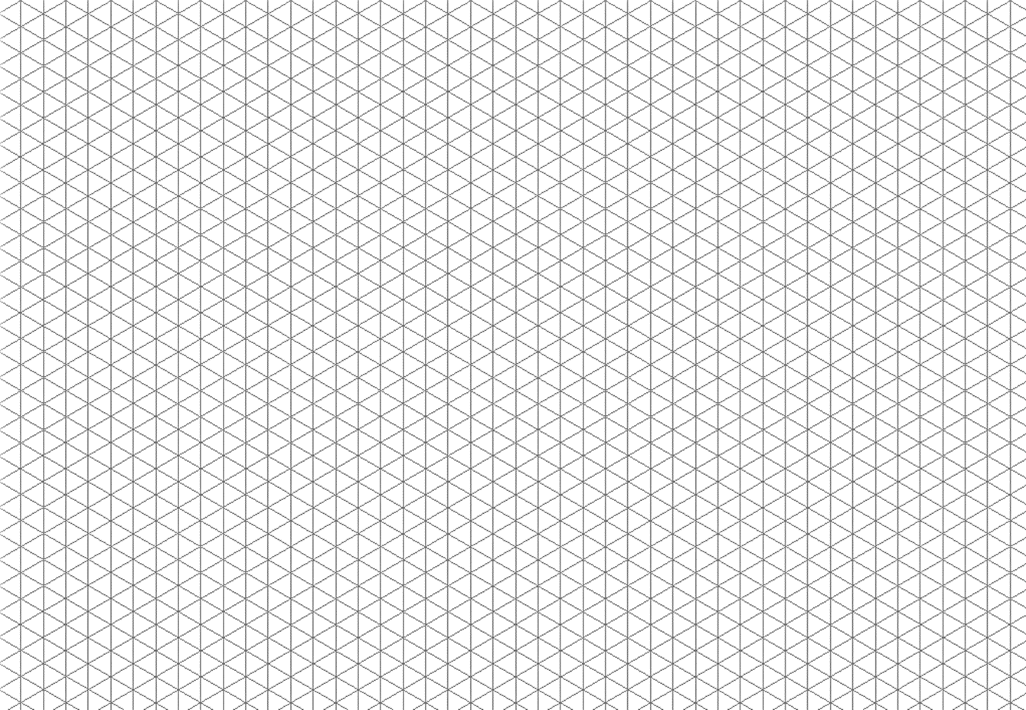
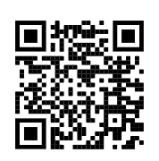
Draw the middle shape on the isometric paper. Now try to show the 3rd angle orthographic projection of it. It may be more helpful to cut it out and stick on plain or squared paper as the isometric paper may confuse you for the orthographic drawing.
If you get stuck, watch the video.

Slide 12
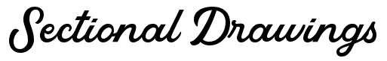
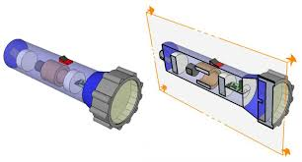
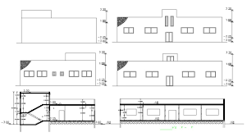
Sectional drawings are created to show hidden detail. To create a simple sectional drawing, you could just cut it in half.
Draw a section drawing of a shape of your choice, perhaps your lamp and show what it looks like cut in half. Use the blank part of this sheet or the isometric grid on the next page,

Slide 13
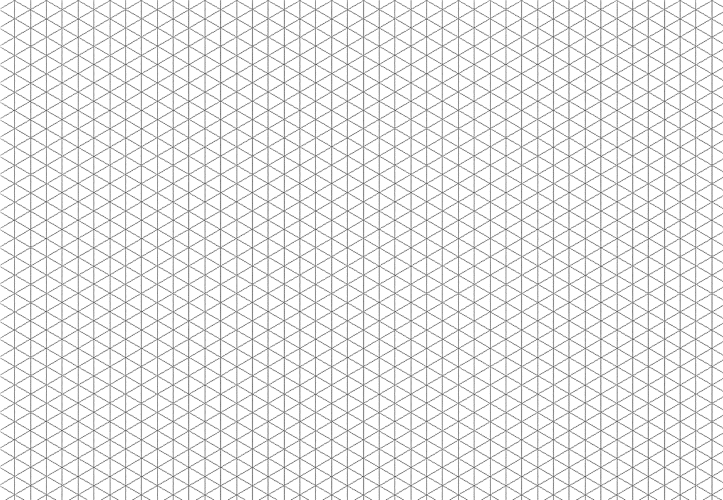

Slide 14
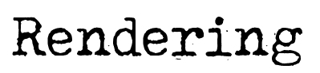
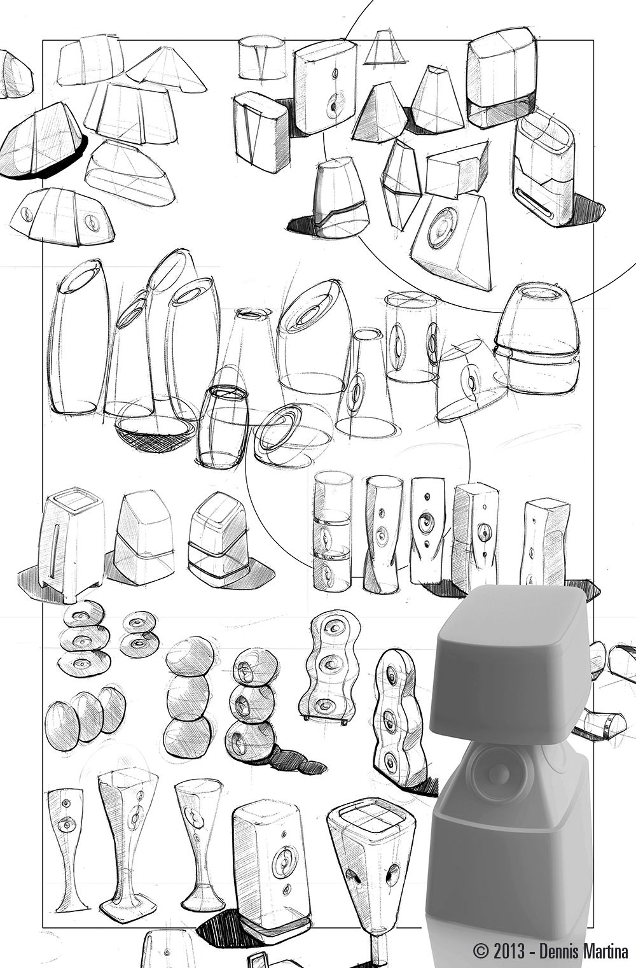
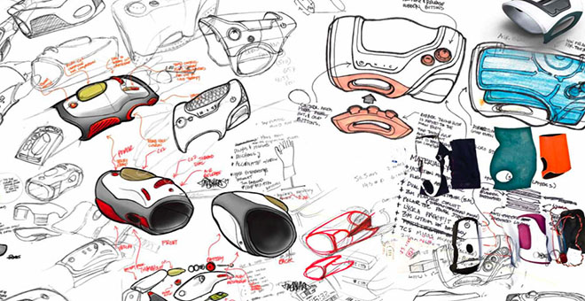
Marker Rendering is used to enhance drawings by adding a base colour and adding up layers and tones. They give drawings more of a 2D effect as do pencil crayons, water colours and fine liners.
Create a sheet of initial 3D sketches of any product of your choice, perhaps your lamp, each drawing should take no more then 3 minutes to draw in pencil. Then have a go at building up colour with any of the above. Use the blank space or the isometric grid on the next 2 slides.

Slide 15
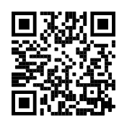

Slide 16


