Slide 1
Setting up firefly for iPad
Prince Henry’s Grammar School Guide
2021

Slide 2
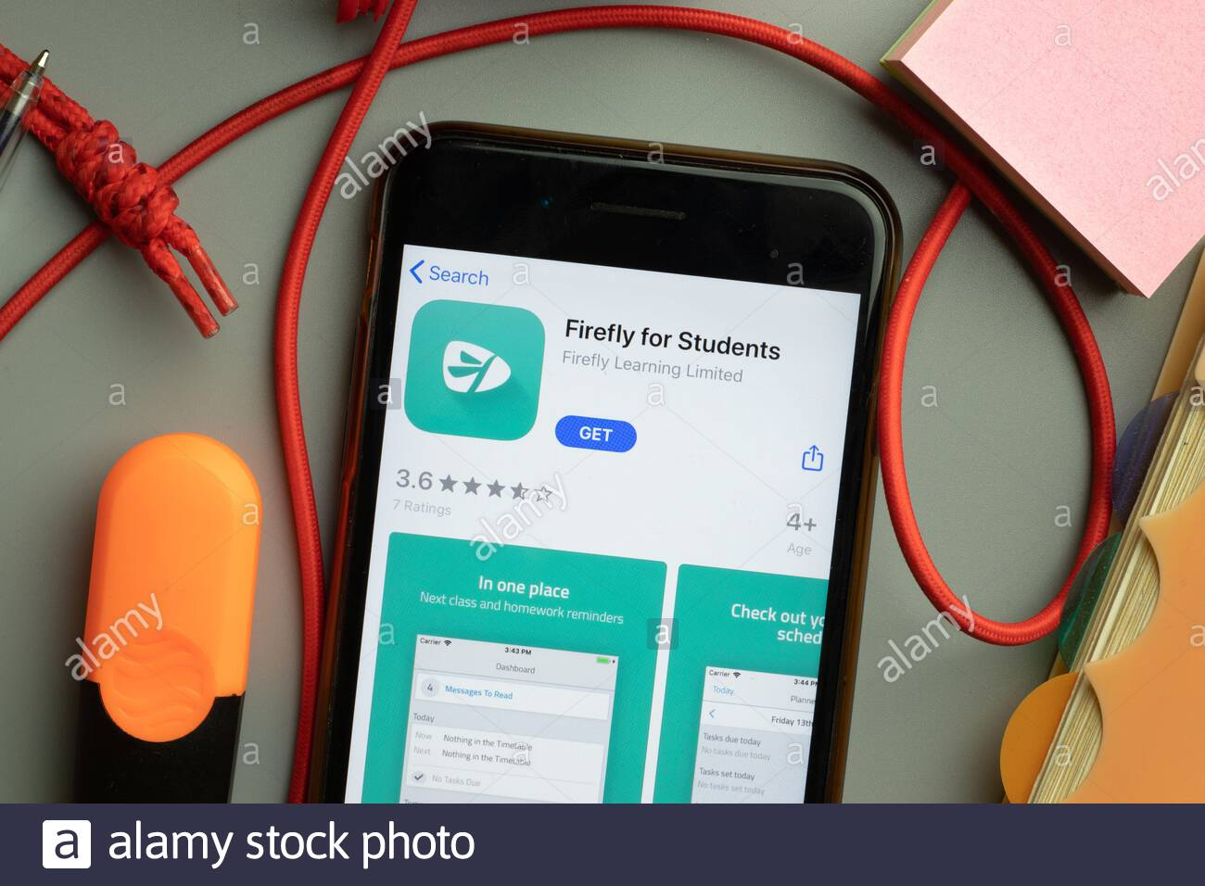
1. Download “Firefly for students” from the app store

Slide 3
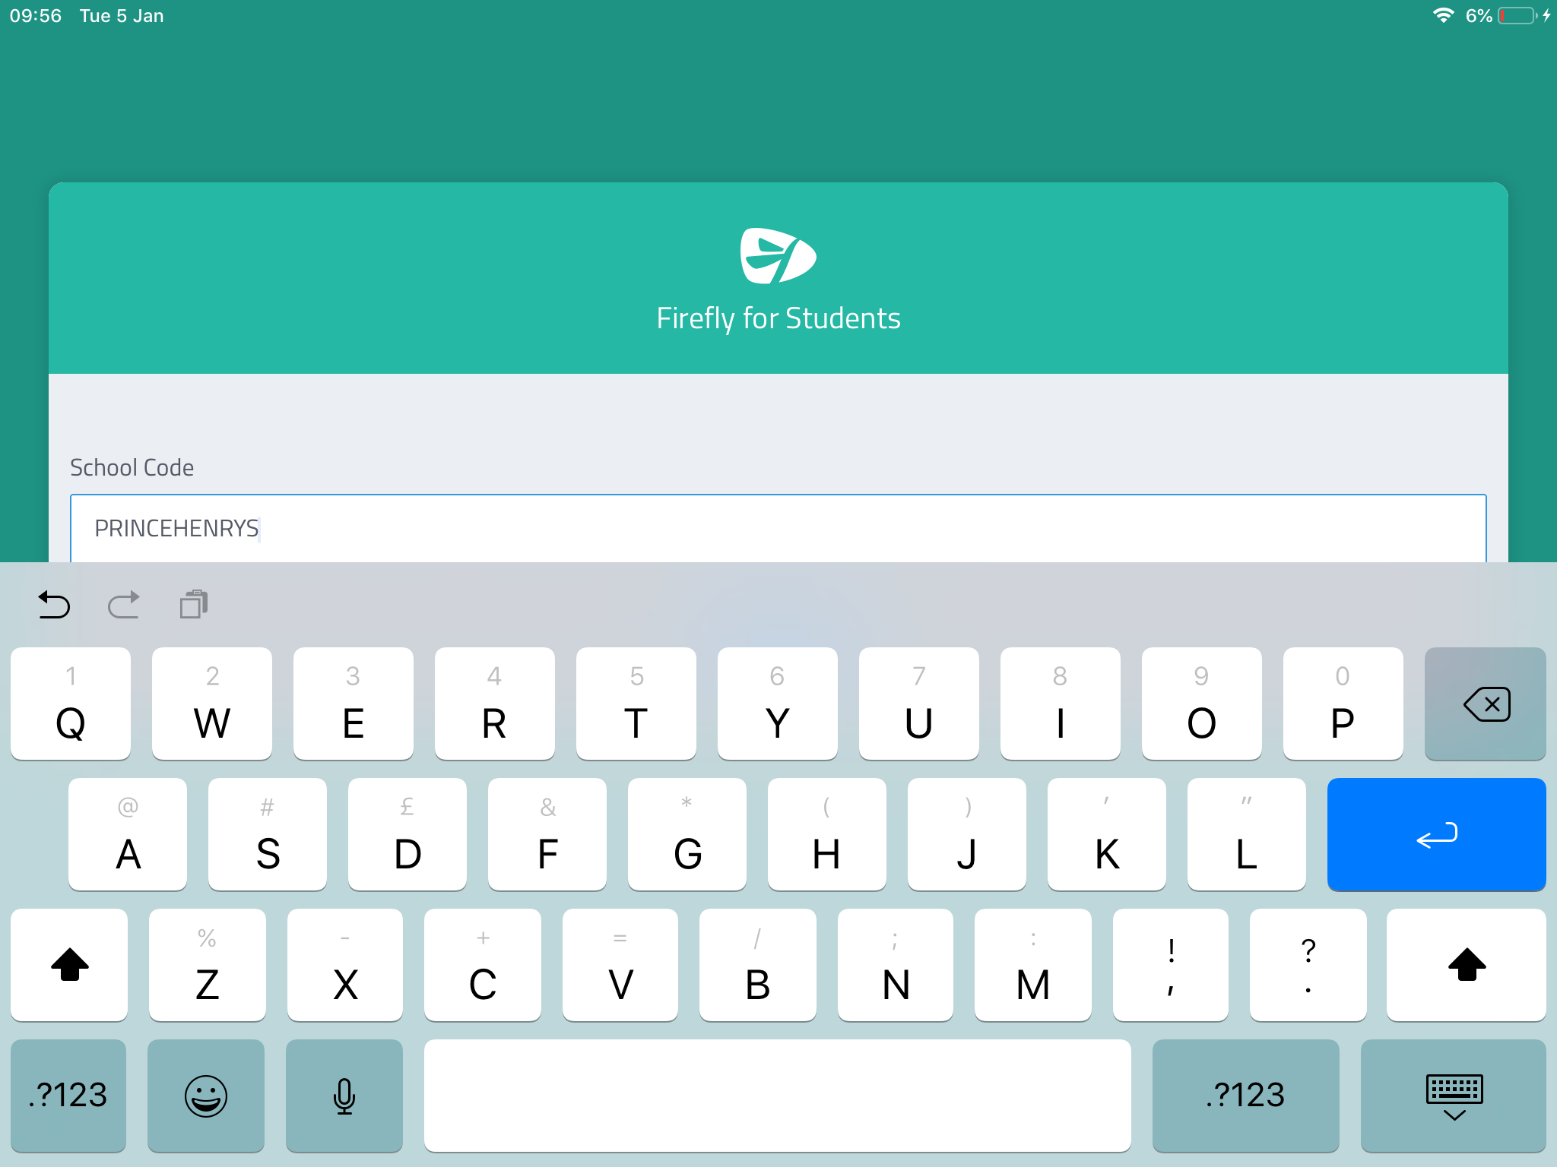
2. Open the app and type in the school code PRINCEHENRYS

Slide 4
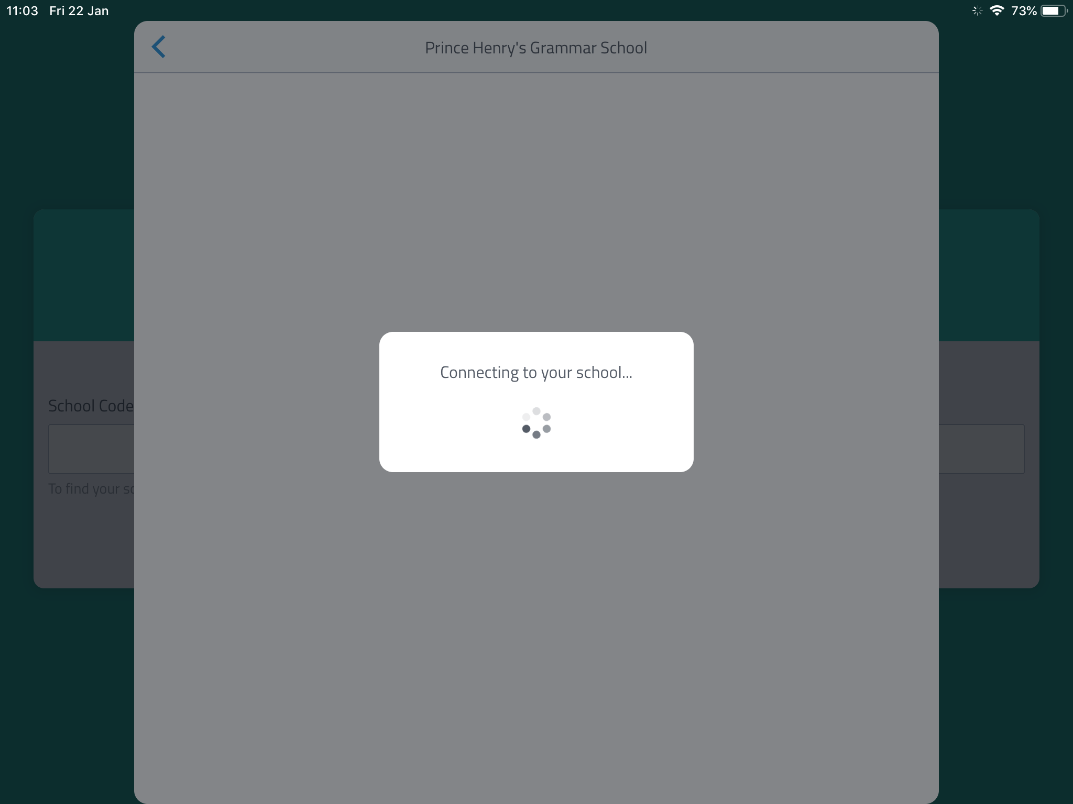
3. The app will then connect to the school system

Slide 5
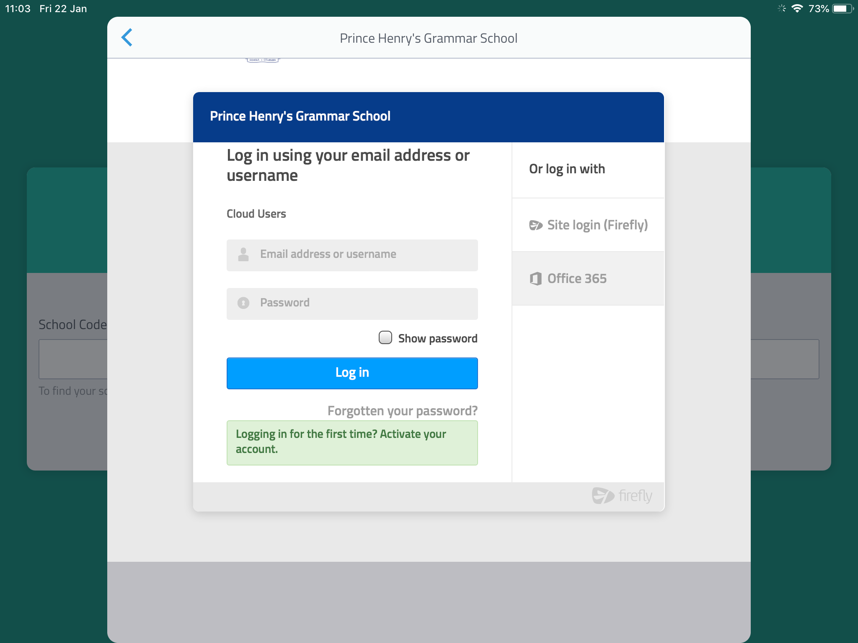
4. Click Office 365
(you may have to tap it a couple times)

Slide 6
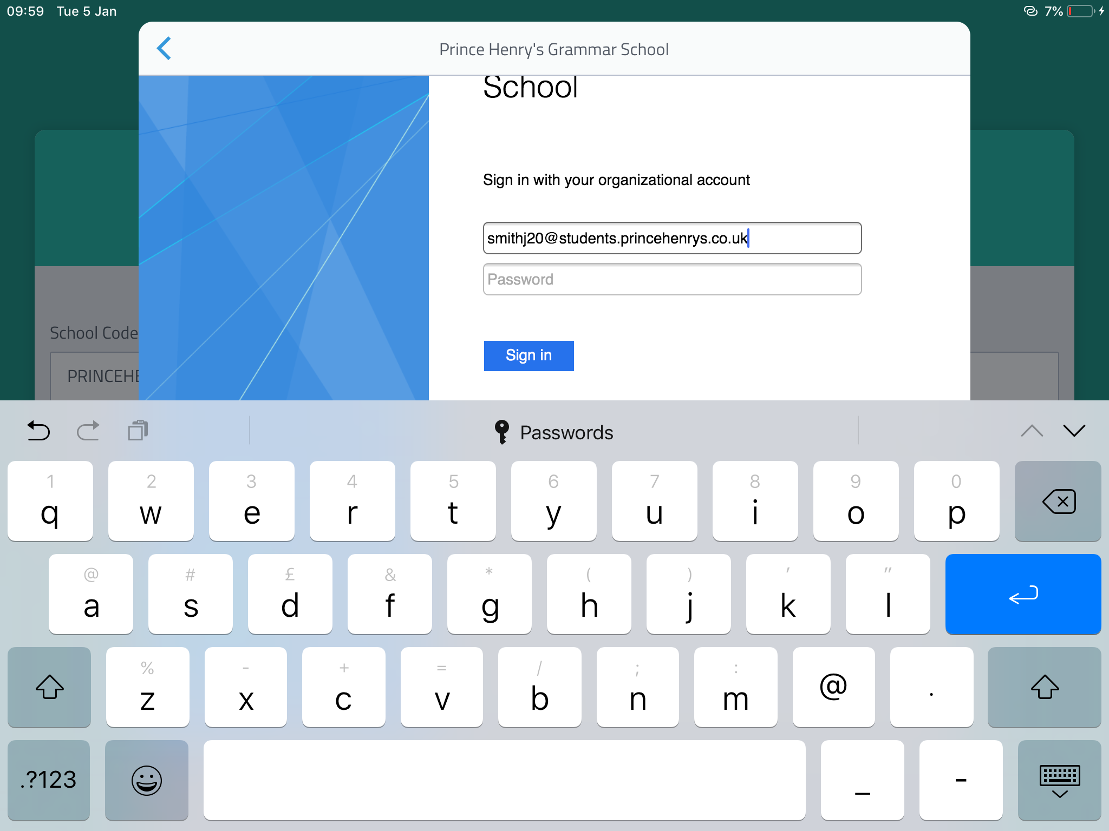
5. Type in your student email address (this is your school username followed by @students.princehenrys.co.uk) Then type in your password and tap sign in.

Slide 7
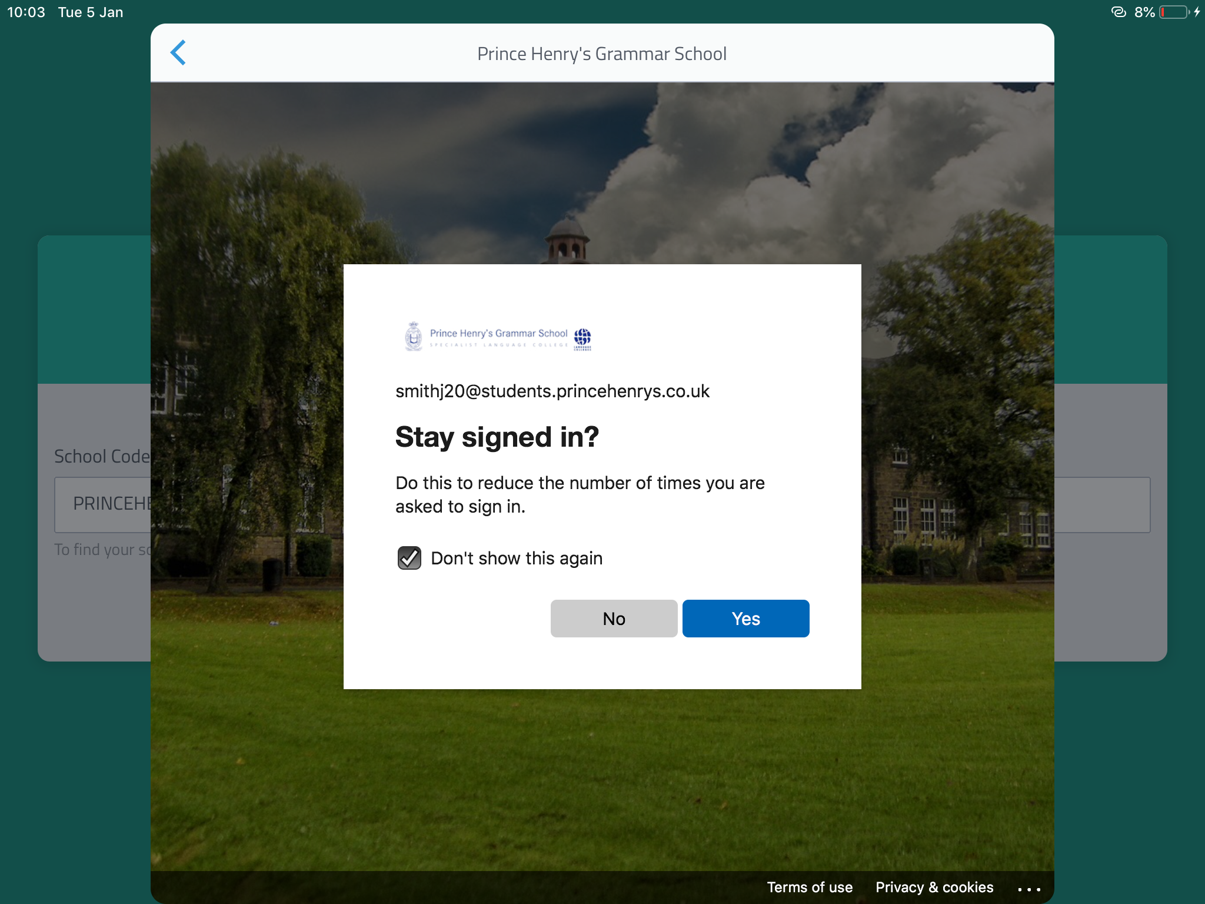
7. Tap the don’t show this again tick box and then tap yes

Slide 8
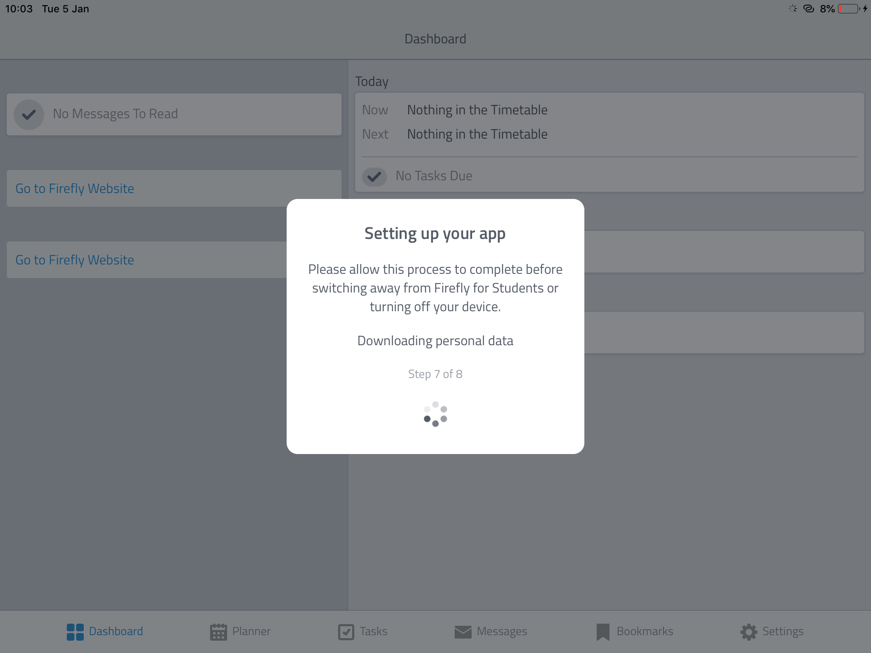
8. The app may take 2-5 minutes to set up

Slide 9
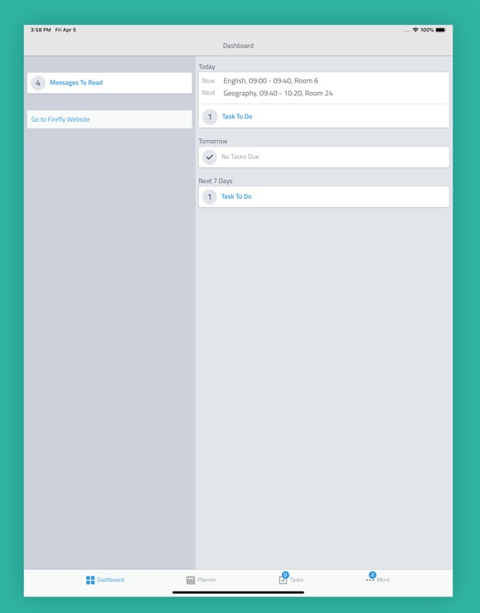
9. The app should look like this after set up is complete.

