Slide 1
Revising for your mock History GCSE exam
Week commencing | If you are short on time focus on weaker areas for each topic / Extra time? Then add to your revision from your classwork | Completed
15/05 - GCSE Paper 1: Medicine
Wk1 | Medieval Medicine: Make mind maps, notes or flash cards from the revision guide pages 6-10
Wk2 | Renaissance Medicine: Make mind maps, notes or flash cards from the revision guide pages 11-16
Wk3 | 18th and 19th Century Medicine: Make mind maps, notes or flash cards from the revision guide pages 17-23
Wk4 | Modern Medicine: Make mind maps, notes or flash cards from the revision guide pages 24-32
Wk5 | Western Front Medicine: Make mind maps, notes or flash cards from the revision guide pages 33-39
Final revision | Review all Medicine revision and make flashcards on the technique needed for each question (refer to the Paper 1 page in this pack)

Slide 2
Topic summaries

Slide 3
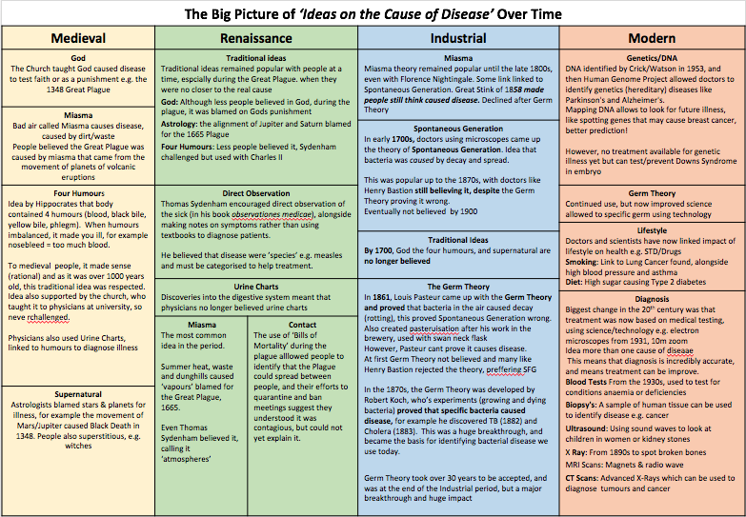

Slide 4
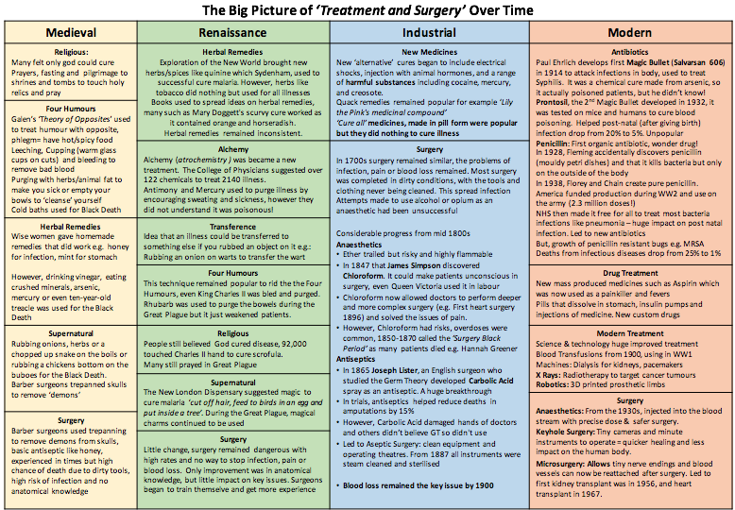

Slide 5
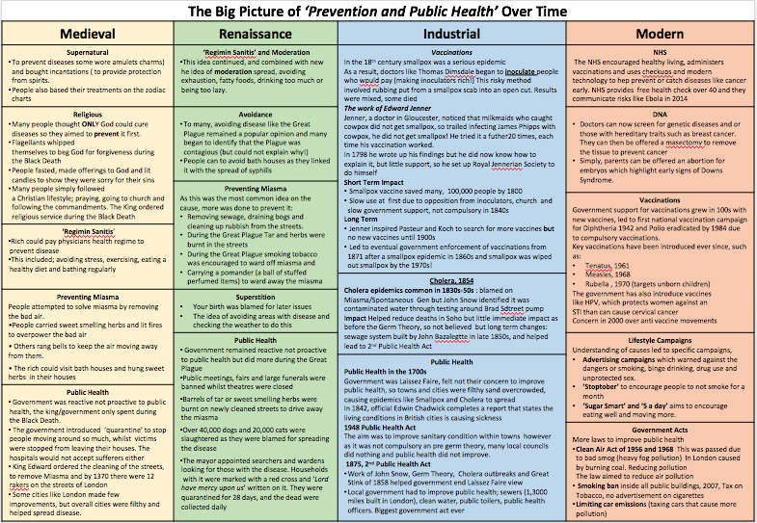

Slide 6
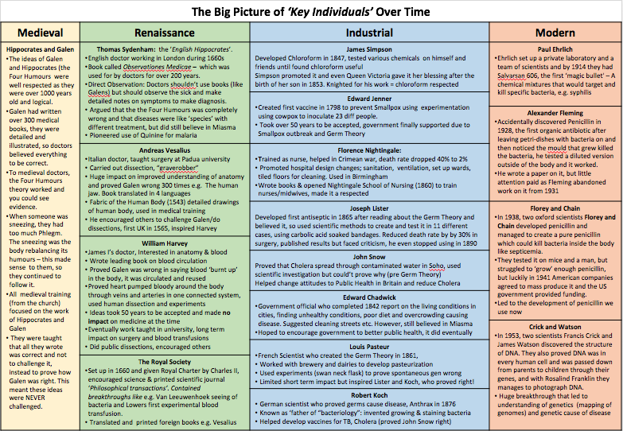

Slide 7
Knowledge organisers

Slide 8
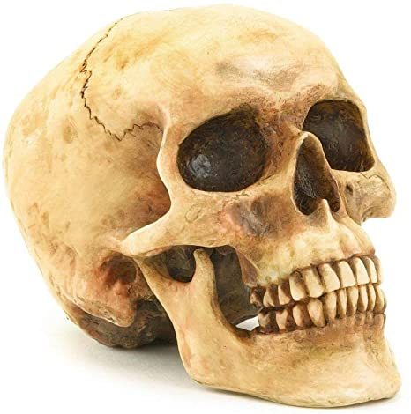
Paper 1 - Part 1Medicine in Britain, c1250–present
AO1 Demonstrate knowledge and understanding of the key features and characteristics of the periods studied.
AO2 Explain and analyse historical events and periods studied using second order historical concepts (causation, consequence, significance, similarity and difference, change and continuity)
Edexcel GCSE
Medicine in medieval England
c1250–c1500
13th,14th and 15th centuries
1348 - Black Death
Medical Renaissance c1500–c1700
16th and 17th centuries
1470s – First British Printing Press (influences this time period)
1660 – Royal Society founded
1665 – Great Plague
Medicine in eighteenth and nineteenth-century Britain
c1700–c1900
18th and 19th centuries
1853 – Smallpox vaccination
1861 – Pasteur’s Germ Theory
1875 – Public Health Act
Medicine in modern Britain
c1900–present
20th and 21st century
1909- First magic bullet
1928 – Penicillin discovered
1948 – NHS founded
1953 – DNA discovered
UNIT CONTENT
This unit will be taught in four time period topics as specified by Edexcel
Topic 1: c1250–c1500: Medicine in medieval England | The key ideas about the causes of disease and illness in the Late Medieval Period were God, Miasmas and the Four Humours Theory. The Church had a huge amount of power and controlled ideas and education about medicine. With little progress in medicine life expectancy remained low and 40% of England died from the Black Death.
Topic 2: c1500–c1700: The Medical Renaissance in England | The key ideas about the causes of disease and illness in the Renaissance were still God, Miasmas and the Four Humours Theory. Although, the power of the Church declined and progress was made by key individuals; Thomas Sydenham, Andreas Vesalius and William Harvey. They produced more accurate knowledge of illness and the human body.
Topic 3: c1700–c1900:Medicine in eighteenth and nineteenth-century Britain | Edward Jenner discovered the first vaccination, 1798. Industrialisation led to developments in science and technology which supported medical progress. Louis Pasteur discovered germs and Robert Koch developed his work further. The germ theory led to the development of antiseptics and persuaded the government to pass public health laws.
Topic 4: c1900–present: Medicine in modern Britain | This was a period of rapid progress. Understanding about the cause of disease and illness progressed further as scientists discovered DNA. Several new treatments were used; e.g. antibiotics, radiotherapy, blood transfusions, transplants. The NHS was set up in 1948.
ASSESSMENT
Exam Board Assessment | This unit will be assessed in a 1 hour 20 minute written exam at the end of Year 11. The paper has two parts to it; the Medicine in Britain part is worth 20% of your final grade and you are advised to spend 50 minutes on it. There are 3 questions: Sim/Diff(4 marks), Explain(12) and Evaluate(16 + 4 SPaG)
School Assessment | Throughout this unit there will be: • Guidance on how to answer each of the 3 questions (Sim/Diff, Explain and Evaluate) • An opportunity to practice the 3 questions and then self assess • Teacher and peer assessments • Educake quizzes to help embed core knowledge • You will have a mock exam too

Slide 9





Topic 1: Medicine in Medieval England
c.1250-1500
Edexcel GCSE
5th century BC
Ancient Greek Doctor Hippocrates wrote about the Four Humours Theory
2nd Century AD
Ancient Greek Doctor Galen worked in Ancient Rome
12th century
(1100s)
Use of Astrology in medicine is brought to Europe from the Middle East
c1250
The beginning of your study of medicine in Medieval England
1300
Fewer than 100 physicians in England
1348
The Black Death – a plague which killed 40% of England
1349
King Edward III ordered the Mayor of London to clear fifth from the streets as it was ‘infecting the air’
1403
Royal surgeon, John Bradmore removed an arrowhead using metal forceps
c1500
The end of your study of medicine in Medieval England
CONTINUITY
Topic 1 Key words | Key words:
Late Medieval Period | This topic focuses on the Late Medieval Period from c.1250-1500. These years cover the 13th, 14th, and 15th centuries.
Physicians | University educated doctors who would treat the wealthy
Four Humours Theory | The theory that the body would be in good health if the humours (blood, phlegm, yellow and black bile) were balanced.
Hippocrates | Ancient Greek doctor who developed clinical observation and the Four Humours Theory.
Galen | Ancient Greek doctor who developed the Opposites Theory and wrote books on anatomy and physiology
Anatomy | The study of the structure of the human body
Physiology | The study of how the human body works
Opposites Theory | The theory that symptoms of illness could be cured using opposites. This was based on the Four Humours Theory
Miasma | Miasma was bad air that was believed to make you ill
Remedies | Herbal remedies were treatments made from plants
Astrology | The study of the movement of the planets and stars
Barber Surgeon | Barbers worked with sharp knives to cut hair so they used the same tools to carry out small surgeries like bloodletting.
Topic 1 Key content
1. What were the supernatural ideas about the cause of disease and illness in Medieval England? | The Christian Church had a significant impact on people’s lives in Medieval England. They taught that God sent disease as a punishment for sins or as a test of your faith. No one questioned the teachings of the Church. Astrology was another supernatural idea about the cause of disease and illness.
2. Why did Ancient ideas about medicine continue in England? | There were two key Ancient ideas which continued in the Medieval period; The Four Humours Theory and the Miasma Theory. Two Ancient doctors, Hippocrates and Galen had written about them. They continued because of Church support and a lack of new ideas
3. How was disease prevented and treated in Medieval England? | Many treatments and approaches to prevention were based upon ideas about the causes of disease and illness; four humours, miasma and God. Herbal remedies were common treatments and sometimes effective. Surgery progressed but was still basic and dangerous.
4. How were the sick cared for in Medieval England? | There were doctors in Medieval England known as physicians but they only tended to the wealthy. Most people would see a barber surgeon, apothecary or the women of their household for treatment. There were some hospitals but they were largely for the elderly.
5. How did Medieval England deal with the Black Death? | The Black Death spread to England in 1348. It killed 40% of the population. The most popular theories for it were God’s punishment, miasma and the movement of the planets (astrology). It is a useful case study to see a Medieval response to an outbreak of disease.
6. Medieval Medicine Review​ | This lesson will: Consider the role of the key factors in Medieval medicine; Individuals, Institutions (Government and Church) Attitudes and Science and Technology and evaluate their relative significance.

Slide 10


Topic 2: Medicine in Renaissance England
c.1500-1700
Edexcel GCSE
c. 1450s
The Printing Press is invented
1536
Dissolution of the Monasteries in England
1543
Publication of Vesalius’ The Fabric of the Human Body
1628
William Harvey publishes his book on the circulation of the blood
1660
The Royal Society is founded
1665
The Great Plague arrives in England
1676
Thomas Sydenham publishes Observationes Medicine
1685
Royal Doctors tried to save the life of Charles II
c1700
The end of your study of medicine in Renaissance England
CONTINUITY
Topic 1 Key words | Key words:
Renaissance Period | This topic focuses on the Renaissance Period from c.1500-1700. These years cover the 16th and 17th centuries.
Four Humours Theory | The theory that the body would be in good health if the humours (blood, phlegm, yellow and black bile) were balanced.
Anatomy | The study of the structure of the human body
Physiology | The study of how the human body works
Secular | Not religious or in any way connected with spiritual beliefs
Printing Press | A machine for printing text or pictures. It had moveable letters so that many copies of the same text could be printed.
The Royal Society | A group of scientists who wanted to make new discoveries and share new ideas.
Quarantined | Separated from the rest of the local population because of illness
Herbal remedy | A medicine made up from a mixture of plants
Scrofula | Tuberculosis of a gland in the neck. Sometimes known as the King’s Evil, as it was believed that being touched by the king could cure the disease
Scarlet Fever | An infectious disease mostly affecting children
Apothecaries | A pharmacist of chemist
Topic 2 Key content
1. Why was there little change in ideas about disease and illness in Renaissance Britain? | There was still widespread belief that miastma caused disease in the Renaissance period. The theory of the Four Humours mostly continued and although supernatural causes were questioned, they were still used as explanations in times of epidemics.
2. Why were there some changes in ideas about disease and illness in Renaissance Britain? | The Church was still powerful, but lost some control over medicine. New ideas about science encouraged people to challenge old ideas and make discoveries. The Royal Society and the printing press helped spread new ideas.
3. Did treatments and methods of prevention change in the Renaissance? | Many of the treatments continued from the Medieval period. Treatments based on the Four Humours Theory, Miasma and God and Superstition continued. There were some small changes as new ingredients for herbal remedies were discovered in the New World.
4. Did how the sick were cared for change in the Renaissance? | Physicians, Apothecaries and women still provided care in the Renaissance period. However, Vesalius made progress in the understanding of the human body (as he dissected bodies). His findings helped train physicians.
5. Did Hospital care change in the Renaissance? | The dissolution of the monasteries, by Henry VIII, meant that many hospitals closed as they were connected to the monasteries. Some smaller hospitals opened in their place, funded by charities. Nuns and Monks no longer provided the care in hospitals.
6. How important was William Harvey in the Renaissance period? | William Harvey discovered how blood circulates around the body. Harvey proved that Galen was wrong on this matter and he showed how the heart acts as a pump, pumping blood around the body.
7. How did Renaissance England deal with the Great Plague? | The Great Plague broke out in 1665. The most popular theories for its cause were miasma, the Four Humours and God’ punishment. People used herbs and ‘plague water’ to try and prevent catching the plague. It is a useful case study to see a Renaissance response to outbreak of disease.
8. Renaissance medicine review | This lesson will: Consider the role of the key factors in Renaissance medicine; Individuals, Institutions (Government and Church) Attitudes and Science and Technology and evaluate their relative significance.
Notes:
12

Slide 11




Topic 3: Medicine in England c.1700 AD-1900 AD
Edexcel GCSE
1798 Edward Jenner discovers a vaccine for smallpox
1847: James Simpson uses chloroform as an effective anaesthetic
1854: John Snow removes the handle from Broad Street pump
1861: Louis Pasteur creates Germ Theory
1867: Joseph Lister uses carbolic acid as an antiseptic
1882: Robert Koch develops the ability to identify specific bacteria.
1854: Florence Nightingale improves conditions in Scutari hospital during the Crimean War
Topic 3 Key words | Key words:
Vaccines | A substance that is given to someone to stop them getting a disease
Germ Theory | The scientific theory that showed disease and infection were caused by germs / bacteria
Antiseptic | Kills bacteria and stops it growing
Anaesthetic | A drug that send you to sleep and stops the body from feeling pain.
Antibodies | Particles inside the body that identify and help to fight off and remove germs in the body.
Cowpox | A disease causing red blisters on the skin, similar to smallpox. It can be transmitted from cows to humans.
Aseptic surgery | Surgery where microbes are prevented from getting into a wound in the first place, as opposed to being killed off with an antiseptic.
Inoculate | Deliberately infecting oneself with a disease, in order to avoid a more severe case of it later on.
Laissez-faire | It is used to describe governments who do not get involved in the day-to-day lives of their population.
Small Pox | A viral disease that could cause considerable scarring ad could kill victims.
Cholera | A deadly bacterial disease that is spread through dirty water. Causes dehydration and vomiting.
Topic 3 Key content
1. What significant medical developments were there between 1700-1900? | Overview of the key medical developments and the roles of specific doctors in the development of these discoveries.
2. How significant was Edward Jenner’s discovery of the smallpox vaccine in the prevention of disease? | Jenner notices that milk maids who get cowpox do not get smallpox. He test this on a young boy called James Phipps. Despite this discovery he faces challenges from other doctors to get his idea accepted.
3. How significant was John Snow’s discovery about the causes of Cholera? ​ | John Snow was anaesthetist working in Soho London. He noticed that people who used the Broad Street pump appeared to get Cholera compared to those who used different sources. He proved that Cholera was spread through water.
4. What was Germ Theory and how was it developed? | Louis Pasteur publishes Germ Theory suggesting microbes are responsible for causing disease. In 1864 he conducts further experiments to prove his theory.
5. How significant was the discovery of Germ Theory? | Using Pasteur’s Germ Theory other scientists such as Robert Koch build on his work. Individual bacteria can be identified allowing the development of new vaccines.
6. Did Hospital care change between 1700-1900? | Florence Nightingale helped to improve hospital care in Scutari hospital during the Crimean War. She then applied her experience to improve hospital care in England. She wrote Notes on Nursing in 1863.
7. How far did surgery develop 1700-1900? | The development of anaesthetics overcomes the problem of pain in surgery and allows for longer and deeper operations. The development of antiseptics allows for the development of more sterile operations.
8. To what extent did Public Health change? | Changes in society and scientific understanding lead to the development of new laws and actions by government to improve living conditions in Britain.
8. 1700-1900 review | Reflection on how far prevention, treatment and idea about causes has changed in this period.
Notes:
12

Slide 12
Topic 4: Modern medicine
c.1900 - present AD
Edexcel GCSE
1901
Karl Landsteiner discovered blood groups
1909
Development of Salvarsan 606
1948
NHS established
1953
Crick and Watson discover DNA
1967
Dr Christian Barnard completes the first successful heart transplant
1990
Human Genome project started
1928
Fleming identifies penicillin
1941
Florey Chain successfully trial penicillin
Topic 3 Key words | Key words:
Mastectomy | Surgical removal of a breast
Hereditary disease | Disease passed from parent and child
Diagnosis | the identification of the nature of an illness or other problem by examination of the symptoms
Smog | Air that is filed with soot and smoke
Antibiotic | A substance that kills bacteria or prevent bacteria from spreading.
Mass production | Producing on large scale
MRSA | A strain of anti-biotic resistant bacteria
Compound | A mixture of two or more elements
DNA | Deoxyribonucleic acid carries all the genetic information from one living thing to another
Genome | The complete set of DNA
NHS | National Health Service that is paid for through taxation and is free at the point of delivery for all citizens.
Topic 3 Key content
1. Why has the understanding of the causes of illness and disease improved in modern medicine? | The discovery of DNA by Crick and Watson and how the Human Genome project mapped out all human genes allowing doctors and scientists to identify how genetic diseases can be spread. The development of new technology was key to this. The understanding of lifestyles and the impact that it has on health becomes better understood.
2. Why does the diagnosis and prevention of disease and infection improve in Modern medicine? | The development of new diagnosis techniques that have allowed diseases to be identified earlier, treated and prevented from becoming serious. The increased role that British government has had on implementing preventative actions to improve peoples’ health.
3. How have treatments in Modern medicine improved? | The development of new treatments such as: magic bullets, blood transfusions, radiotherapy, chemotherapy, transplant surgery, use of X-Rays, customised drugs, gene therapy, keyhole and micro-surgery, improved anaesthetics, pacemakers and plastic surgery.
4. Why was the development of penicillin so significant for modern medicine? | The work of Alexander Fleming in the identification of penicillin and how Florey and Chain developed it into a treatment and the impact that World War Two had on its’ mass production and the implication of its’ use after the war on medicine
5. How has access to medical treatment changed since 1900? | The development of the NHS in 1948 and how universal, free at the point of access health care had a major impact on the health of people in Britain.
6. Case study on lung cancer | The impact of science and technology in diagnosing lung cancer and the way in which doctors and scientists have developed new treatments using transplants, radiotherapy, chemotherapy and genetic research.
7. Review of learning | Recap of learning from this unit.
Notes:
12

Slide 13
Paper 1 - Part 2 Historic environment: The British sector of the Western Front 1914-18: injuries treatment and the trenches
AO1 Demonstrate knowledge and understanding of the key features and characteristics of the periods studied.
AO3 Analyse, evaluate and use sources (contemporary to the period) to make substantiated judgements, in the context of historical events studied.
Edexcel GCSE
British sector of the Western Front and trench warfare
Ypres
The Somme
Arras
Cambrai
Trench system
Illness and wounds
Trench fever (PUO)
Trench foot
Dysentery
Shell shock
Infection
Gas
Helping the wounded
Chain of evacuation
Royal Army Medical Corps
Alexandra Nurses
Female Auxiliary Nursing Yeomanry
Volunteer Aid Detachments
Impact of the Western Front on medicine and treatment
Thomas Splint
Mobile x-ray machines
Blood transfusions
Blood banks
Brain surgery
Plastic surgery
UNIT CONTENT
This unit will be taught in areas as specified by Edexcel
British sector of the Western Front and trench warfare | There were four main key areas of fighting for British and Empire troops on the Western Front. These were in Northern France (The Somme, Arras and Cambrai) and in Belgium (Ypres). Vast networks of defensive trenches were built and new technologies and strategies developed to break the stalemate.
Illness and wounds | The nature of trench warfare and length of the war meant that soldiers were afflicted by a range of illnesses and injuries such as Trench fever (PUO), Trench foot, Dysentery, Shell shock, Infection and Gas. The size and scale of the army on the Western Front put unique pressure on doctors and nurses treating these soldiers.
Helping the wounded | As the war progressed, a complex and sophisticated network was developed to help treat soldiers as best as possible. This was known as the chain of evacuation. The British army’s medical response was organised by the RAMC and the Queen Alexandra Nurses. They were supported by the Female Auxiliary Nursing Yeomanry and Volunteer Aid Detachments.
Impact of the Western Front on medicine and treatment | The unique challenge that the wounds and illnesses that the First World War provided to doctors and nurses meant that new ideas and treatments could be developed. New treatments included: the Thomas Splint, Mobile x-ray machines, Blood transfusions, Blood banks, Brain surgery and Plastic surgery
ASSESSMENT
Exam Board Assessment | This unit will be assessed in a 1 hour 15 minute written exam at the end of Year 11. The paper has two parts to it; the Historic environment: The British sector of the Western Front 1914-18: injuries treatment and the trenches 10% of your final grade and you are advised to spend 50 minutes on it. There are 3 questions: Describe two features(4 marks), How useful (8) and How would you follow up (4)
School Assessment | Throughout this unit there will be: • Guidance on how to answer each of the 3 questions • An opportunity to practice the 3 questions and then self assess • Teacher and peer assessments • Educake quizzes to help embed core knowledge • You will have a mock exam too

Slide 14
Check list

Slide 15
Medicine Through Time Revision topic list | Revision completed | Summary of revision taken place – ‘just reading my notes is not enough!’
What were the supernatural ideas about the cause of disease and illness in Medieval England?
Why did Ancient ideas about medicine continue in England?
How was disease prevented and treated in Medieval England?
How were the sick cared for in Medieval England?
How did Medieval England deal with the Black Death?
Why was there little change in ideas about disease and illness in Renaissance Britain?
Why were there some changes in ideas about disease and illness in Renaissance Britain?
Did treatments and methods of prevention change in the Renaissance?
Did how the sick were cared for change in the Renaissance?
Did Hospital care change in the Renaissance?
How important was William Harvey in the Renaissance period?
How did Renaissance England deal with the Great Plague?
What significant medical developments were there between 1700-1900?
How significant was Edward Jenner’s discovery of the smallpox vaccine in the prevention of disease?
How significant was John Snow’s discovery about the causes of Cholera? ​
What was Germ Theory and how was it developed?
How significant was the discovery of Germ Theory?
Did Hospital care change between 1700-1900?
How far did surgery develop 1700-1900?
To what extent did Public Health change?
Why has the understanding of the causes of illness and disease improved in modern medicine?
Why does the diagnosis and prevention of disease and infection improve in Modern medicine?
How have treatments in Modern medicine improved?
Why was the development of penicillin so significant for modern medicine?
How has access to medical treatment changed since 1900?
Case study on lung cancer

Slide 16
Medicine on the Western Front - Revision topic list | Revision completed | Summary of revision taken place – ‘just reading my notes is not enough!’
Trenches
Battle Case Studies: Somme, Cambrai, Arras and Yrpres
Medical problems in the trenches
Wounds and infection in the trenches
Chain of evacuation
Medical staff on the Western Front
Existing treatments at the beginning of the war
New treatments developed during the war.

Slide 17
Medicine through time revision
Ideas about the causes of disease and illness
Ideas about the causes of disease and illness
Medieval medicine
c.1250-1500
Renaissance medicine
c.1500-1700
Treatment of disease and illness
Prevention of disease and illness
Treatment of disease and illness
Prevention of disease and illness
Ideas about the causes of disease and illness
Ideas about the causes of disease and illness
18th and 19th century medicine
c.1700-c.1900
Modern medicine
c.1900-present
Prevention of disease and illness
Treatment of disease and illness
Prevention of disease and illness
Treatment of disease and illness

Slide 18
Exam question guidance

Slide 19
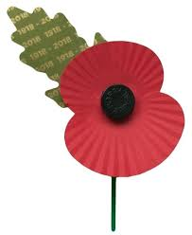



Paper 1
Part 1: The British sector of the Western Front 1914-18: injuries treatment and the trenches
1. Describe two features (4) | One feature is…​ An extra detail is…​ A second feature is…​ An extra detail is…
5
Give a supporting detail for each feature
2a.How useful are sources A and B for an enquiry into…? (8) | 1 paragraph on source A (SKP) 1 paragraph on source B (SKP) S - Source __ tells me… This is useful for an enquiry into X because…​ K - The source is also useful because it fits in with my knowledge that...​ P - The origin(author)/nature(type)/purpose of source __ means it is useful/limited because...​ ​​
15
SKP for each source Use the word USEFUL a lot!
2b. How could you follow up source…? (4) | Detail in the source I would follow up: ​ State a detail from the source linked to the enquiry​ Question I would ask:​ Link the question to the detail​ What type of source I could use:​ Link the type of source to the question​ How this might help answer my question:​ Explain what information the source might give you
5
Name a source specific to WWI e.g. a diary from…

Slide 20
How do I answer questions for the British Sector of the Western Front? 25-30 minutes of the Medicine Paper
4 marker Describe TWO features of… (5 minutes) | Approximately 5 minutes Short and simple One feature is… An extra detail is… A second feature is… An extra detail is… | Examples Describe two features of the methods used to reduce trench foot on the Western Front. Describe two features of Casualty Clearing Stations. Describe two features of the work of nursing units such as FANY. Describe two features of the methods of used to reduce the risk of trench fever
8 marker How useful are sources A and B for an enquiry into… 15-20 minutes | Consider each source separately: S K P (in any order but make sure you do all three elements for each source) S - Source A tells me… This is useful for an enquiry into X because… K - The source is also useful because it fits in with my knowledge that... P - The origin/nature/purpose of source A means it is useful/limited because... S - Source B tells me… This is useful for an enquiry into X because… K - The source is also useful because it fits in with my knowledge that... P - The origin/nature/purpose of source B means it is useful/limited because... Use the words useful and not useful a lot! | Questions to consider when evaluating the sources Source content: What does the source tell you that’s relevant to the enquiry focus of the question? Knowledge: How does the source match with what you know? By supporting it with your knowledge you are suggesting the content is correct and so the source is useful. Provenance: How do the nature, origin or purpose make the source more or less useful? Questions to consider... Is the source representative of the whole time period or every area on the Western front? Is the author an expert or emotionally influenced? Is the purpose to commemorate or give a factual account? Does the nature mean it could have been censored?
4 marker How would you follow up Source B to find out more about… 5 minutes | Detail in the source I would follow up: State a detail from the source linked to the enquiry Question I would ask: Link the question to the detail What type of source I could use: Link the type of source to the question How this might help answer my question: Explain what information the source might give you | Types of sources you could use Diaries and/or letters of... (Soldiers’, doctors’, nurses’ surgeons’),Hospital/casualty clearing station etc. records (would record admissions, wounds and illnesses, treatments and death/recovery rates), Photographs or art work of... (useful if you are looking at conditions of battlegrounds, trenches and treatment areas) Medical reports on...(gave details on how different wounds and illnesses were caused and the success of treatments), Army orders on...(information on how medical care was organised), Journal of the RAMC article on... (reports on problems and successes in care of wounded/ill soldiers), British Medical Journal article on...(articles on new medical problems and treatments)
Notes:
6-9 MEAs without sentence starters, more conceptual

Slide 21




Paper 1
Part 2: Medicine in Britain c.1250-present
3. Explain one way in which.... were similar /different​ in … (4) | One paragraph One way in which.... were similar/different was....​ ​For example, in the … century....​ ​Similarly/whereas, in the … century....​ ​Therefore, … were similar/different because....​
5
Give an example from each time period
4. Explain why…(12) ​ ​ | Point Evidence Explanation​
x3
20
3 points in 3 paragraphs No conclusion needed
5/6.How far do you agree?​ (16 + 4 SPaG) | Give a brief overall argument – agree or disagree with the statement?​ Agree paragraph Disagree paragraph Agree or disagree paragraph Conclusion that fits with your introduction Link to your overall argument throughout your answer
+
+
or
25
5 paragraphs Must argue for and against
For all questions- Use the wording of the question at the start of every paragraph and link back to it to explain ​

Slide 22
Practise questions – Medicine Through Time
4 mark questions
Explain one way in which ideas about preventing the plague were different in the 14th and 17th centuries.
Explain one way in which ideas about the cause of illness in the years c1700–c1850 were different from ideas about the cause of illness in the years c1900–present.
Explain one way in which understanding of the causes of illness was similar in the late nineteenth and twentieth centuries.
Explain one way in which understanding of the causes of illness was different in the late nineteenth and twentieth centuries.
Explain one way in which ideas about preventing the plague were different in the 14th and 17th centuries.
16 mark questions
Simpson's use of chloroform as an anaethestic was a major breakthrough in surgery during the period 1700-1900.’ How far do you agree?
• Jenner’s vaccination • the Black period
‘The role of science and technology was the main reason why diagnosis improved in the 18th and 19th centuries.’ How far do you agree?
• Microscopes • Robert Koch
‘Louis Pasteur's publication of the Germ theory was the biggest turning point in medicine in the period c1700-c1900.’ How far do you agree?
• Edward Jenner • Robert Koch
‘The work of Florence Nightingale was the most important development in the care and treatment provided in hospitals in the years c1700–c1900.’ How far do you agree?
• Florence Nightingale’s Notes on Nursing (1859) • anaesthetics
‘Germ theory was the most significant medical breakthrough in the 1800s.’ How far do you agree?
• Louis Pasteur • Vaccinations
Treatment of diseases and care of the sick completely changed after c1800.’ How far do you agree?
• magic bullets • the NHS
‘Government action is the most important reason why there were improvements in care and treatment in hospitals during the nineteenth and twentieth centuries.’ How far do you agree?
• Florence Nightingale • government funding
12 mark questions
Explain why there was little change in the care provided by hospitals in the period c1250-c1500.’
• ideas in the Church • herbal remedies
Explain why there was continuity in ideas about the cause of disease during the period c1250-c1500.
The Christian Church • Galen
Explain why the role of Church in medicine decreased in importance in the years c1250–c1700.
• medical training • William Harvey
Explain why there were changes in the way ideas about the causes of disease and illness were communicated in the period c1500-c1700
• the printing press • the Royal Society
Explain why there was continuity in the way disease was treated in the period c1500-c1700
• the Great Plague • attitudes in society
Explain why there was rapid change in the prevention of smallpox after 1798
• inoculation • the government
Explain why there was both continuity and change in treatments for sickness during the period 1700-1900
• hospital care • carbolic acid

Slide 23


