Slide 1

A Level Psychology

Slide 2

What is Psychology?
Psychology is the science of mind and behaviour
Our main goal is to understand why people behave the way they do

Slide 3

Course content and assessment
2 year A Level course
3 externally examined papers

Slide 4
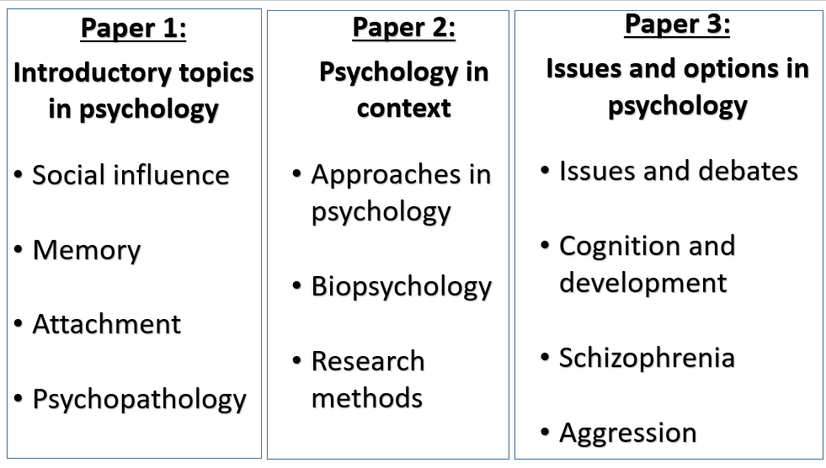
Paper 1:
Introductory topics in psychology
Social Influence
Memory
Attachment
Clinical Psychology and Mental Health
Paper 2:
Psychology in Context
Approaches in Psychology
Biopsychology
Research methods
Paper 3:
Issues and Options in Psychology
Issues and Debates
Gender
Schizophrenia
Aggression

Slide 5
What will the exam paper be like?
Multiple choice questions
Short answer questions
Extended response

Slide 6




Textbooks…
AQA
Teaching from 2025

Slide 7

Psychology: What to expect in September

Slide 8


A Level Psychology:
Your learning journey
Gender
Aggression
Schizophrenia
Issues & debates
Social influence
Attachment
Research methods
Memory
Psychopathology
Research methods
Research methods
Biopsychology
Research methods
Approaches

Slide 9
Issues & debates
Gender
Schizophrenia
Aggression
Approaches and Research methods will be the first topics to be taught in September along side each other. You will have one research methods lesson per week in year 1.

Slide 10

What is Research methods all about?

Slide 11




As psychologists, we try to understand human behaviour

Slide 12
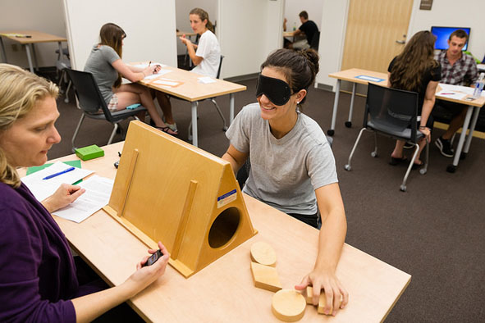
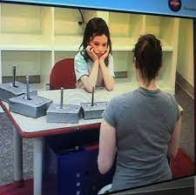
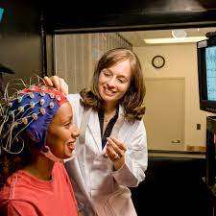
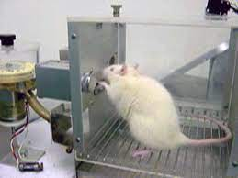
By conducting research on humans (and animals) we get closer to ‘the truth’ about human behaviour

Slide 13


From our research we can construct theories

Slide 14
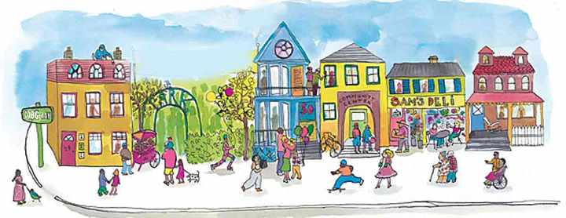
The more we understand about human behaviour (through research and theory construction) the more we can try to increase positive behaviour and reduce negative behaviour in society

Slide 15

There are many methods available to psychologists to investigate behaviour…
Experiments
Observation
Self-report
Correlation
Content analysis
Case studies
Each method has its own strengths and limitations
Some methods are more scientific than others
At least 25–30% of the overall assessment will assess skills, knowledge and understanding in relation to research methods.

Slide 16

What is the ‘approaches’ topic all about?

Slide 17

Psychologists try to understand behaviour
There is no one correct explanation
Each psychological approach explains behaviour in a different way
(We look at 5 different approaches to understanding behaviour in our course)

Slide 18

For example… how might some psychologists explain criminal behaviour?
Learning Approach
This approach assumes behaviour is learned. (We are born as a blank slate) Criminals may learn that stealing a car is rewarding so is more likely to do it in the future.
Biological approach
This approach assumes physical processes in the body e.g. genes, neural functioning and hormones are responsible for behaviour. Criminals may have an aggressive gene or excess testosterone which accounts for their behaviour.
Cognitive approach
This approach assumes the way we process information, the way we think is responsible for behaviour. The criminal may think in a certain way e.g. lack remorse or justify their acts in a certain way.

Slide 19
The five approaches try to explain behaviour in different ways
Humanistic psychology This approach assumes we all have an innate drive to be the best we can (self actualise) which is different for everyone. The humanists emphasise the importance of our unique, subjective experience and free will. We are masters of our own destiny.
Learning Approach
This approach assumes behaviour is learned (we are born as a blank slate). We learn through consequences (reward and punishment) and association (linking one thing with another)
Psychodynamic approach This approach assumes that unconscious forces drive our behaviour and our childhood affects how we are as adults.
Cognitive approach
This approach assumes the way we process information, the way we think is responsible for behaviour. It looks at processes we can’t physically see such as memory and attention.
Biological approach
This approach assumes physical processes in the body e.g. genes, neural functioning and hormones are responsible for behaviour.
There is no right or wrong explanation for behaviour
Depending on the approach taken, implications will follow e.g. a biological cause of schizophrenia suggests a biological treatment (drug therapy)

Slide 20
The more we understand about human behaviour (from each approach) the more we can try to increase positive behaviour and reduce negative behaviour in society

Slide 21

First lesson you will need…
Your completed timeline
A4 Lever Arch Folder
Lined paper
iPad (ESSENTIAL FOR EVERY LESSON!)
I will provide subject dividers
  (you may wish to put them in a plastic wallet or stick them to your own subject dividers)

Slide 22

Sharepoint

Slide 23

Sharepoint
All Powerpoints/course content is on Sharepoint
You must ‘do something’ with this material
    Flashcards
    Mindmaps
    Summaries
    Posters
    Quizlets
Once you’ve created your own resource, you can successfully revise from it
On Sharepoint you’ll also find…
Videos
Wider reading
Exam practice questions
Revision resources

Slide 24

Independent study:
STEER your learning in the right direction!
S
T
E
E
R
Space your learning across the two years (not cramming at the end)
Transform the Ppoints/Sharepoint information - e.g. mindmaps, flashcards, learning posters
Elaborate on your knowledge – do additional reading (Psychologist magazine, Sharepoint, Tutor2U website, think how knowledge links with other topics
Exam practice - specimen and past questions available on AQA website
Retrieve your knowledge – test yourself using cue cards, free-recall on blank paper, quiz each other, Psychology Apps (AQA), Quizlets

Slide 25
What will make you successful in psychology…
Two year linear course – the need to ‘make it stick’ - continual revision
Keep going over notes, creating mind maps/diagrams, posters, flashcards, practicing questions
Extra reading on Sharepoint/Psychologist magazine (front of classroom)
Home learning
Organisation - Label every piece of work with the unit name e.g. ‘research methods’
Good attendance
Engagement in lessons
It is your responsibility to keep up with work if you are absent

Slide 26
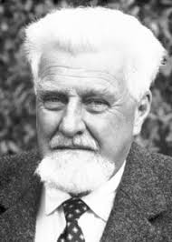
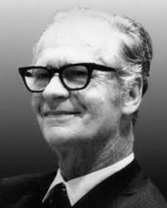
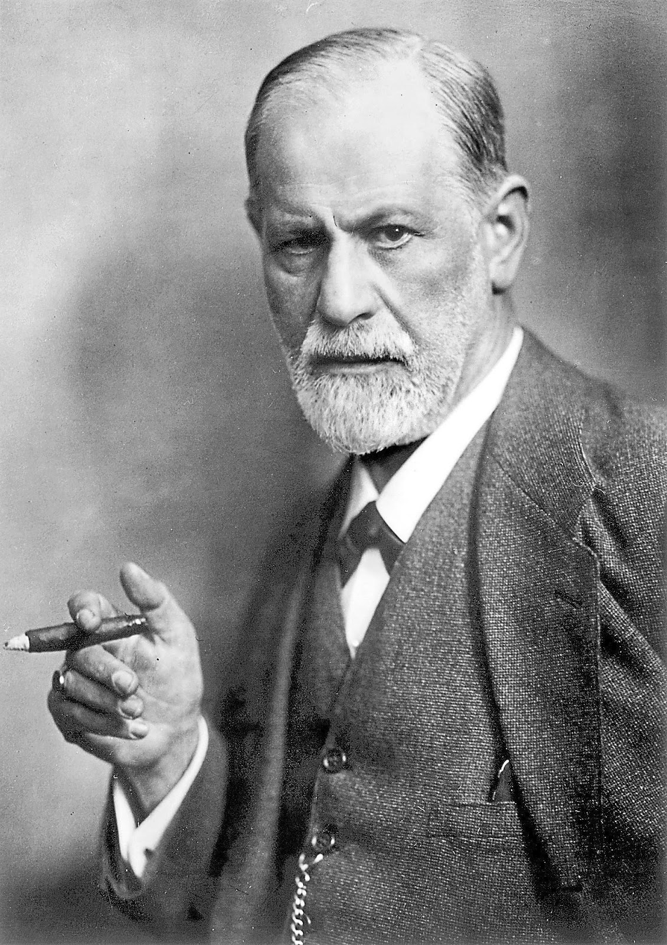
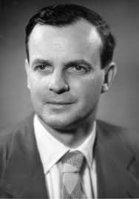
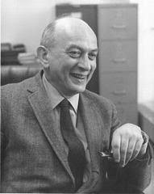
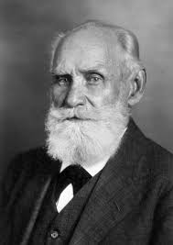
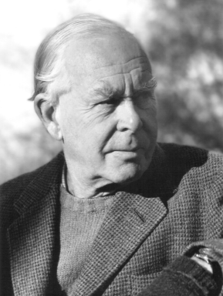
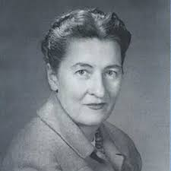
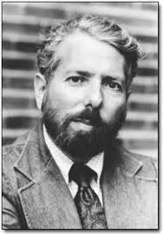
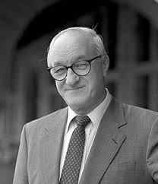
During the course you will encounter a number of psychologists who have contributed to psychology
Summer Home Learning Task…
Choose two psychologists from the list below and research them
Present your research in a creative and interesting way
Sigmund Freud
B.F Skinner
Ivan Pavlov
Stanley Milgram
Harry Harlow
Konrad Lorenz
Solomon Asch
Mary Ainsworth
John Bowlby
Albert Bandura
Questions to consider:
What area of Psychology did they contribute to?
Did they put forward a theory in psychology?
What research did they carry out (a famous study?)
Any other interesting information about them?

